Slide 1
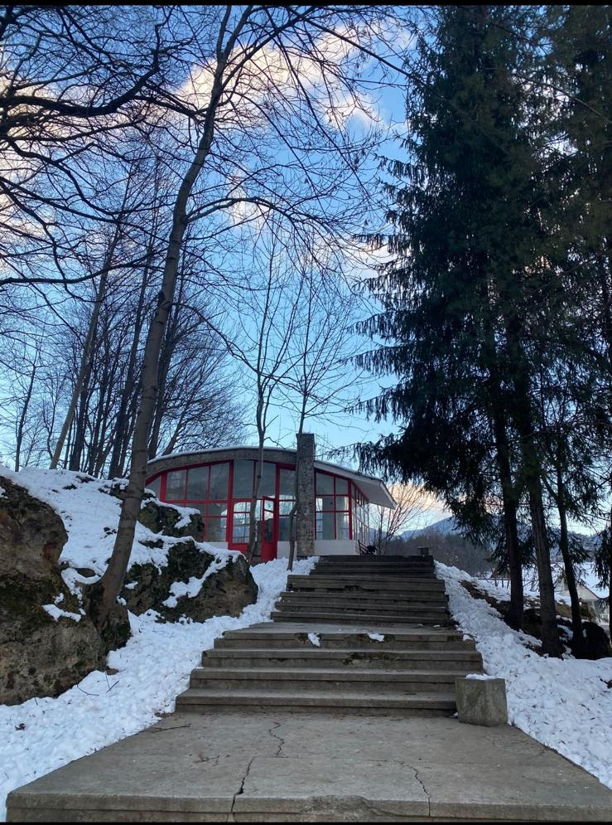
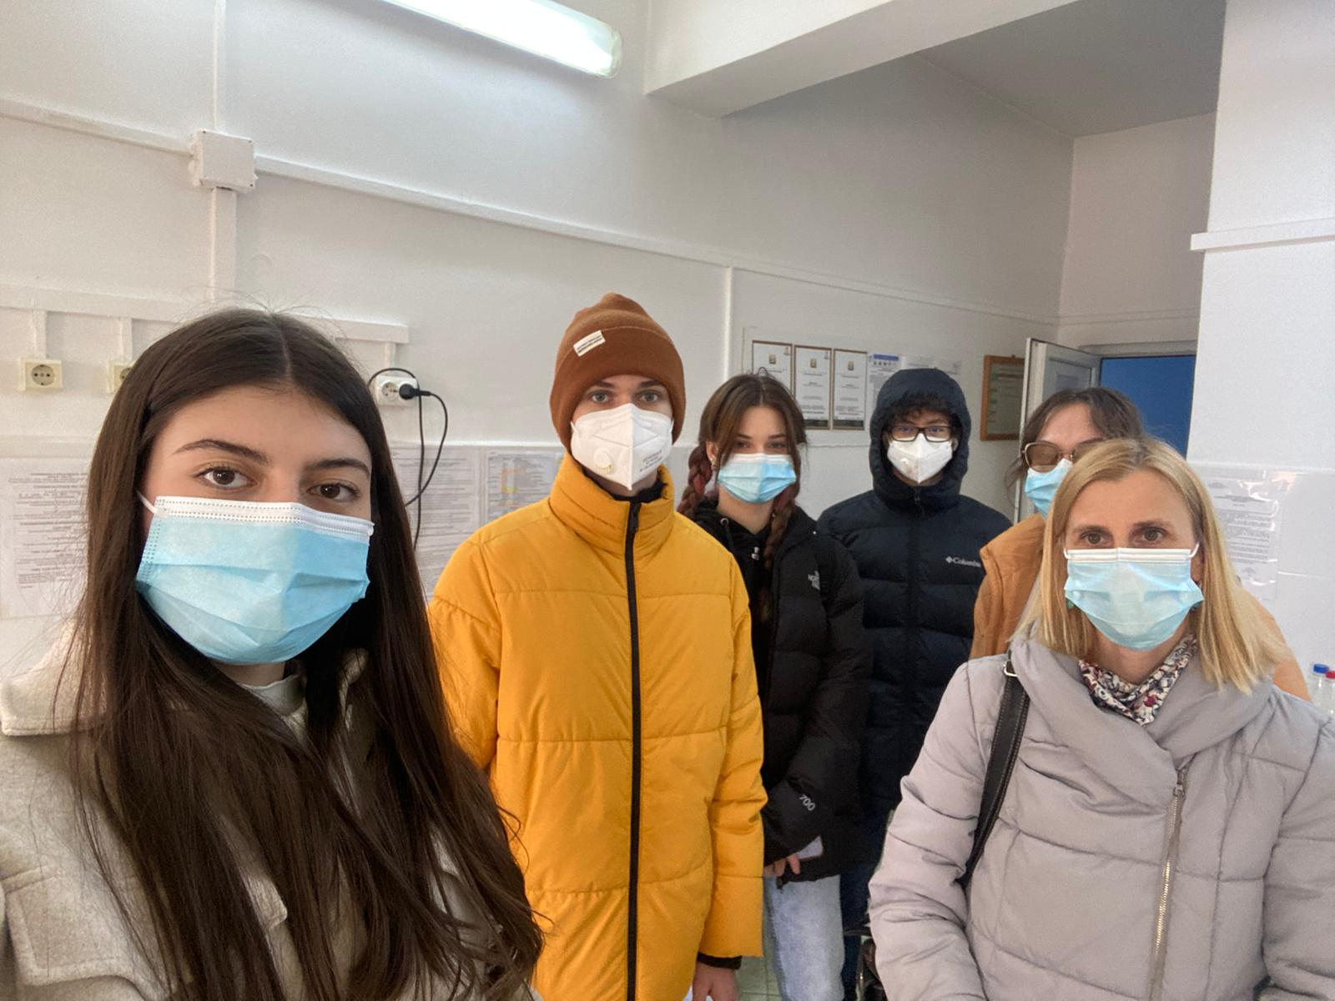
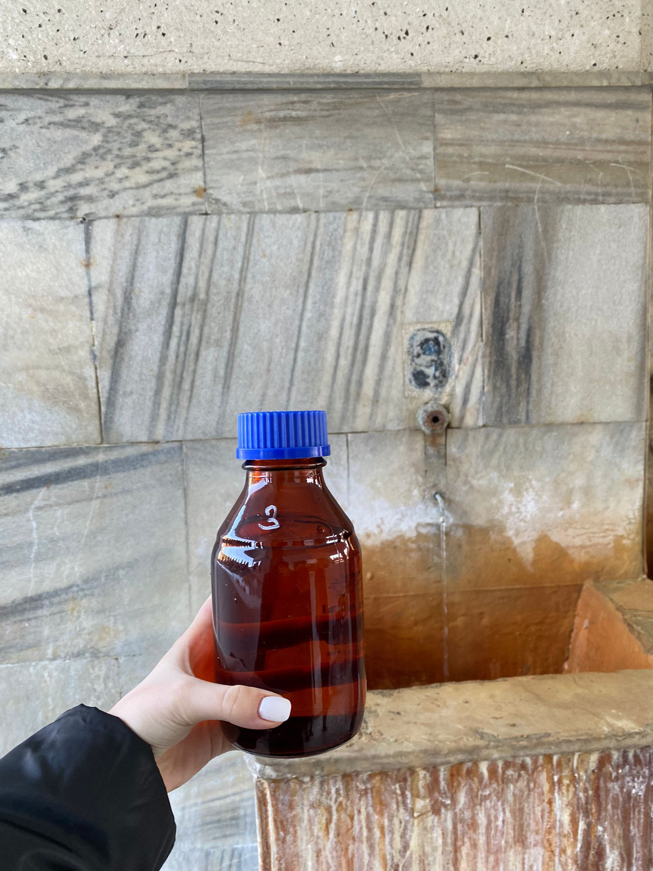
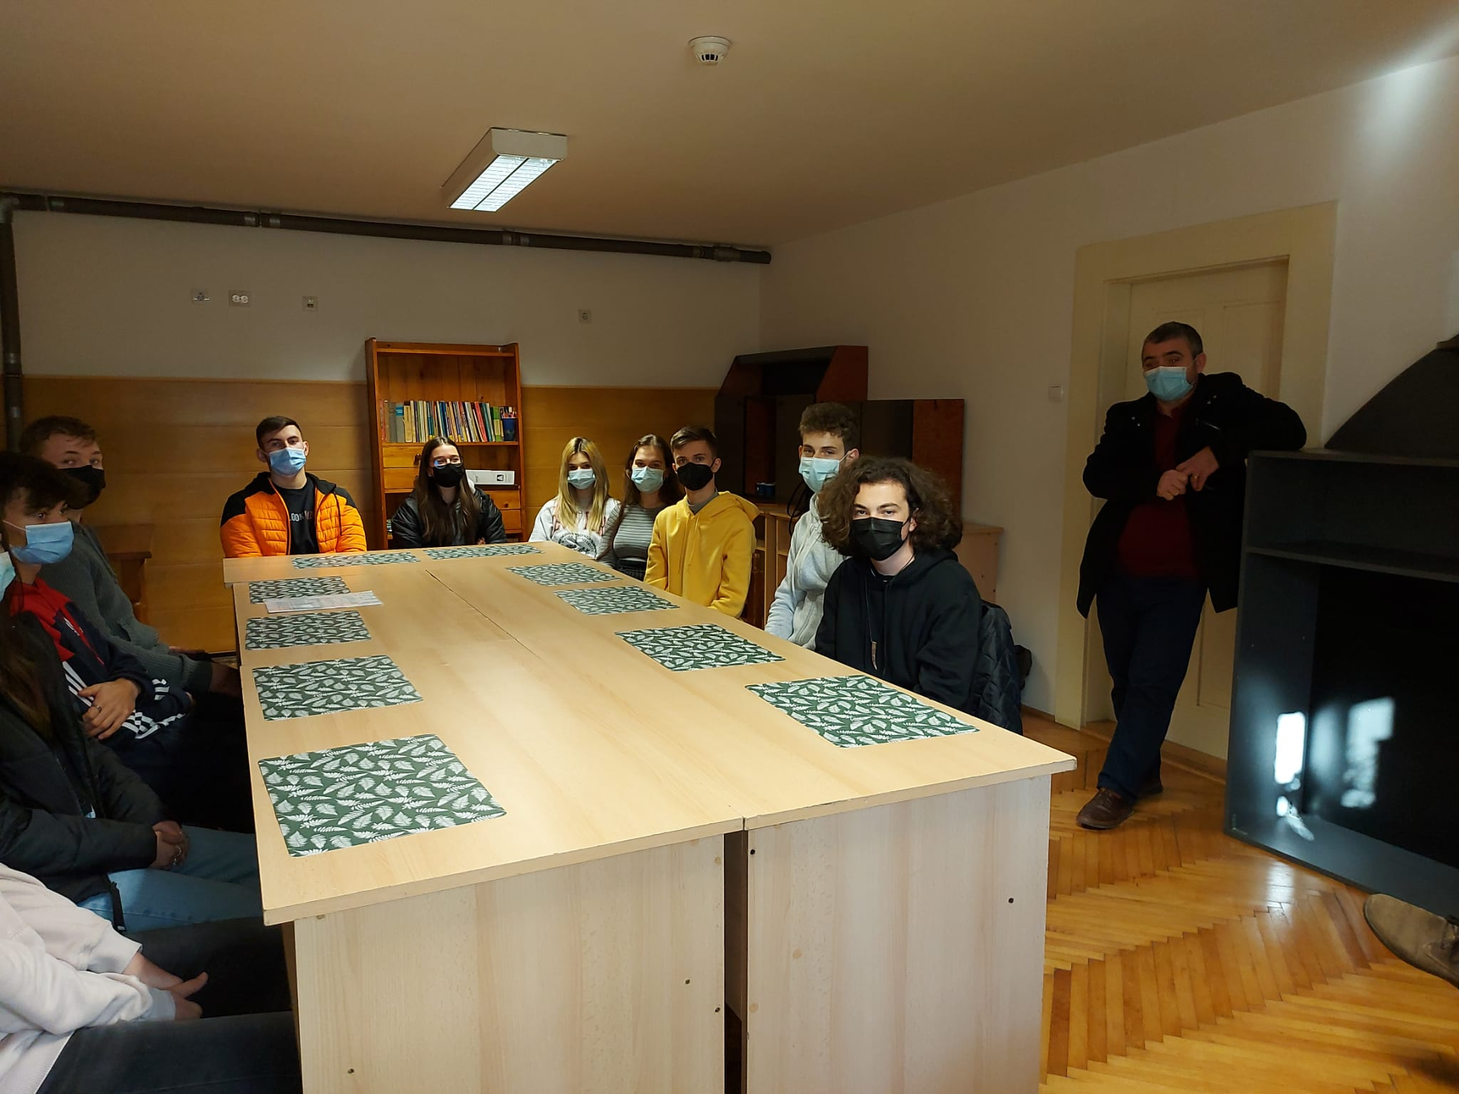
The minerals of eternal youth
National College “Andrei Muresanu” Bistrita

Slide 2
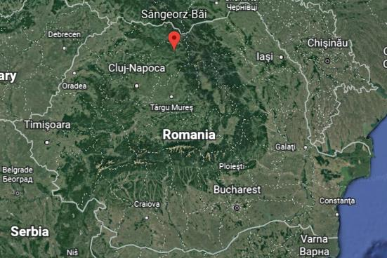
The Springs’ location

Slide 3
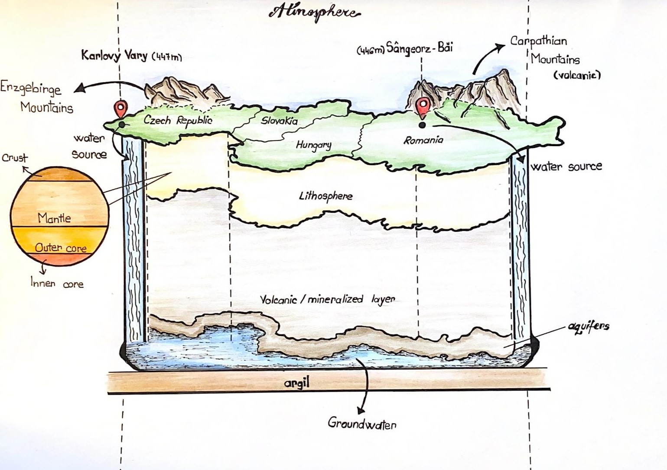
Method:Geological study

Slide 4
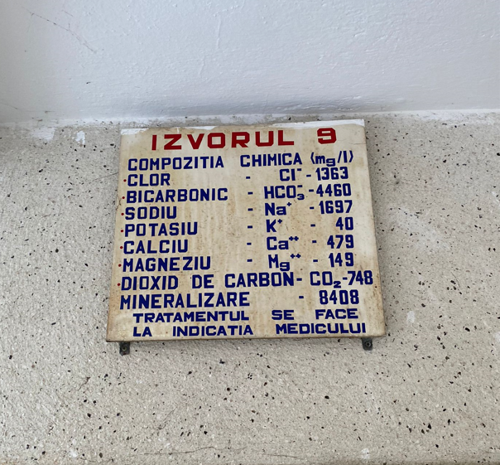
Chemical (old)study
The mineral water’s composition
Used for treatment
Prescribed by the doctors since 1970

Slide 5
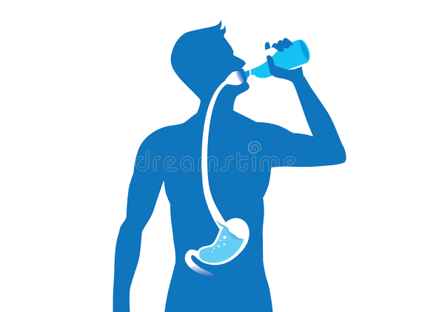
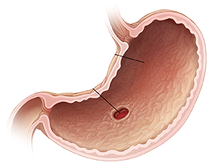
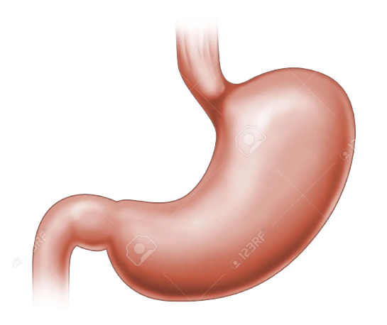
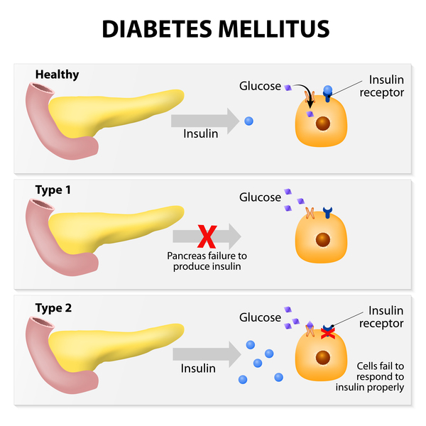
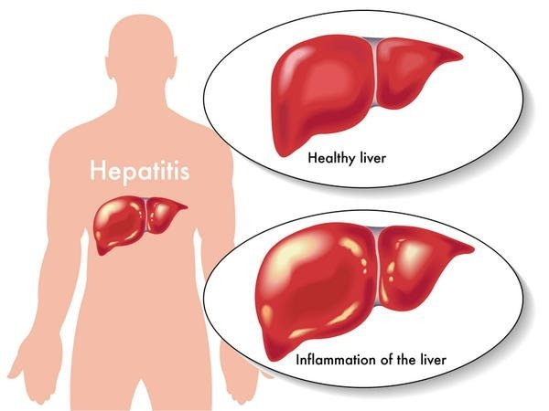
The benefits of mineral water
Treats liver, stomach diseases, helps with diabetes
Treatable diseases

Slide 6
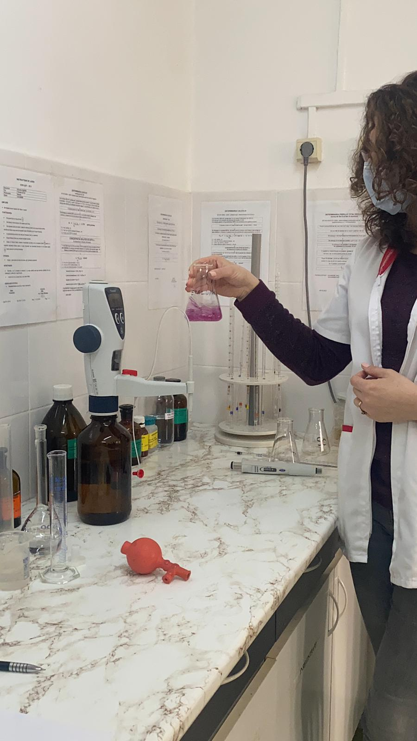
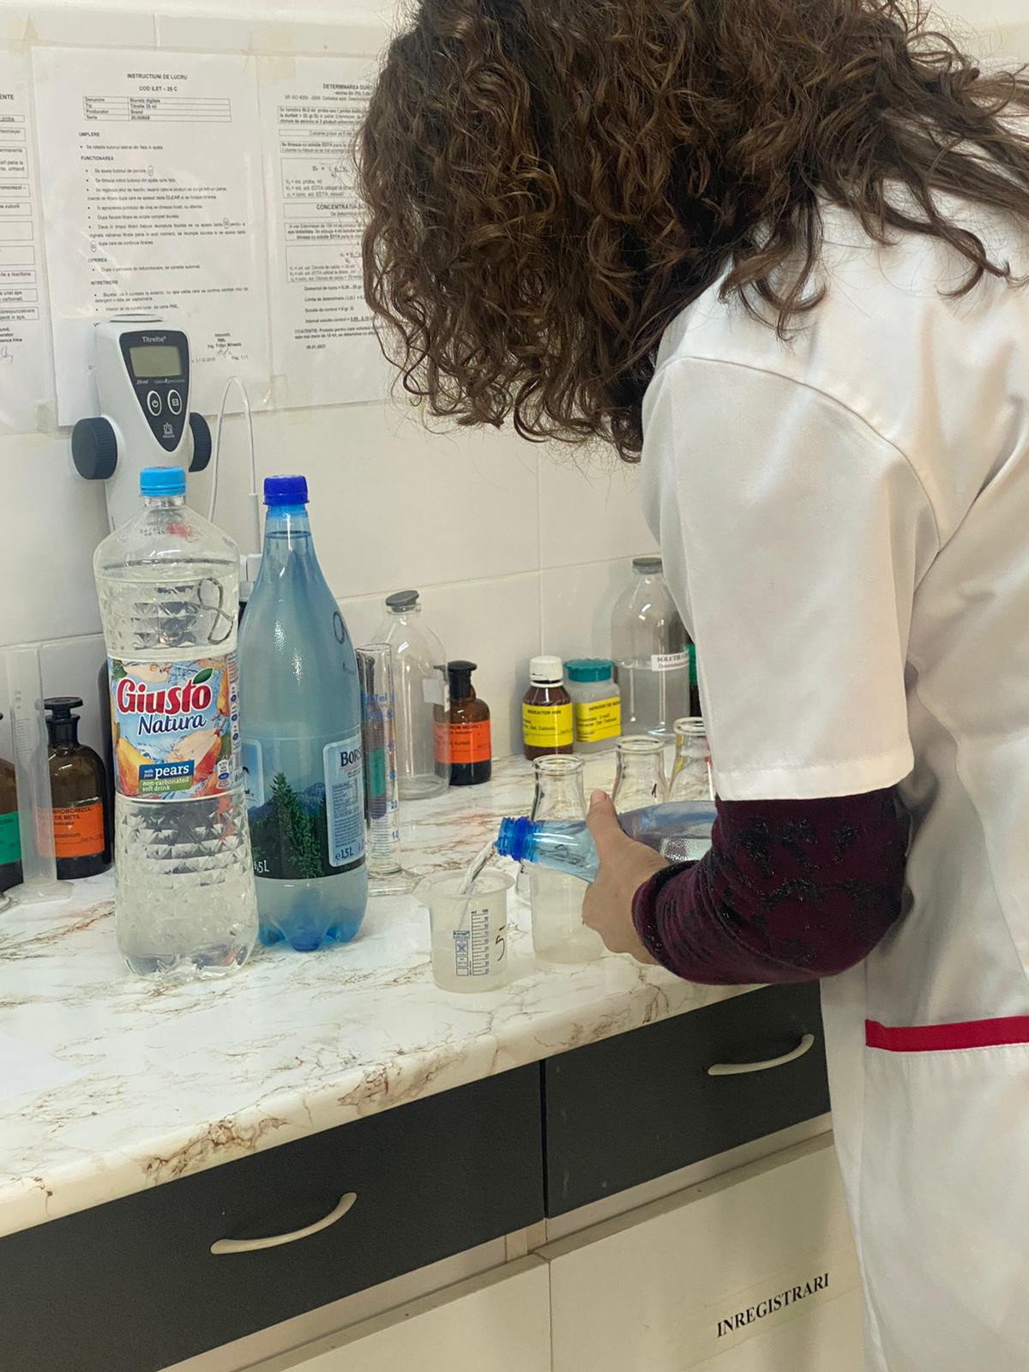
Scientific research

Slide 7
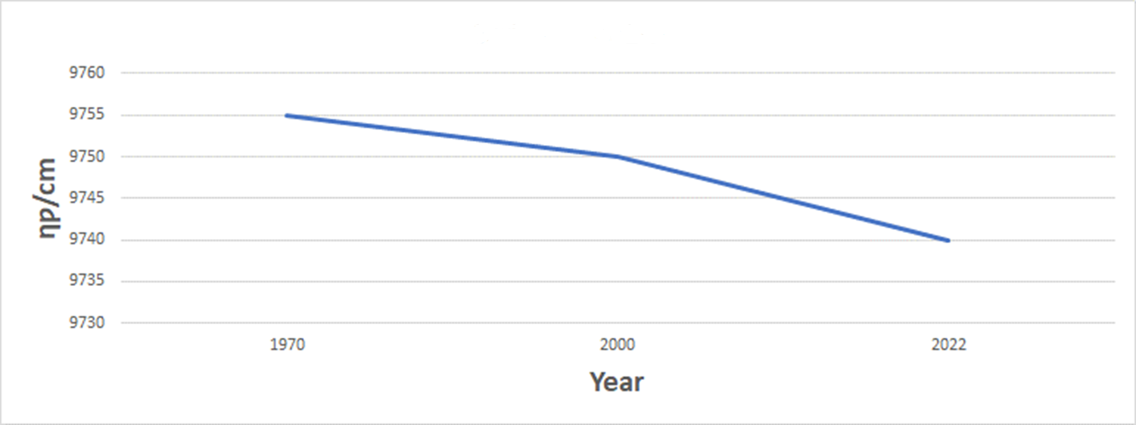
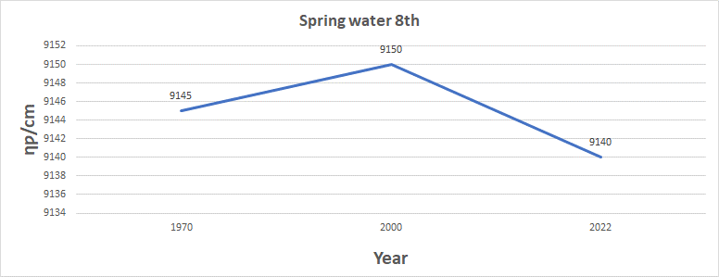
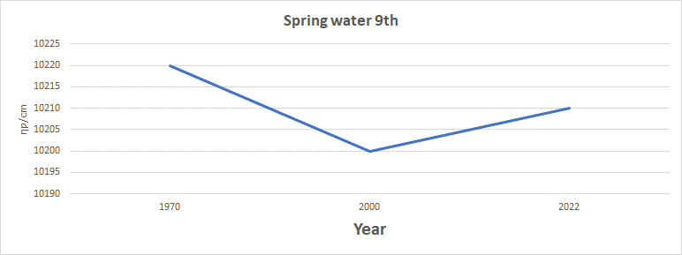
The potability of the mineral water
Spring number 2

Slide 8
Conclusions
The mineral springs are still potable
Today’s mineral springs still have the same health benefits.

Slide 9
Bibliography
Wikipedia.org
„Mic Indreptar turistic Sangeorz-Bai”-G.Mohan,V. Pintea
„Muntii Rodnei”-Ana Aurelia
„Ghidul statiunilor balneoclimatice din Romania”- L. Munteanu,C. Stoicescu
„Studiul monografic asupra unor conditii sanitare si de sanatate in orasul Sangeorz-Bai”-V. Pintea
https://medlineplus.gov/genetics/condition/type-2-diabetes/

Slide 10
ACKNOWLEDGEMENTS Rotary Club Bistrita Nosa Water treatment plant-Aquabis Bistrita Dr. engineer Florin Iliescu
Project team:
Teachers: Delia Goina, Varvari Marin, Peter Crina, Alina Dragan, Muller Krisztina
Students: Niculai Oana, Cotutiu George, Luci Emanuel Florin, Leah Paul Sorin, Miciu Caterina, Costin Hanna, Olá Arianna, Fodor Balázs, Sztankovszky András, Roman Cristian, Strugari Cristian. Stefanut Leonard, Căluș Ionel

