Slide 1
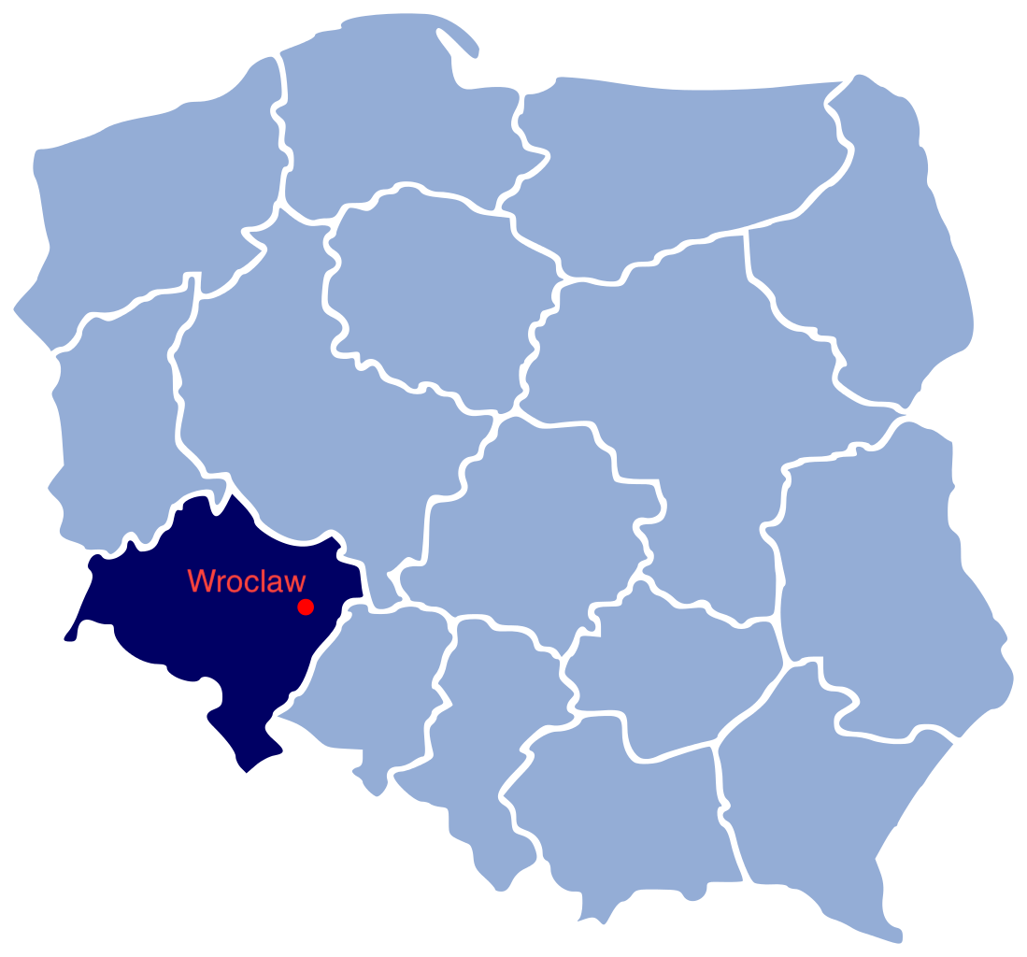
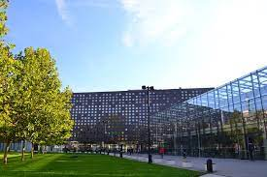
ROTARY
HANDS ACROSS WATER
Academic High School of the Wroclaw University of Technology, Wroclaw, Poland

Slide 2
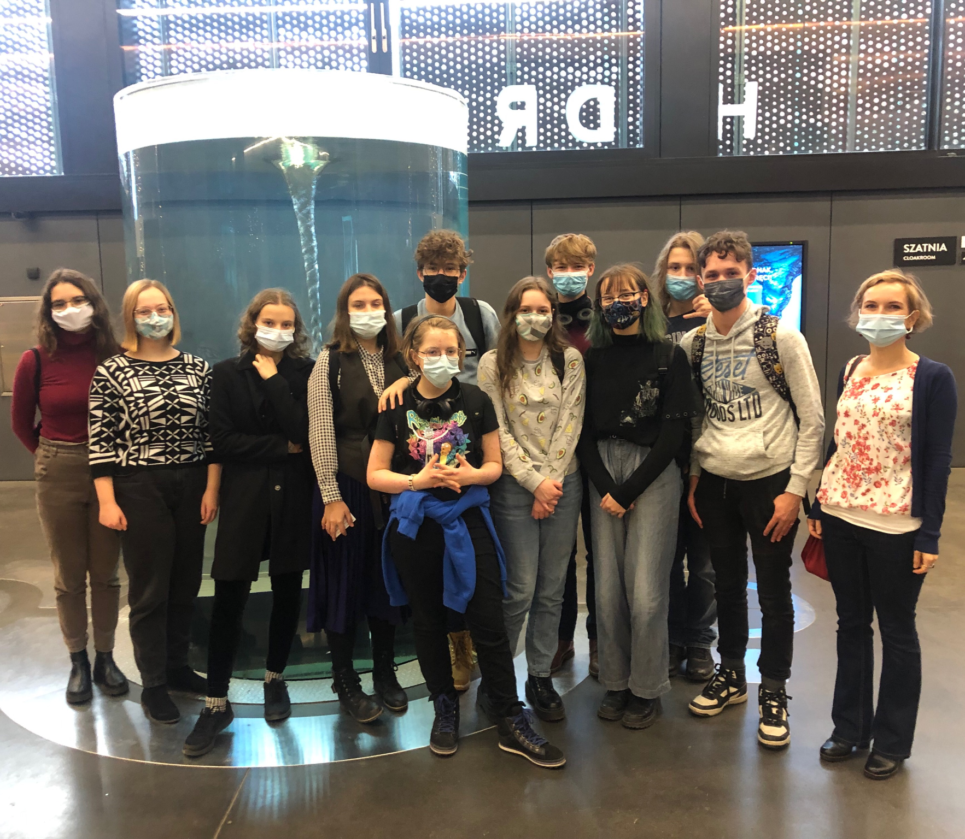
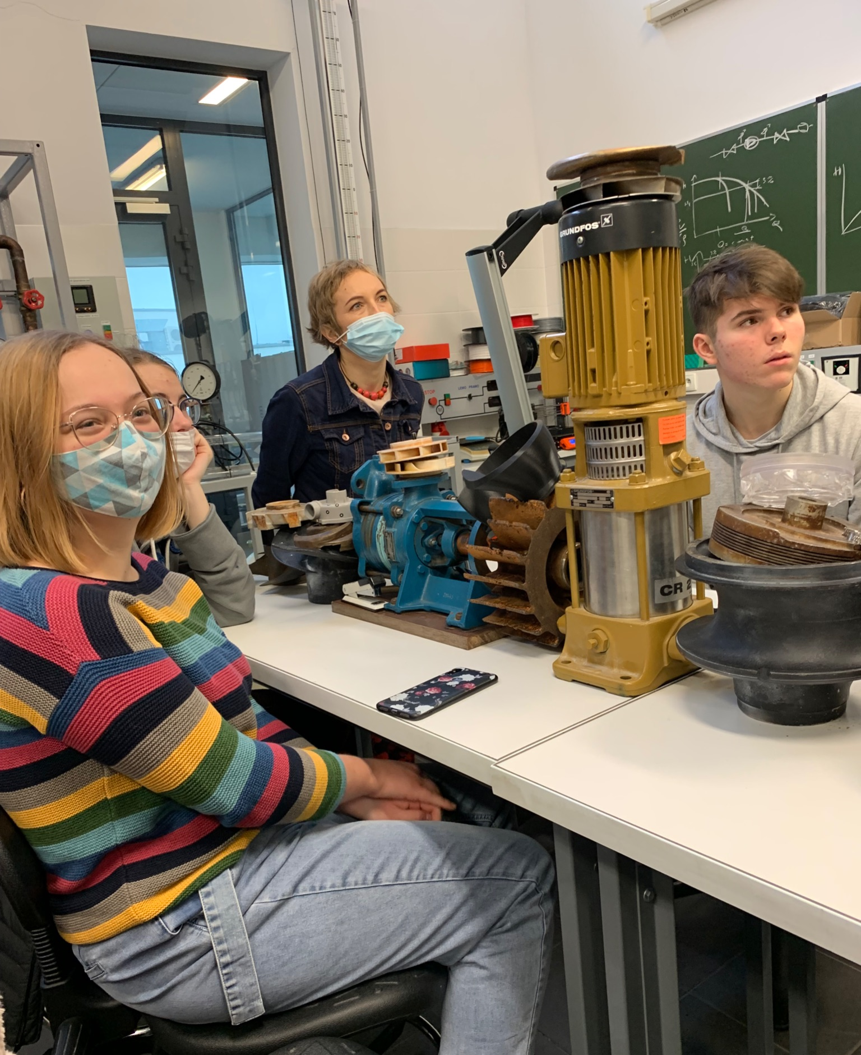
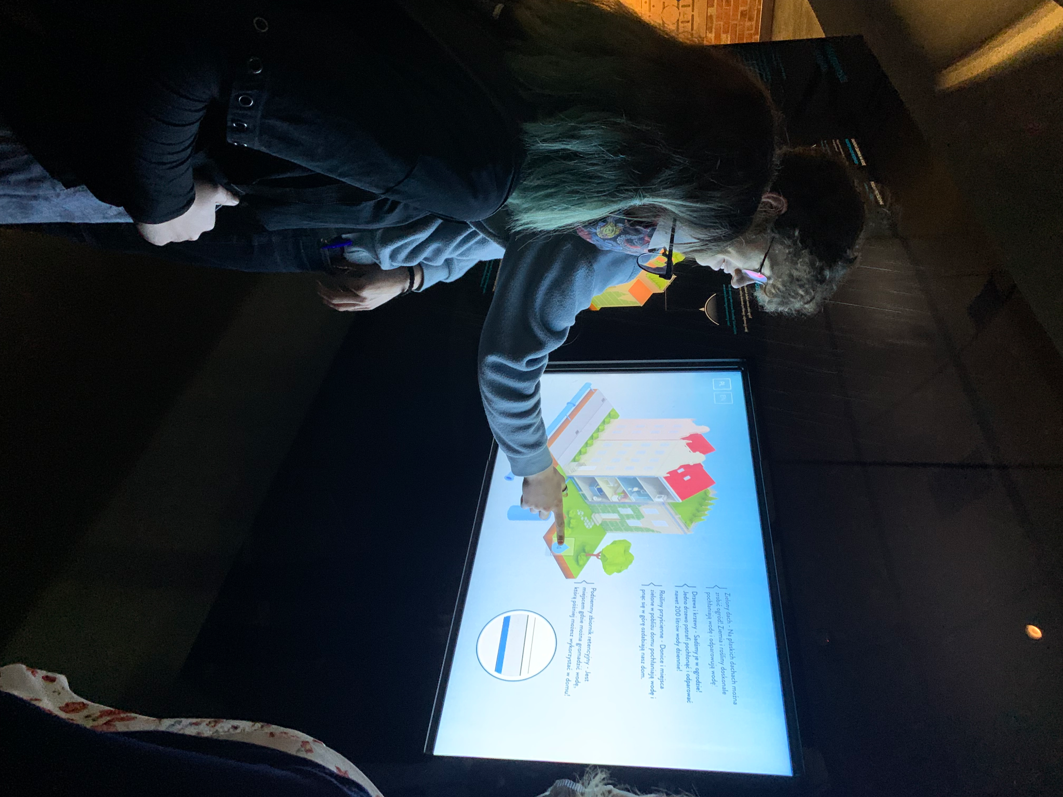
Who are we?

Slide 3
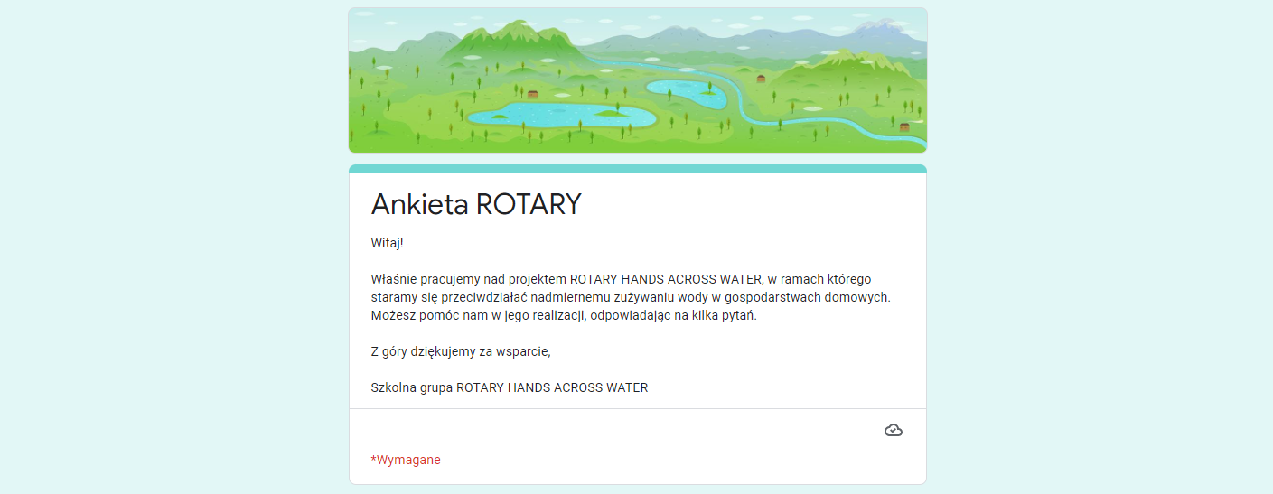
The survey
own attempts in minimising water consumption
ROTARY SURVEY
Hello!
We are currently working on the project called ROTARY HANDS ACROSS WATER, in which we try to reduce domestic water consumption. If you’d like to help us in the research, fill in the survey, please.
Thank you in advance!

Slide 4
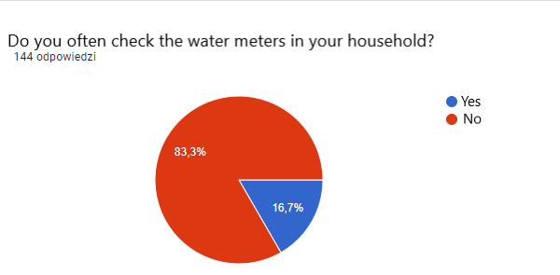
The survey summary
Do you frequently use a dishwasher?
Have you installed sink aerators?
Yes
No
I don’t know
Yes
No
Yes
No
Do you typically choose bathtub or shower?
Do you typically choose bathtub or shower?
Bathtub
Shower

Slide 5
Assumptions
Information
Awareness
Disseminating information
Savings
Ecology

Slide 6
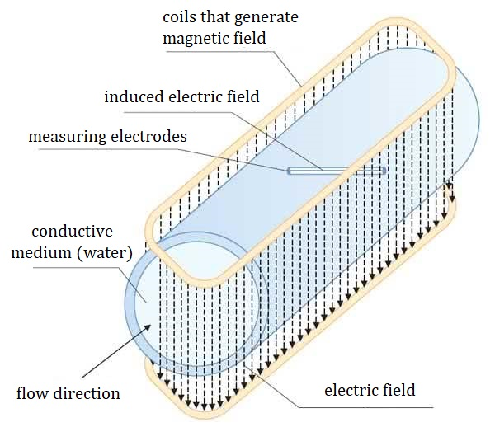
Designing our own electromagnetic flow meter
The operation of this type of flow meters is based on the Faraday's electromagnetic induction
The biggest advantages of our solution is non-invasive measurement and low energy consumption.
This solution is practically maintenance-free due to the lack of moving parts and, in addition, it has a fairly small size, which makes it easy to use.

Slide 7
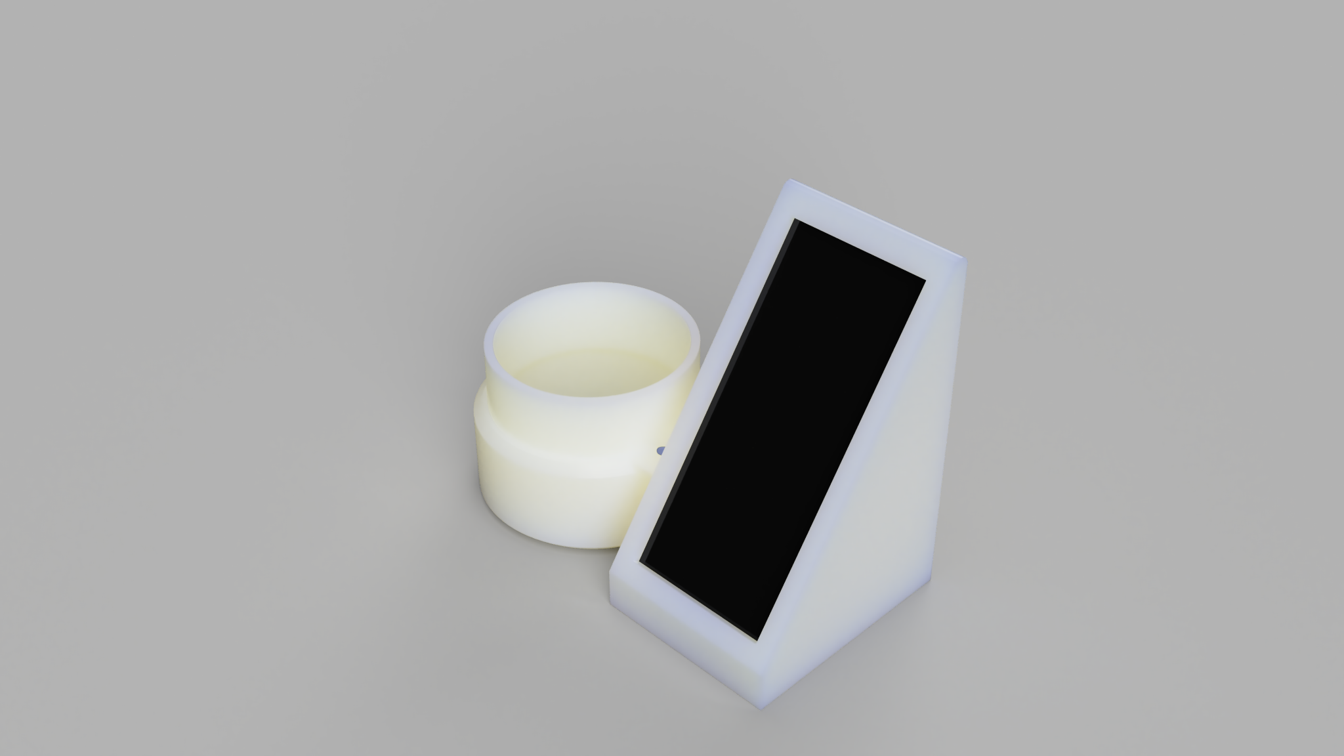
System
Central unit and EMF flow meter - On the main "entrance" pipe/pipes to the house or apartment we place an electromagnetic water flow meter, which, using the previously described technique, calculates for us how much water we have used. This information is sent via wifi by the main module to the overlays, where it is then displayed to the user with information about the current consumption.
Faucet attachment - Clearly informs the user of the amount of water used. By using a gradient of water illumination and display, the overlay gives feedback to the user.

Slide 8
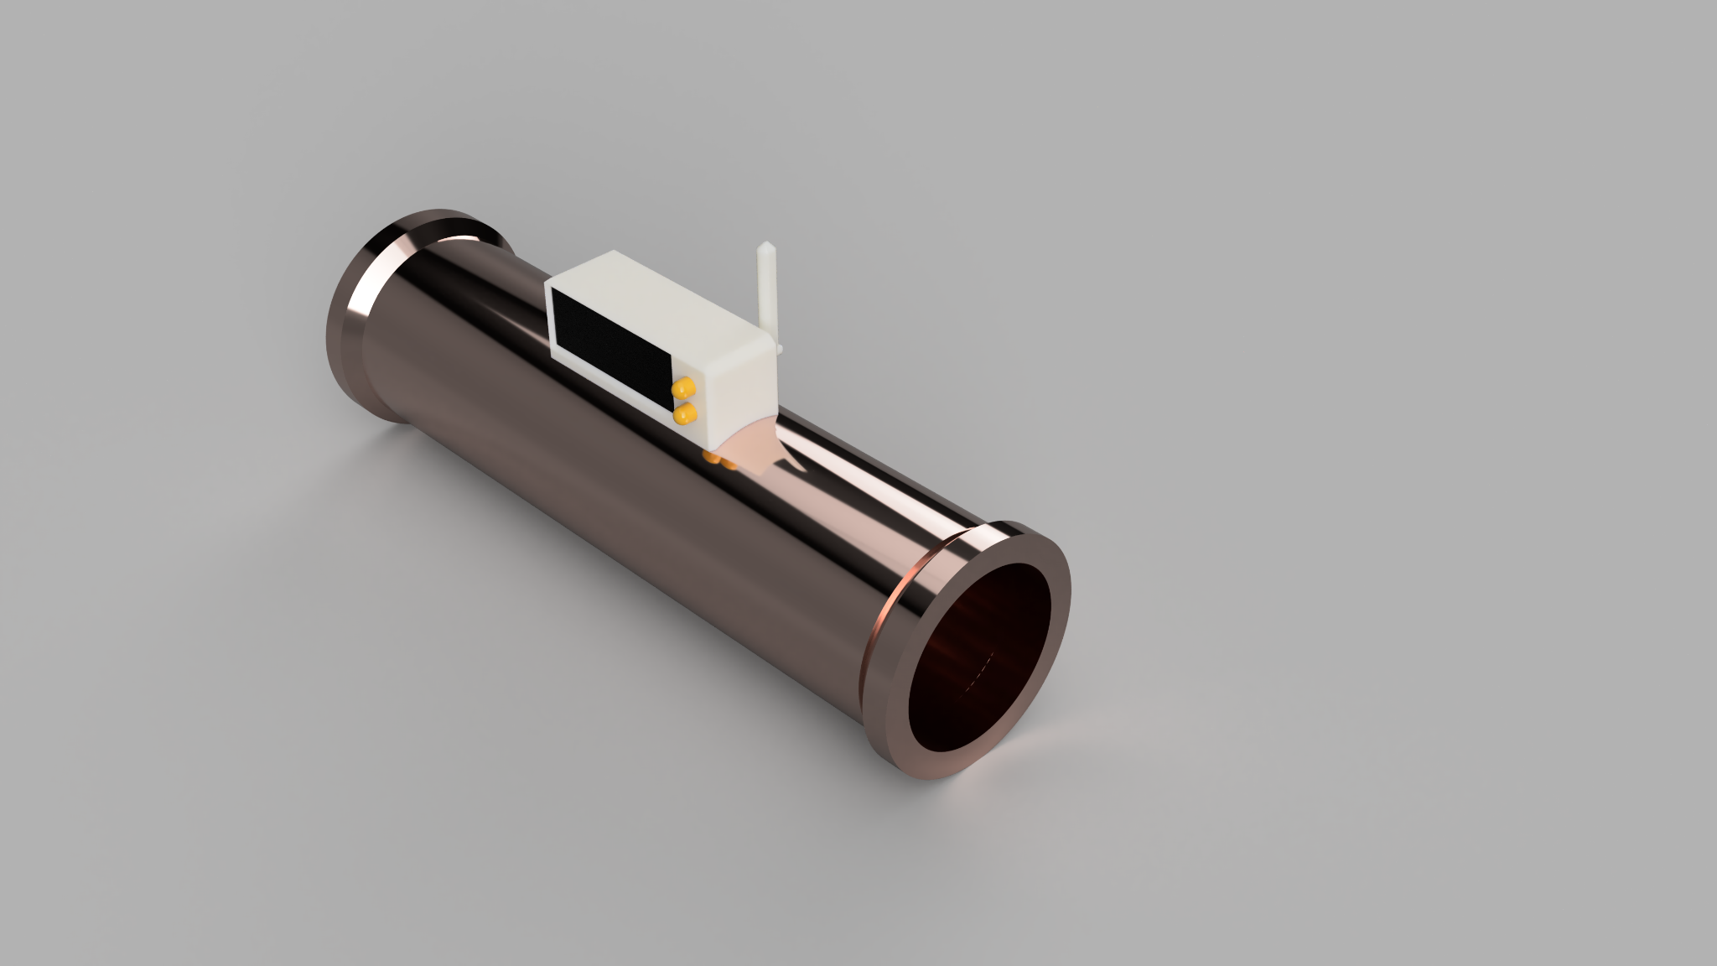
Meter Prototype
-wifi module - server
-arduino - sensor
-housing
-cables/ solders
-2-4xAA batteries
-antenna

Slide 9
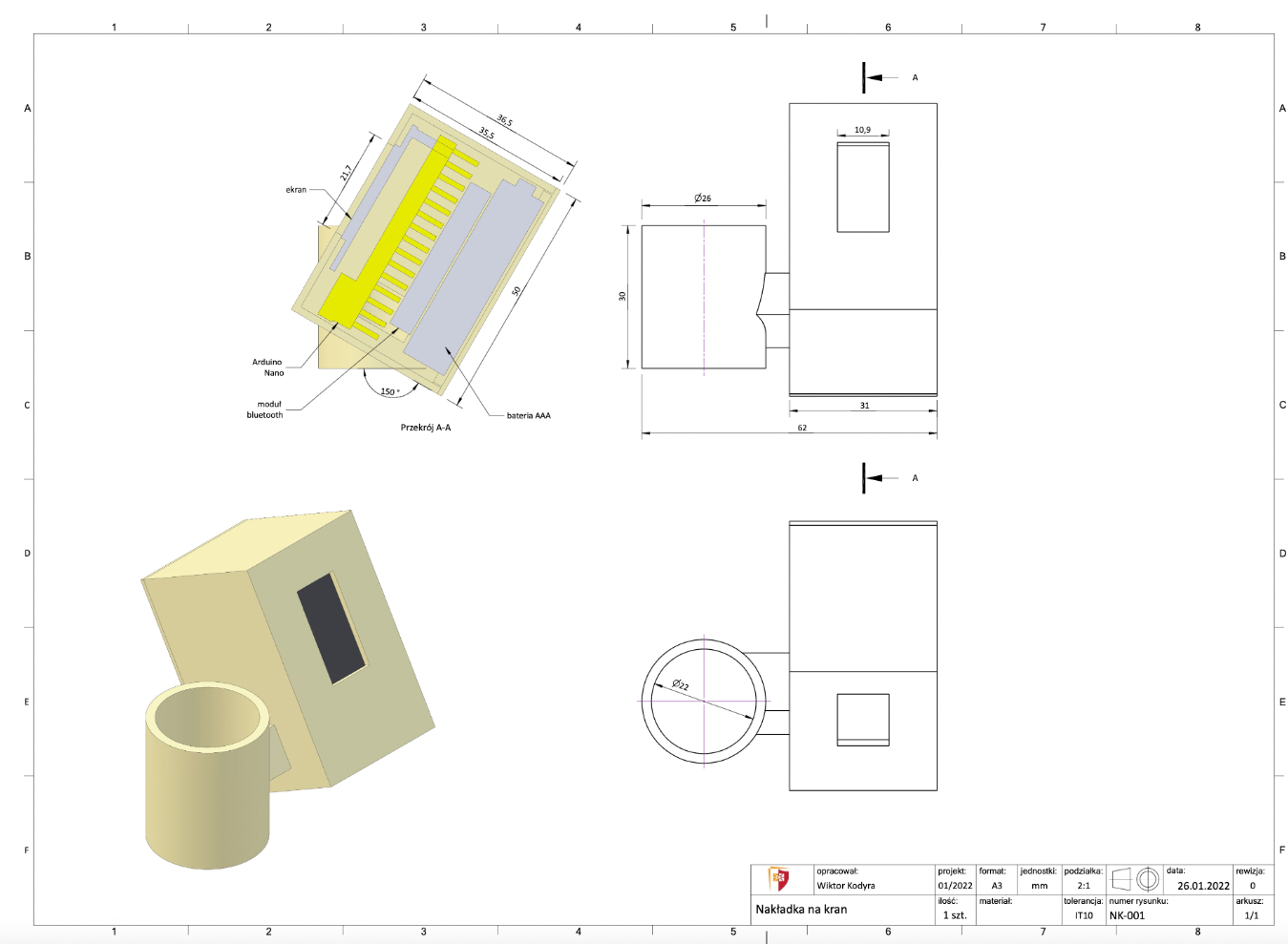
1st Prototype
-wifi module - client
-arduino - taps
-RGB diode
-housing
-cables/solders
-OLED display
-LiPo
-booster board
-1xAAA battery

Slide 10
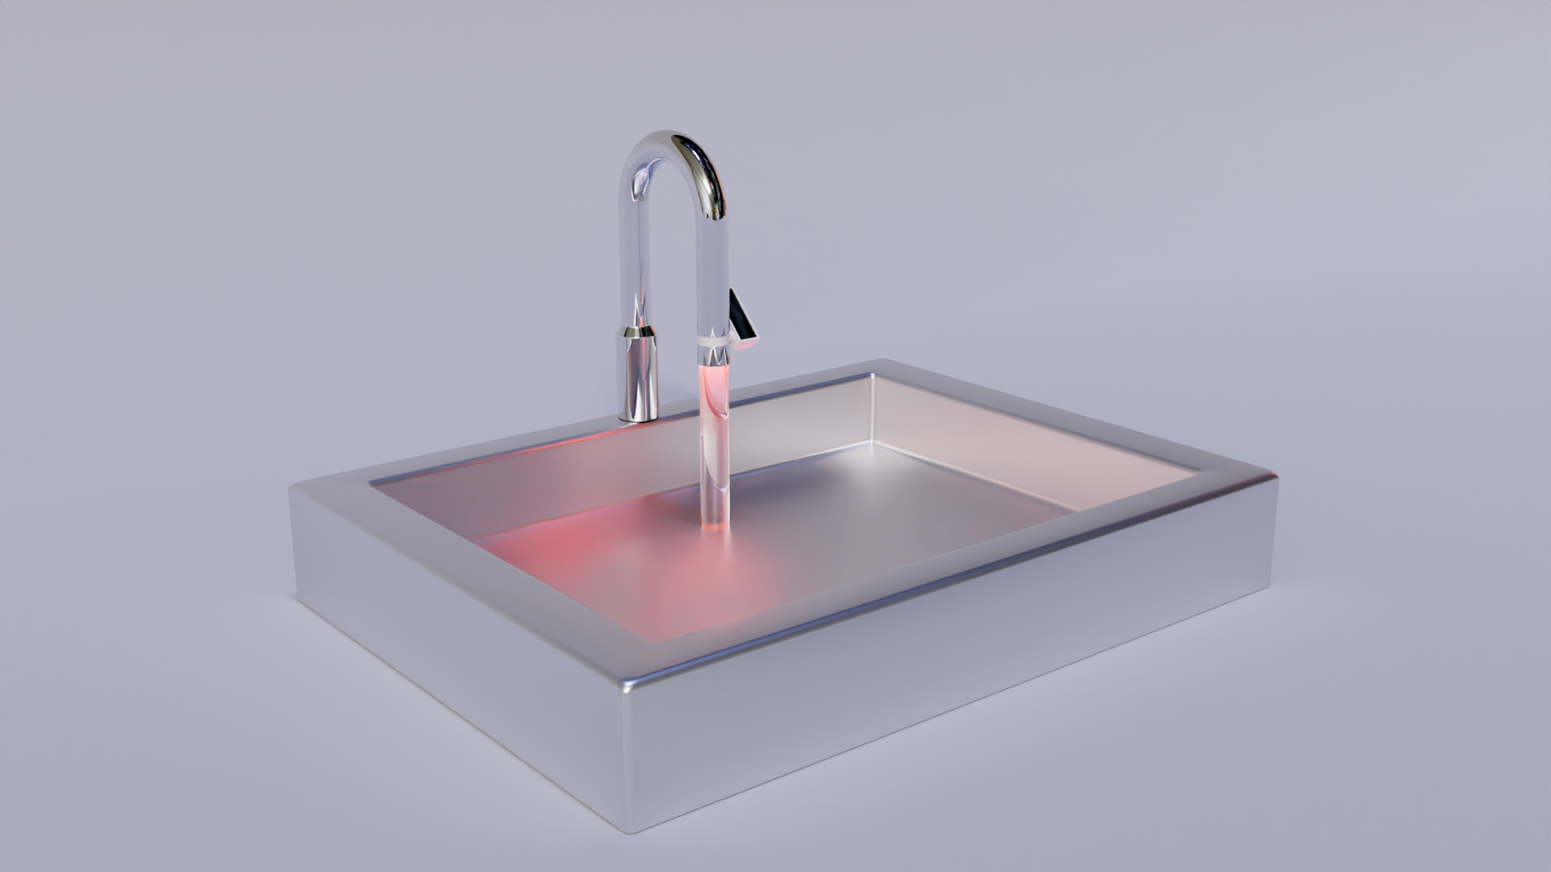
The model we’re aiming for

Slide 11
Thank you!

