Slide 1
Water quality in Arad - today and tomorrow

Slide 2
Table of contents
Drinking Water
Wastewater
The Mureș River
Final conclusions

Slide 3
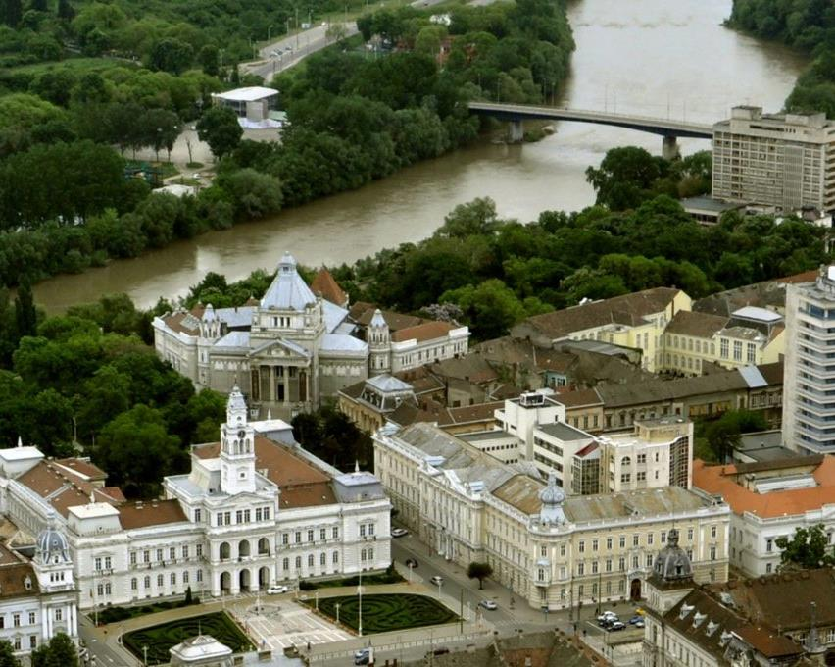
Today

Slide 4
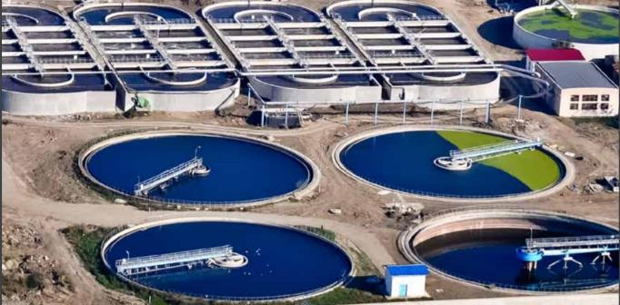
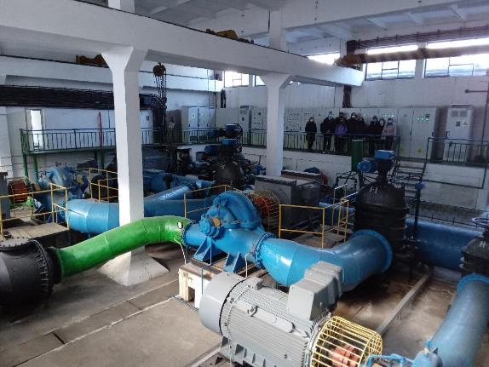
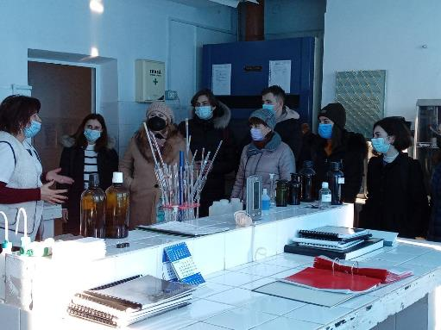

Slide 5
01
Drinking Water

Slide 6
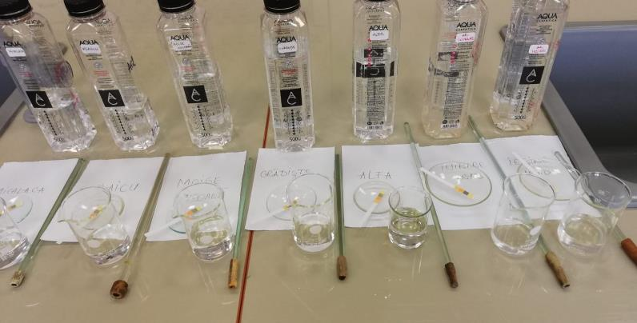
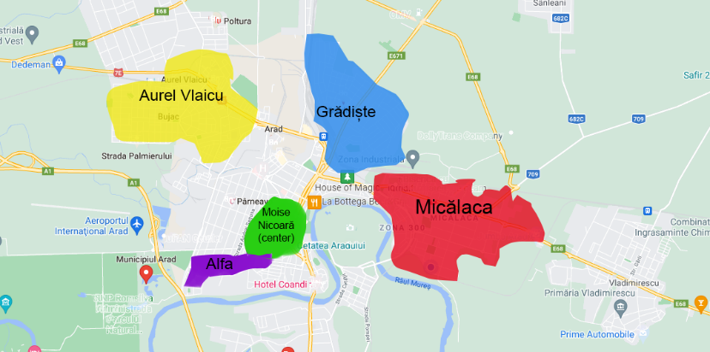
Chemical
analysis

Slide 7
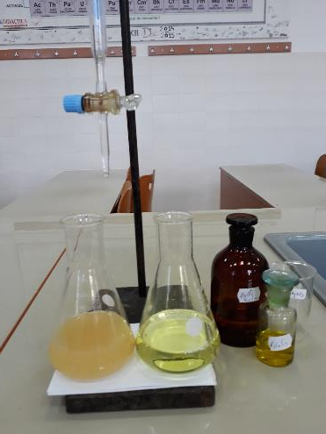
Determination of Chloride Ions
Quality indicator | Maximum accepted values | Water Plant | Moise Nicoară laboratory
 |  |  | NEIGHBOURHOOD
 |  |  | Moise Nicoară | Micălaca | Aurel Vlaicu | Grădiște | Alfa
Cl⁻ (mg/l) | 250 | 24,4 | 31,2 | 30,1 | 29,8 | 31,9 | 28,18

Slide 8
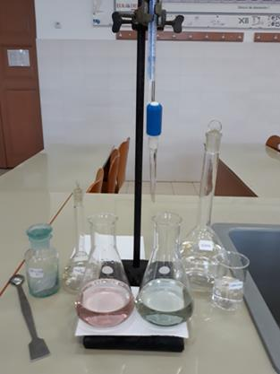
Determination of Total Water Hardness
Quality indicator | Minimumaccepted values | Water Plant | Moise Nicoară laboratory
 |  |  | NEIGHBOURHOOD
 |  |  | Moise Nicoară | Micălaca | Aurel Vlaicu | Grădiște | Alfa
Total Water Hardness (ºDH) | 5 | 15,84 | 14 | 13.5 | 14.3 | 13,7 | 14,8

Slide 9
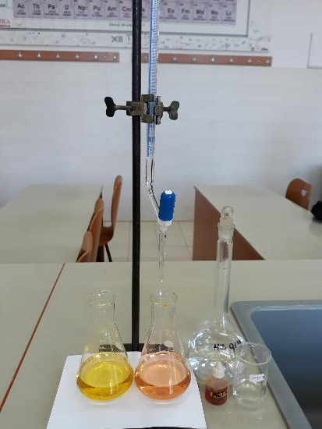
Determination of Bicarbonate Ions Concentration
Quality indicator | Moise Nicoară laboratory
 | NEIGHBOURHOOD
 | Moise Nicoară | Micălaca | Aurel Vlaicu | Grădiște | Alfa
HCO₃⁻ (mg/l) | 238 | 238 | 219,4 | 213,6 | 244

Slide 10
Determination of Heavy Ions Concentration
Quality indicator Minear Laboratoare | Maximum accepted values | Water Plant | NEIGHBOURHOOD
 |  |  | Moise Nicoară | Micălaca | Aurel Vlaicu | Grădiște | Alfa
Total iron (μg/l) | 200 | 3 | 200 | < 100 | < 100 | < 100 | < 100
Total manganese (μg/l) | 50 | 2 | < 100 | < 100 | < 100 | < 100 | < 100
Zinc ions (μg/l) | 5000 | - | 256 | 50 | 50 | 52 | 73

Slide 11
02
Wastewater

Slide 12
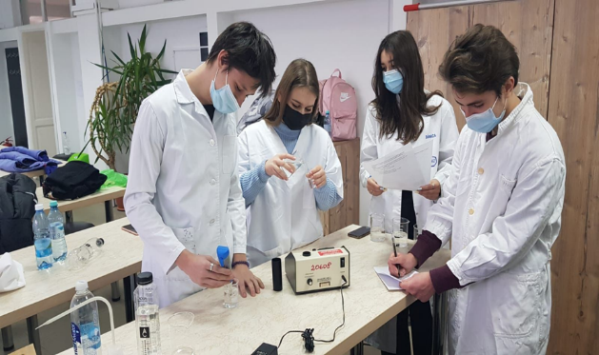
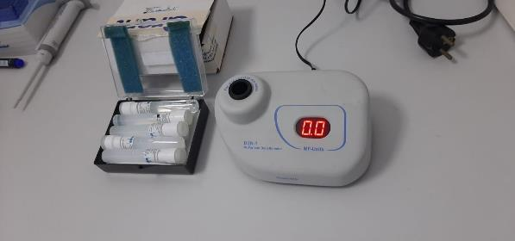
Wastewater microbiological analysis.

Slide 13
 | Turbidity | BaSO₄ concentration | Bacterial concentration | Theoretical optical density
Entrance wastewater | 1,5 | 7,20 x 10⁻⁵ mol/l | 4,5 x 10⁵ cellule/mol | 0,375
Exit wastewater (treated water) | 0,7 | 3,36 x 10⁻⁵ mol/l | 2,1 x 10⁵ cellule/mol | 0,175

Slide 14
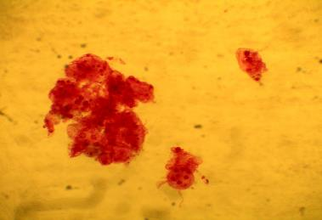
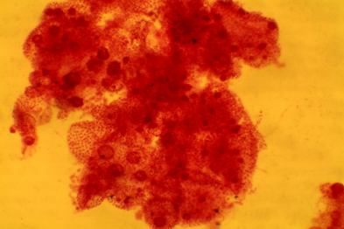
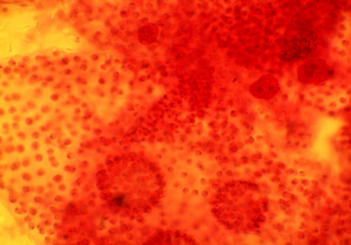
Microscopic aspects of plant organisms
1. VOLVOX
x40
x100
x400
Polyphyletic genus of chlorophyte green algae in the family Volvocaceae.

Slide 15
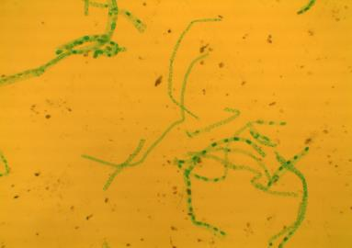
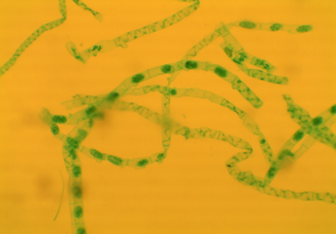
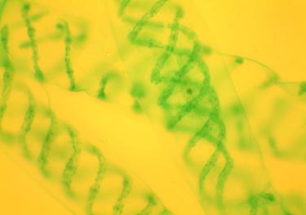
2. SPIROGYRA
x40
x100
x400
Filamentous charophyte green alga, named for its helical or spiral arrangement of the chloroplasts.

Slide 16
03
The Mureș River

Slide 17
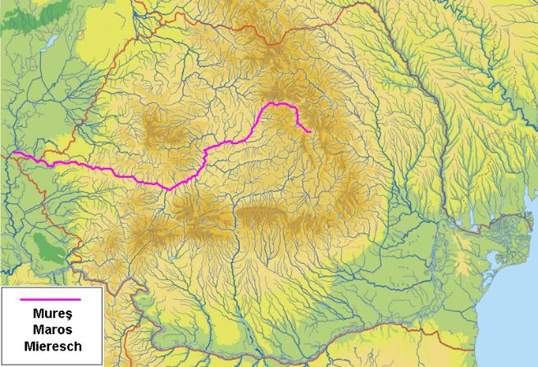
It’s the most important river crossing Arad county's territory (191,6 km).
It forms the border between Romania and Hungary over a distance of 22 km.
The Mureș Floodplain Natural Park an important protected area for its natural habitats.

Slide 18
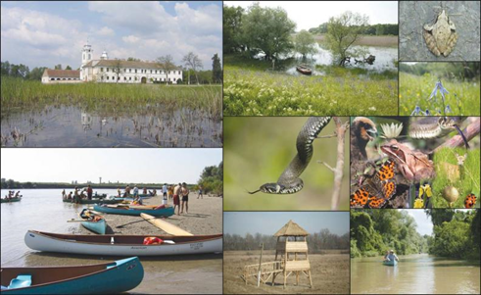
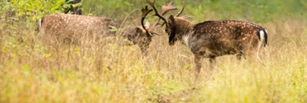
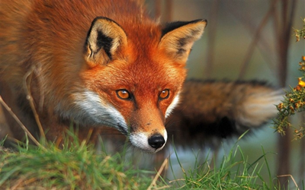
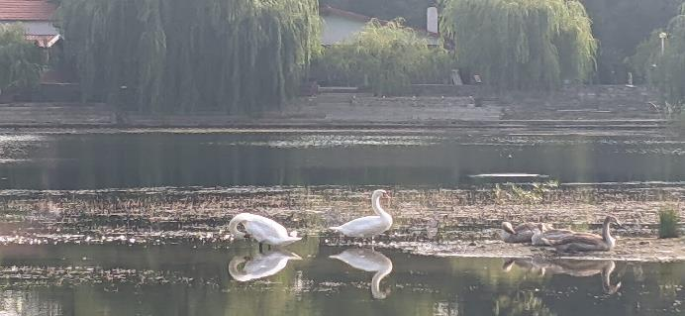

Slide 19
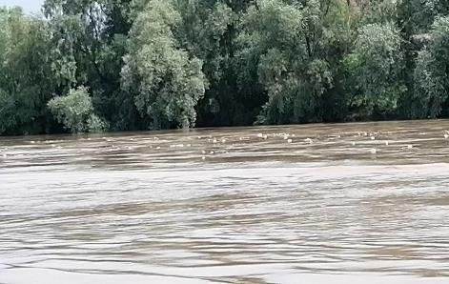
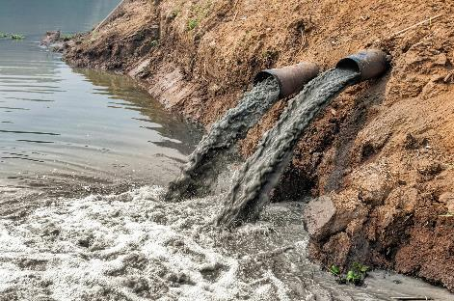
Pollution of the Mureș River
Sources of pollution:
Solid waste
Industrial activities
The exploitation of wood
Discharges of contaminated water
The exploitation of sand and gravel

Slide 20
Chemical analysis
Quality indicator | Water sample |  |  |  | Max. values accepted
 | Mureș River entrance |  | Mureș River exit
 | Minear laboratoare | Moise Nicoară laboratory | Minear laboratoare | Moise Nicoară laboratory
Na⁺ (mg/l) | 36,7 | - | 37,2 | - | 120
Cl⁻ (mg/l) | 68 | 71,6 | 74 | 75,5 | 300
Ammonium NH₄⁺ (mg/l) | 0,22 | - | 0,21 | - | 0,5
Nitrates NO₃⁻(mg/l) | 7,74 | - | 7,5 | - | 40
Nitrites NO₂ ⁻(mg/l) | 0,15 | - | 0,14 | - | 0,08
Phosphates PO₄³⁻ (mg/l) | 0,87 | - | 1,2 | - | 0,6

Slide 21
Interpretation
Mureș water pollution with detergents and food.
1.2
0.87
74
68
36.7
37.2
$${Na}^{+}$$
$${Cl}^{−}$$
$${{PO}_{4}^{3}}^{−}$$

Slide 22
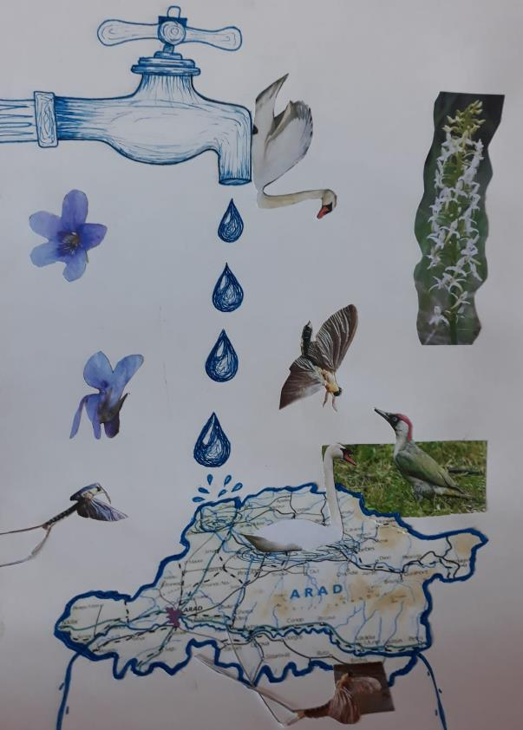
Tomorrow

Slide 23
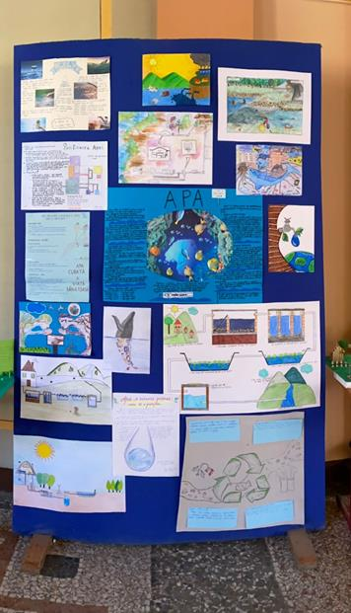
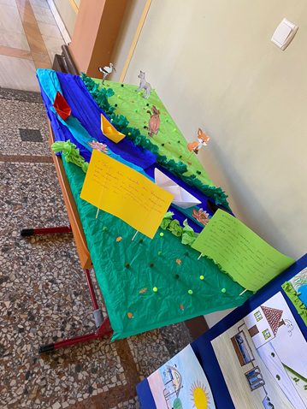
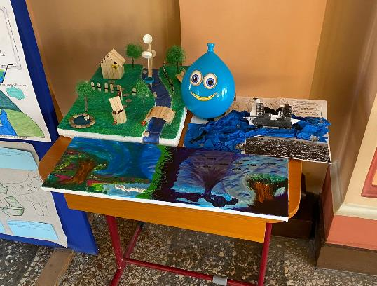
Messages from ”Moise Nicoară” National College for the future

Slide 24
Special thanks to
Rotary Club Arad
Arad Water Company
Aurel Vlaicu University
Minear Laboratoare Arad

Slide 25
Bibliography
Internet explorer
https://www.sciencedirect.com/topics/earth-and-planetary-sciences
https://luncamuresului.ro
https://www.caarad.ro
https://www.qdidactic.com
https://www.meteo.md

