Slide 1
Droplets

Slide 2
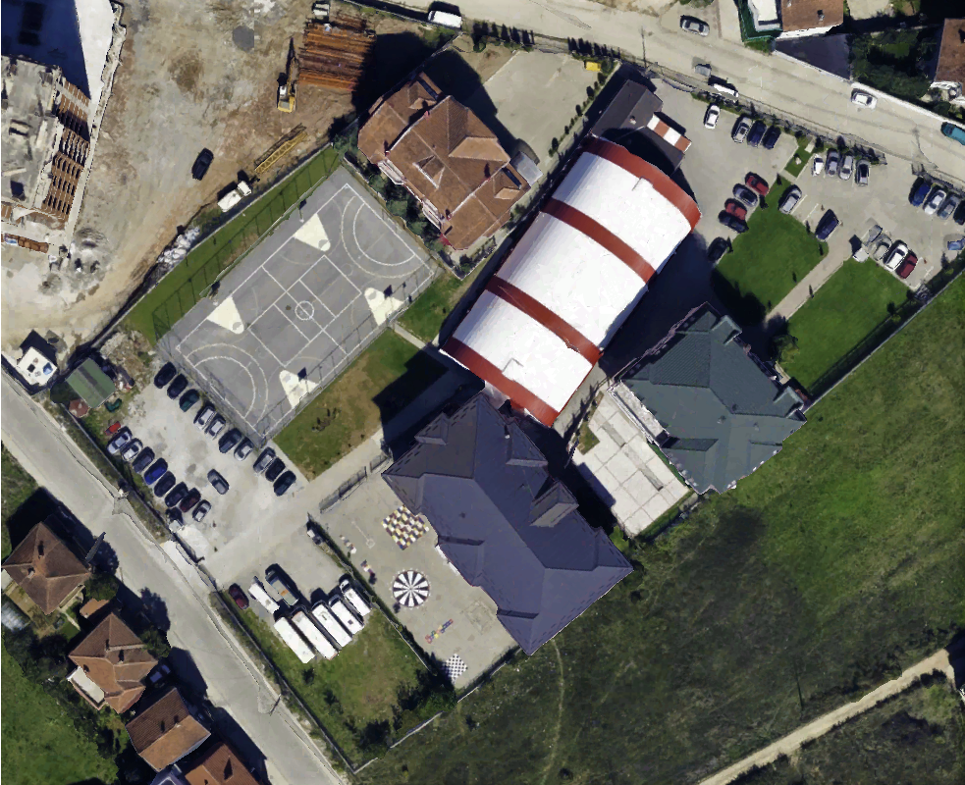
Rainwater Harvesting
2016
2017
2018
2019
890.0
703.5
667.5
607.4
Physical measurements of greenery and school roof:
2070 m²
360 000 l (summer)
1.46 milion l (yearly)

Slide 3
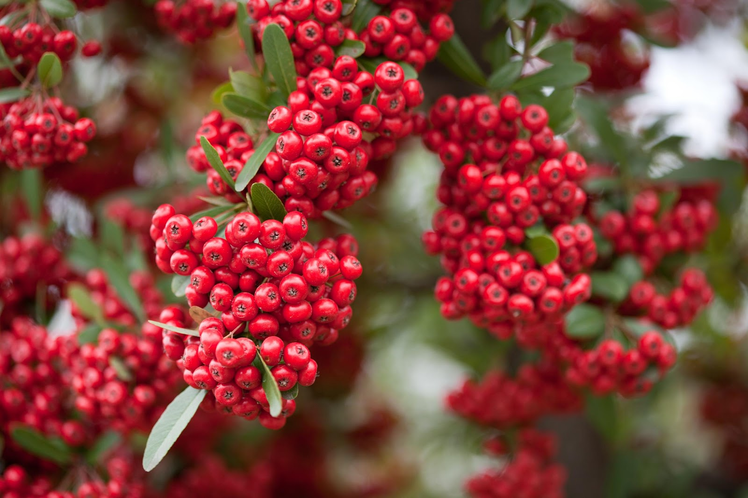
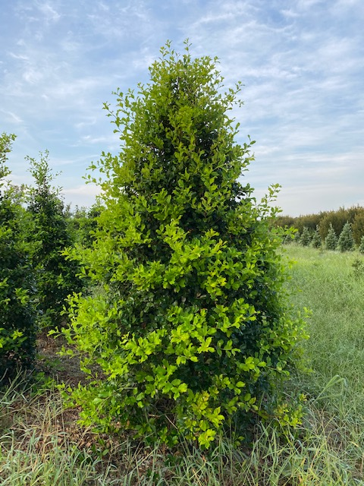
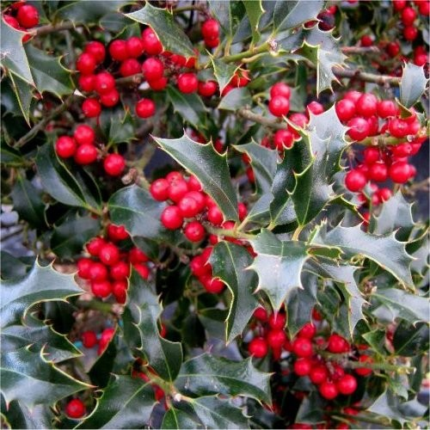
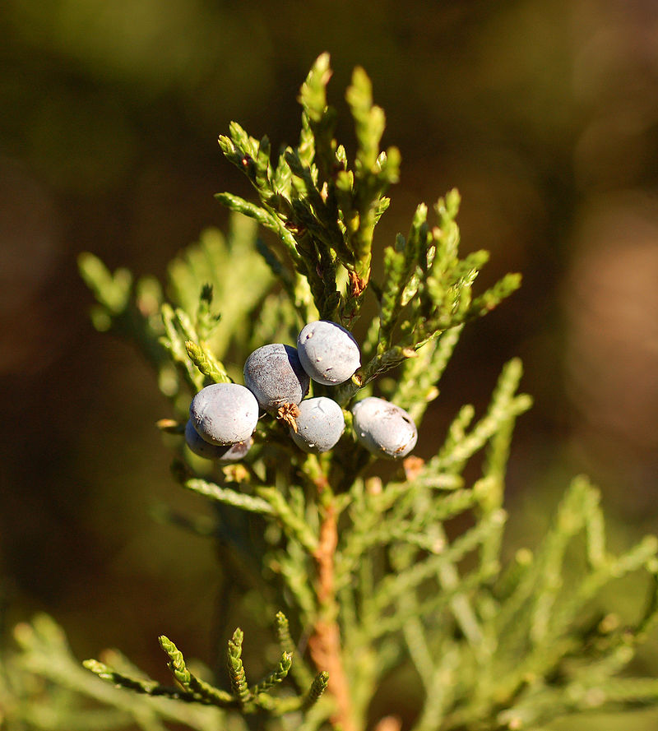
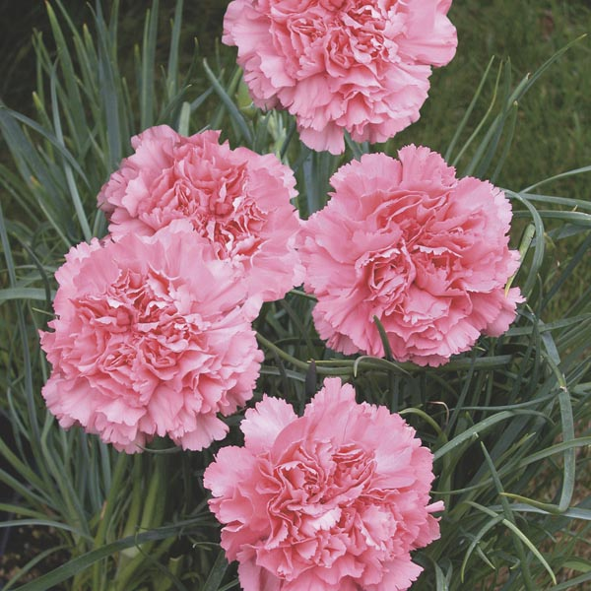
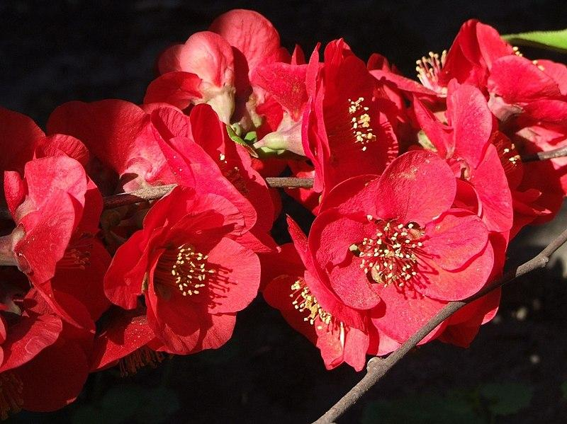
Watering
Firethorn
White Cedar
English Holly
Red Cedar
Clove Pink
Rose
Once every two weeks
Water everyday
Once per week
Light watering everyday
Once per week
Two-three times per week

Slide 4
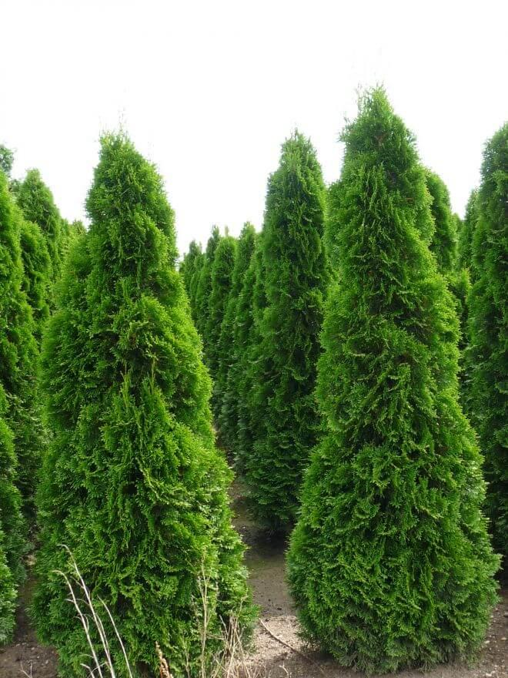
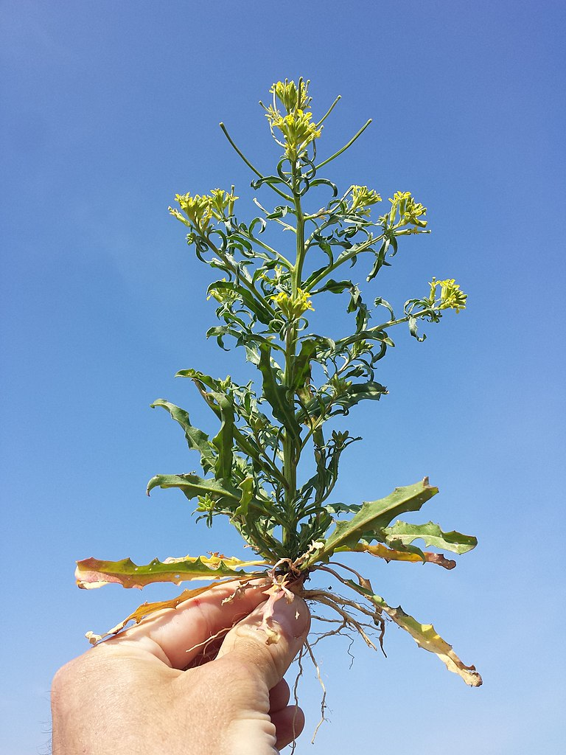
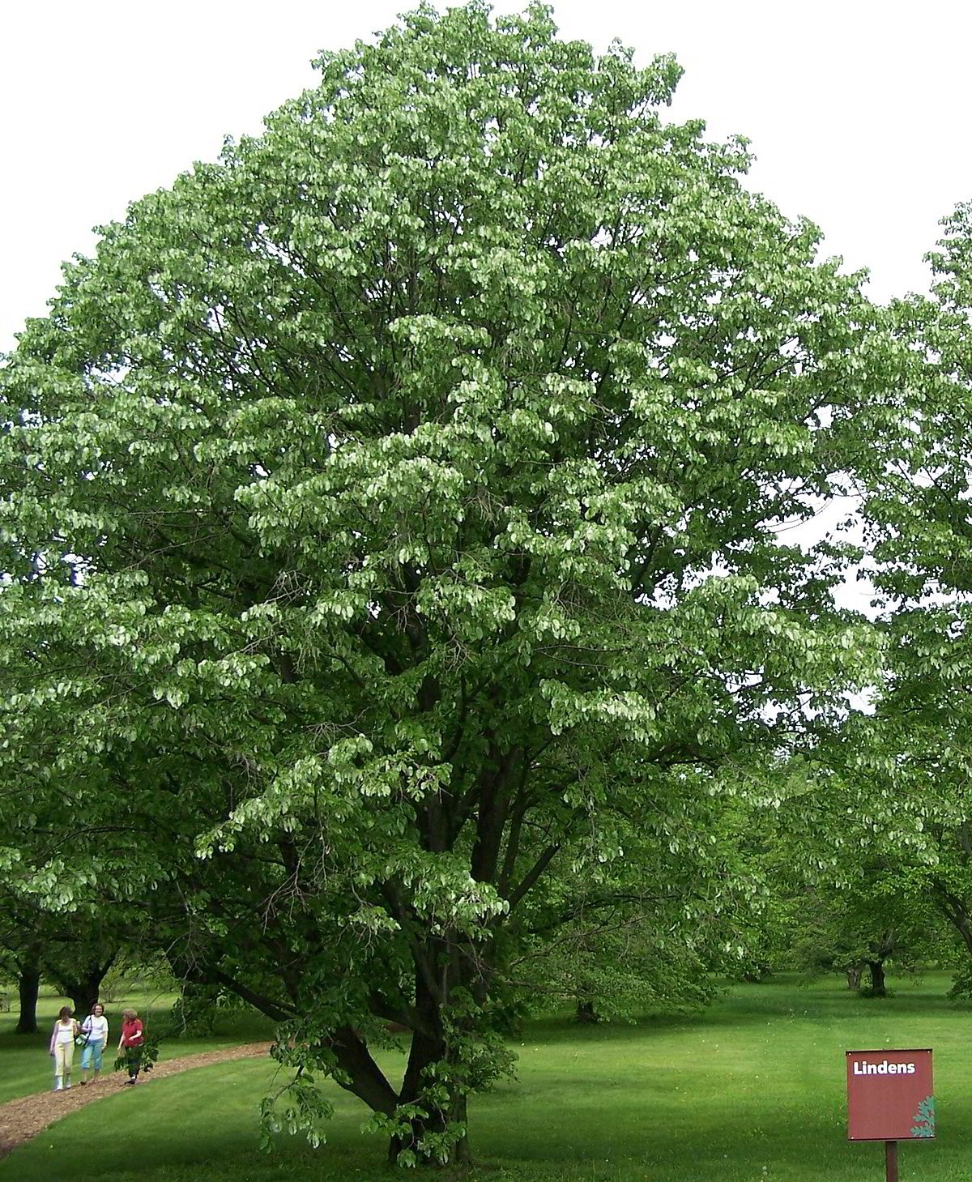
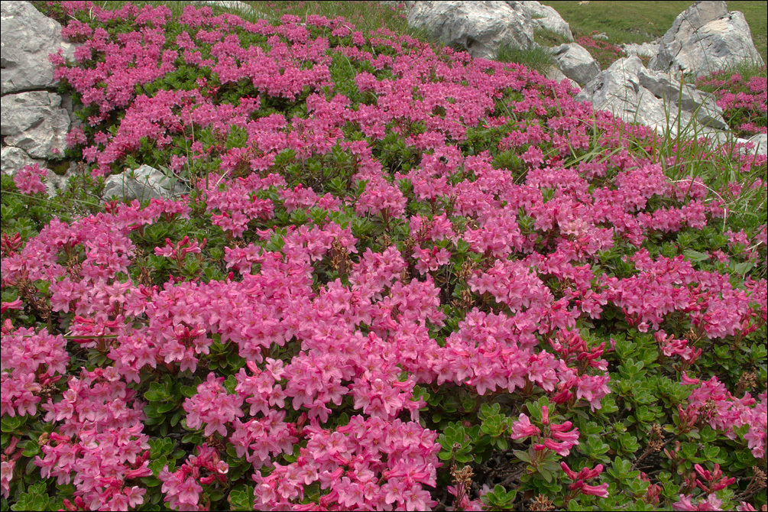
Hairy alpenrose
Thuya
Lindens
Wallflower
Once-twice per week
Everyday
Once-twice per week
2 hours with dripping hose once per week

Slide 5
Ficus
Houseplant
Soil dry out before watering
Bright, indirect light
Te more light, more water
Use: design focal point indoor

Slide 6
Statistics
Average rainwater 2015-1019 (Prishtina) | 705.58 l/m²
Green area needing water | 1500m²
Area of three buildings’ rooftops (In our campus) | 2070m²
Height of rezervuar | 1m
Watering needed for plants during summer | 360’000 litra
Maximal water that can be accumulated on all three roofs throughout the year | 1.46 milion litra
Roof surface to be utilized | 517.5 m²
Price of water per 1m³ | 69 cent
Cost that would be incurred if irrigation were to be carried out of drinking water | 250€ (273.59$)

