Slide 1
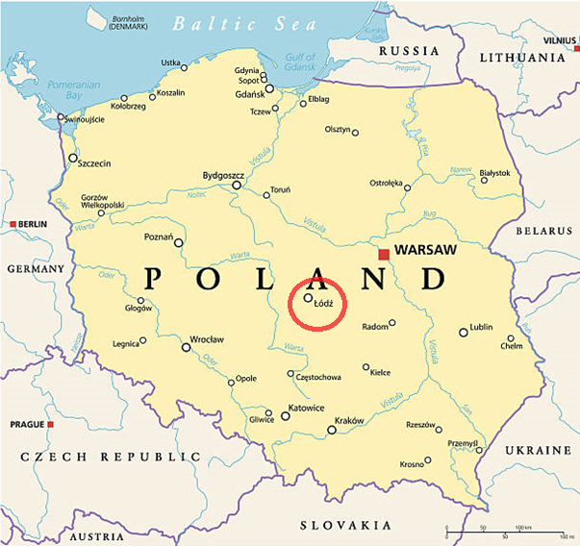
Special School and Educational Center No. 3 in Łódź Poland

Slide 2
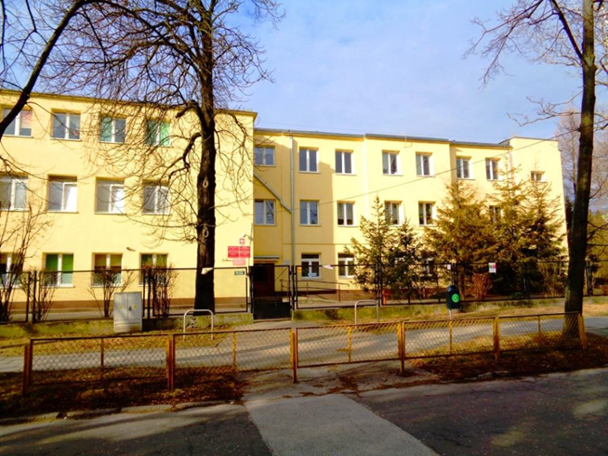
OUR SCHOOL
AND STUDENTS

Slide 3
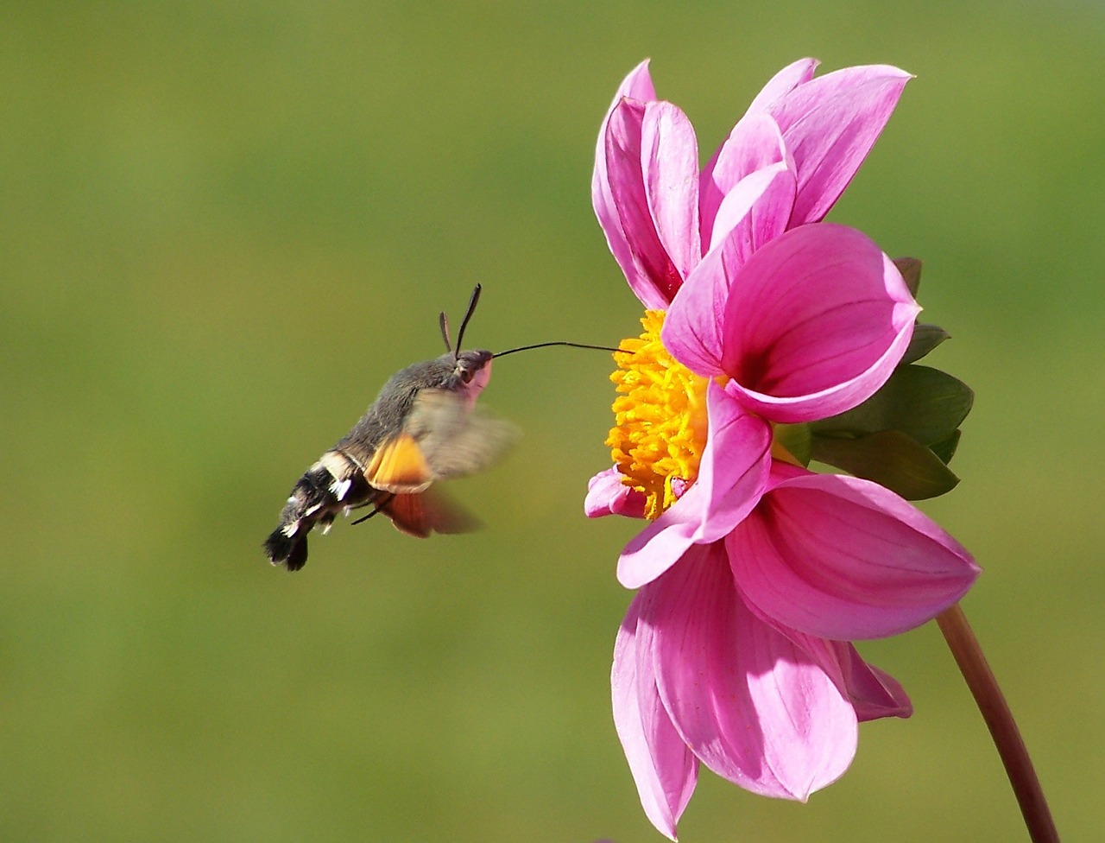
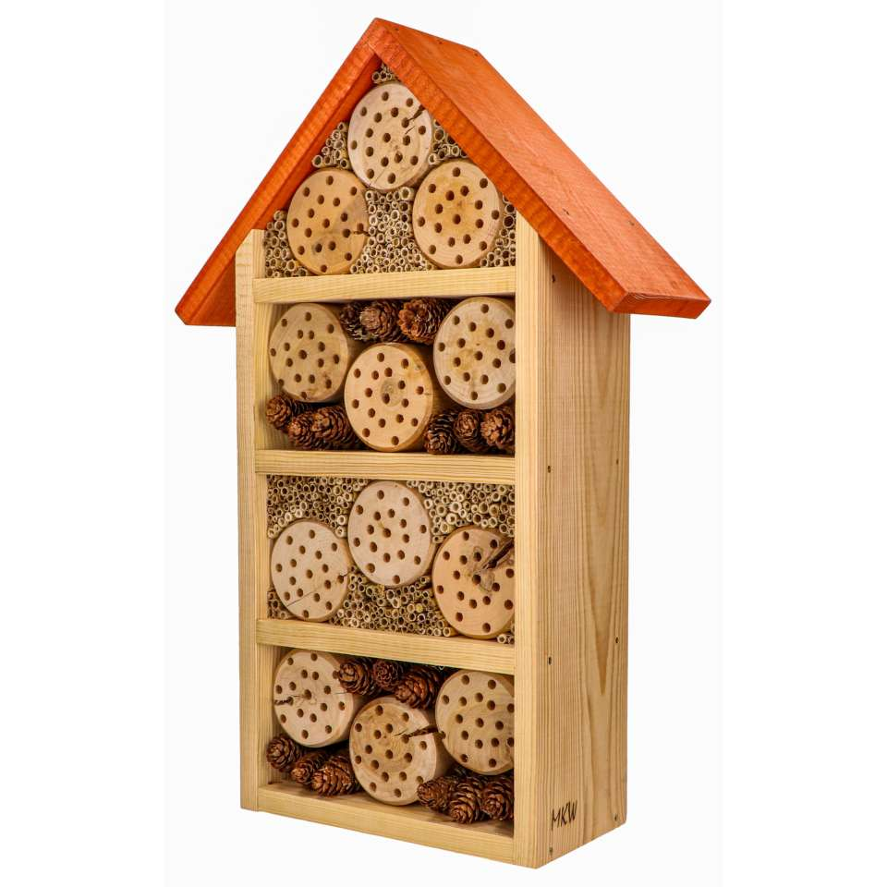
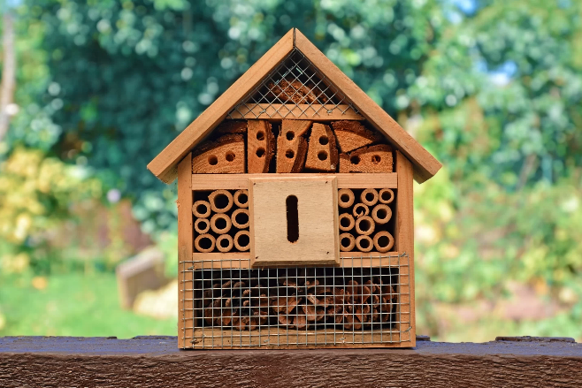
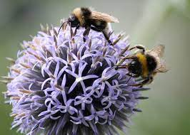
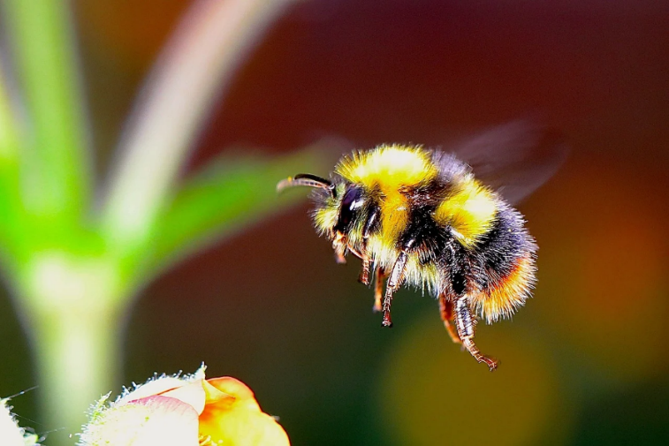
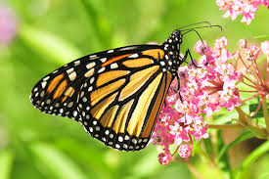
SHELTERS FOR Wild pollinating insects

Slide 4
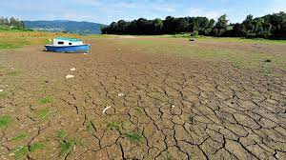
The mass disappearance of insects in recent decades is due to: ∙ the destruction and fragmentation of natural habitats, ∙ the chemicalization of agriculture, ∙ the massive use of pesticides, ∙ DROUGHTS, ∙ climate changeS.

Slide 5
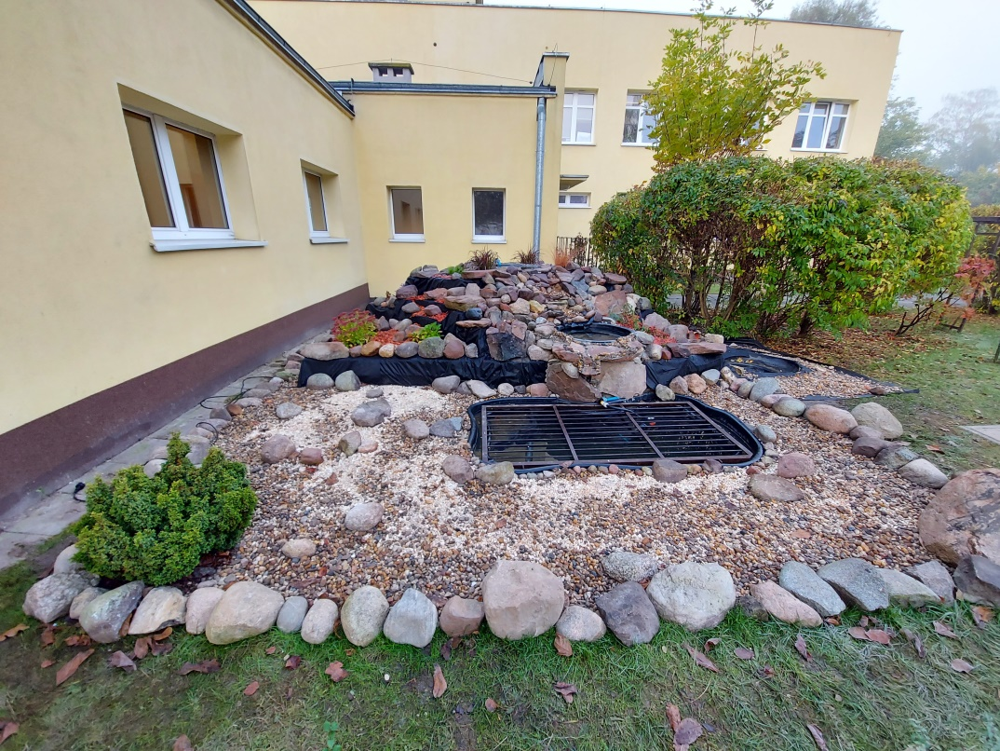
Currently, in the school garden, we have tanks for rainwater which we water flowers and vegetables. We also built a pond, with our own efforts, creating a specific microclimate.

Slide 6
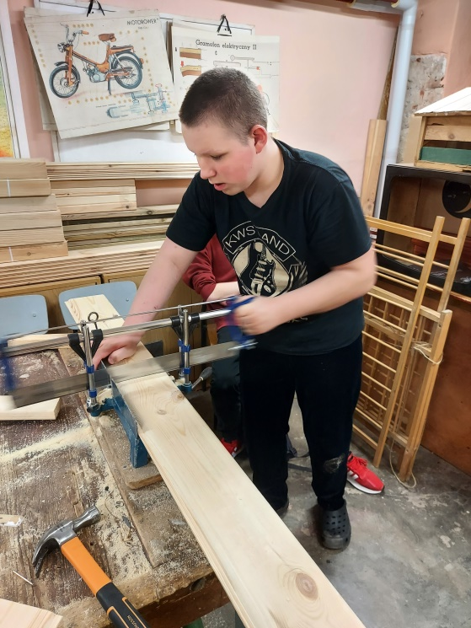
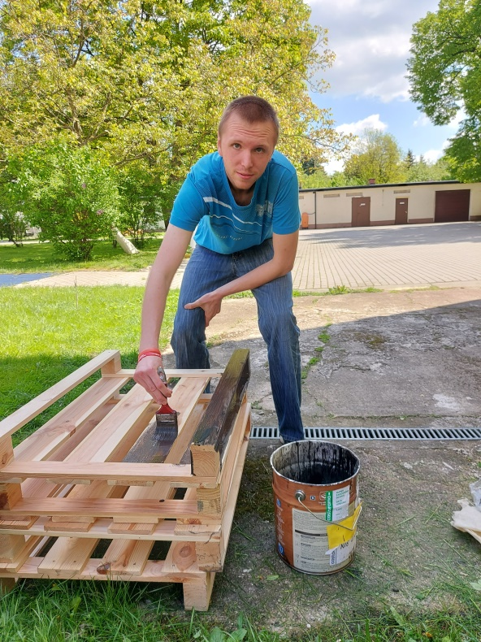
recycled materials uSAGE

Slide 7
