Slide 1
Water analysis. Physical and chemical features. Bahlui river, Iasi
Hands across Water
2021-22
EuroEd Secondary School, Iasi, Romania

Slide 2
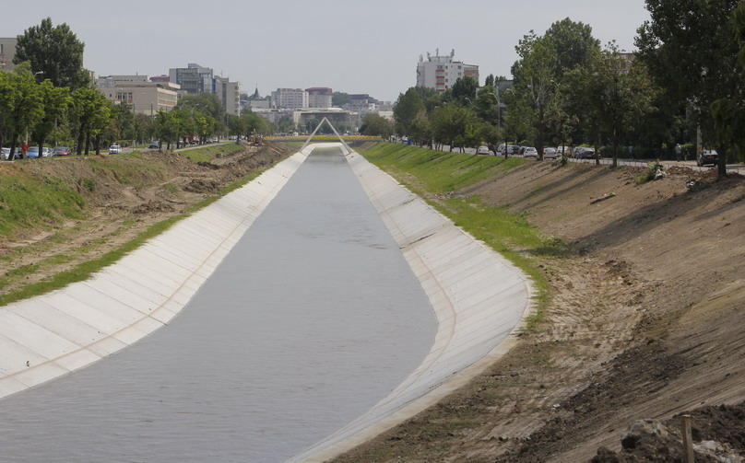
Introduction:
Bahlui river is situated in the north-eastern part of Romania.
It crosses the city of Iasi (14 km) and practically splits the city in two.
There have been chosen 5 collecting spots from the river, from 5 residential areas, for the chemical analysis of the water, 1-2 L of water from each spot.

Slide 3
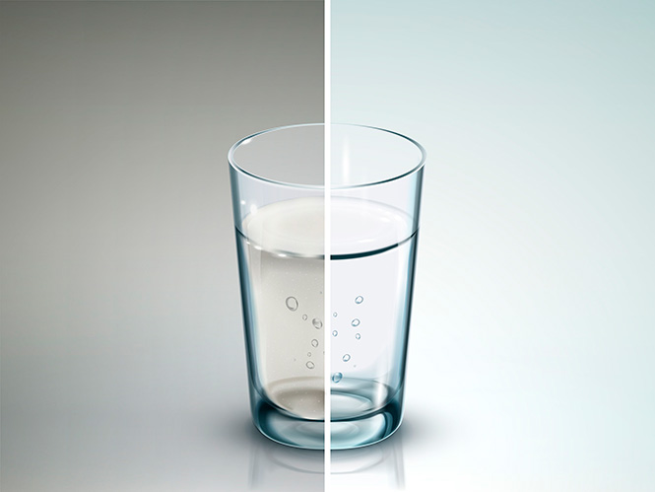
Research Question:
The technological processes and other industrial activity need big quantities of water.
Periodical analysis of the water is necessary, in order to monitor the quality parameters or the environment standards.

Slide 4
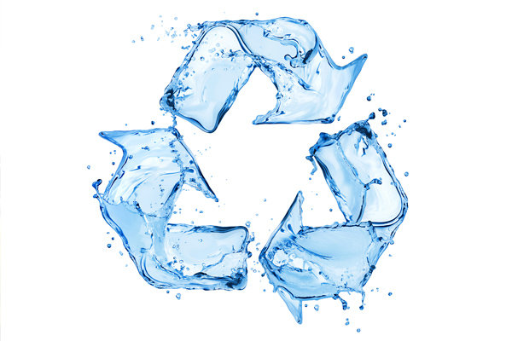
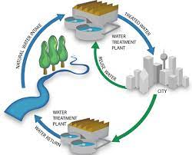
Hypothesis:
Awareness of our impact on nature will lead to the reduction of waste and its correct recycling.
Personal involvement in the protection of the environment and water recycling.

Slide 5
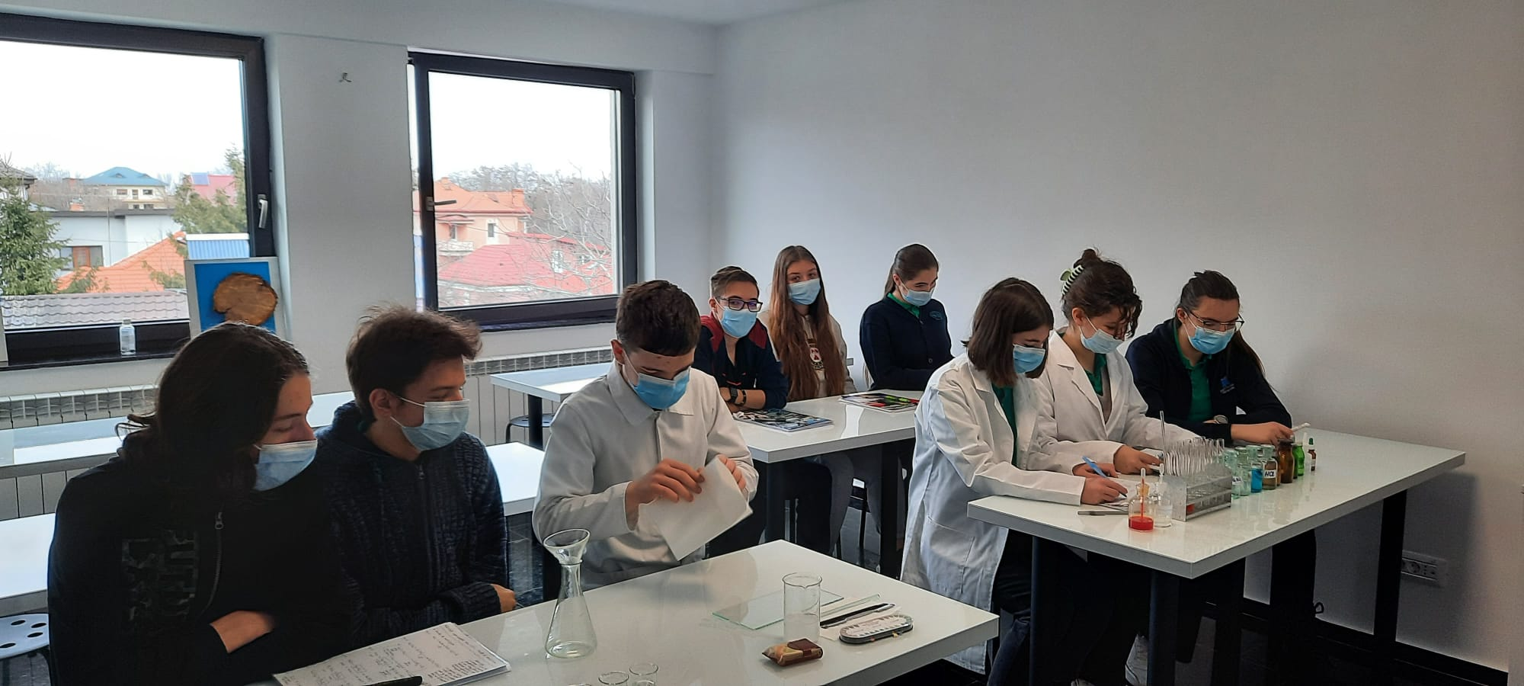
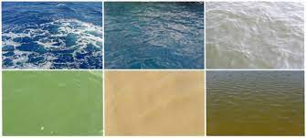
Methods and principles:
The methods of water analysis can be:
Determinations of the physical features.
The chemical analysis of the water.
Determination of the bio-chemical and biological properties.

Slide 6
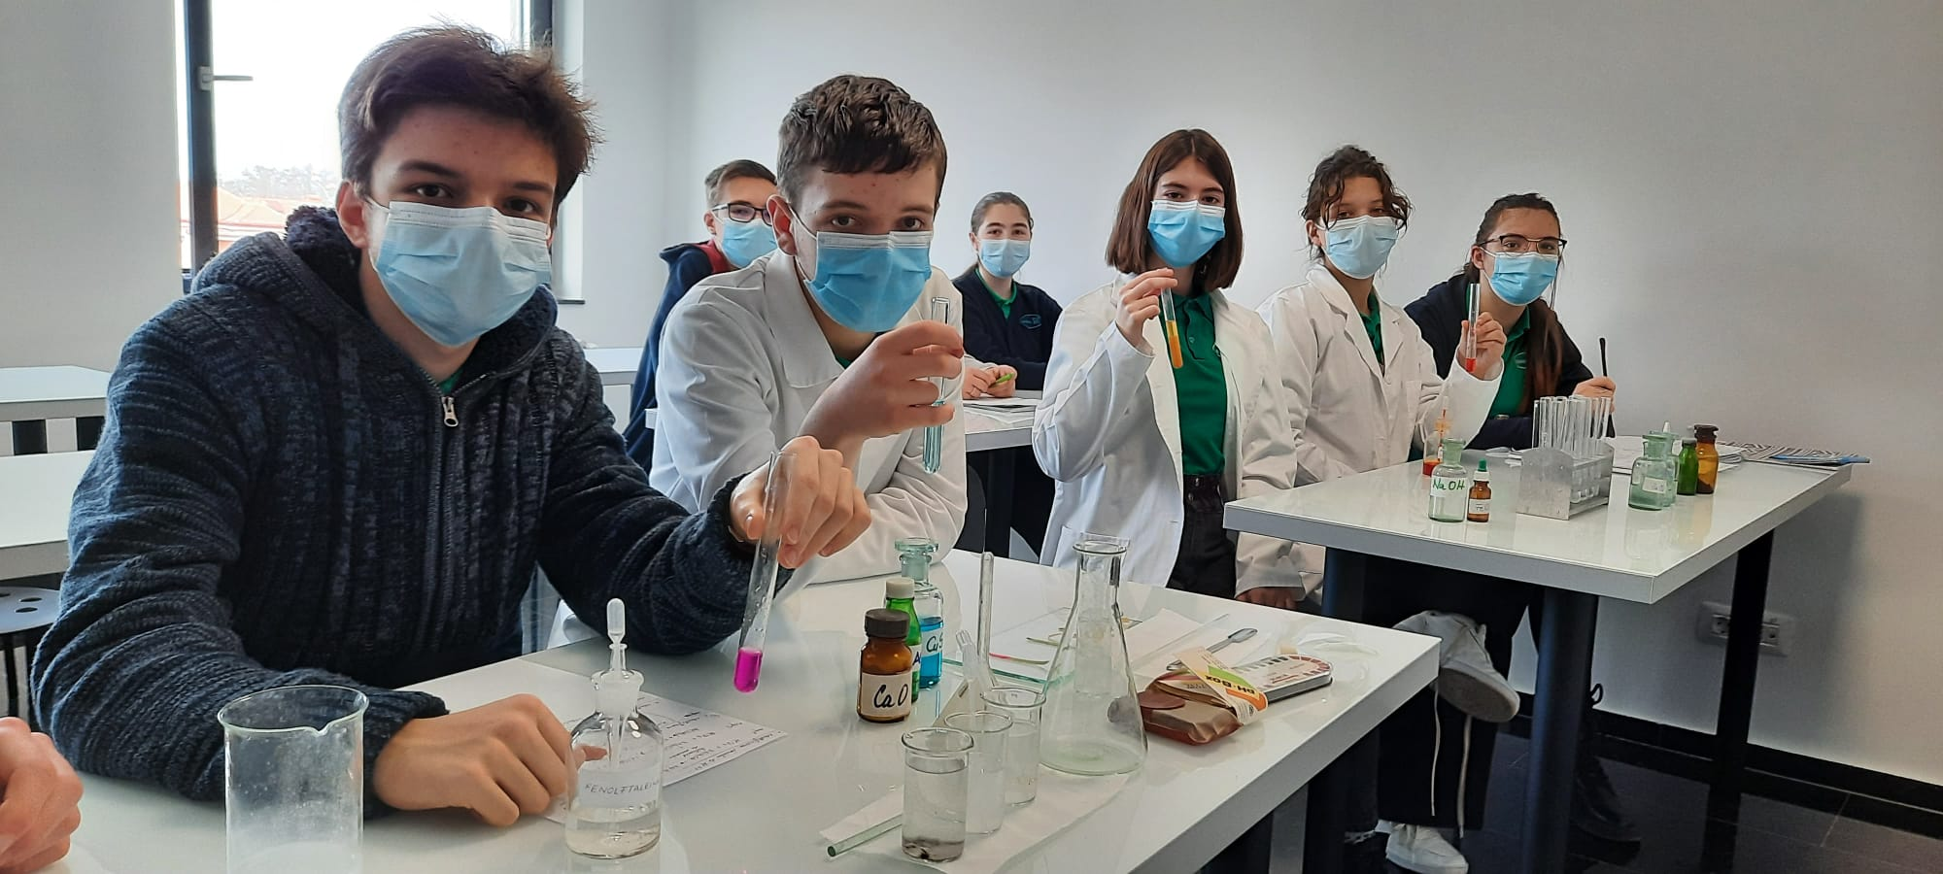
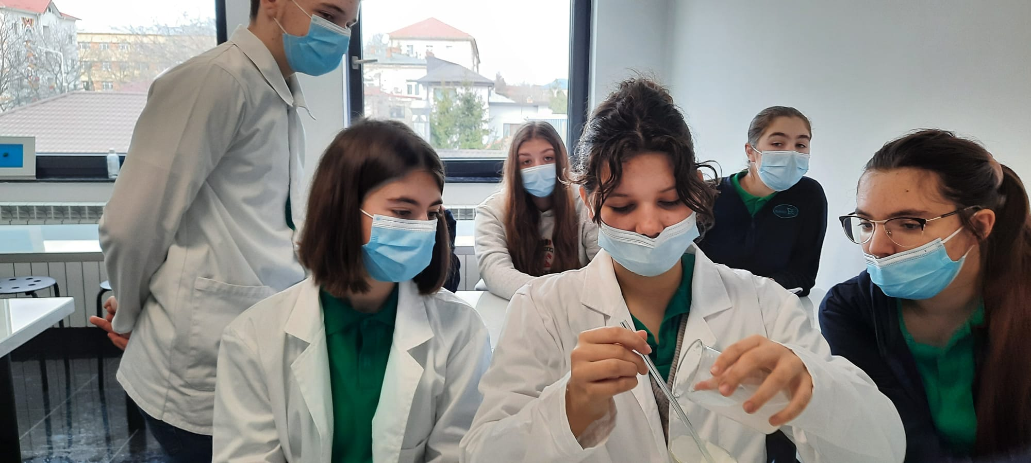
Methods and principles:
The smell
The taste
Turbidity
The chemical analysis of the water
PH determination
The Hardness

Slide 7
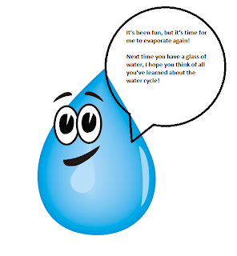
Conclusion:
There aren’t major modifications in the environment parameters, following the physical and chemical determinations carried out with water samples from Bahlui river, from the 5 collecting points.
We expect modifications of the physical parameters, due to rising temperatures, the previous samples having been collected in winter (water temperature - 5 C).
Maintaining the studied parameters at an approximately equal level indicates that the standards for the environment protection are followed in Iasi.

Slide 8
Water analysis. Physical and chemical features. Bahlui river, Iasi Thank you!
Hands across Water
2021-22
EuroEd Secondary School, Iasi, Romania

