Slide 1
Municipal institution of the Lviv regional council "Multidisciplinary educational and rehabilitation center named after St. Mykolay"
Location: Ukraine
Lviv, Bryukhovychi Nezalezhnosti Ukrainy St.

Slide 2
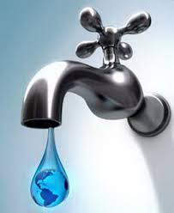
School project “Water - the source of life”

Slide 3
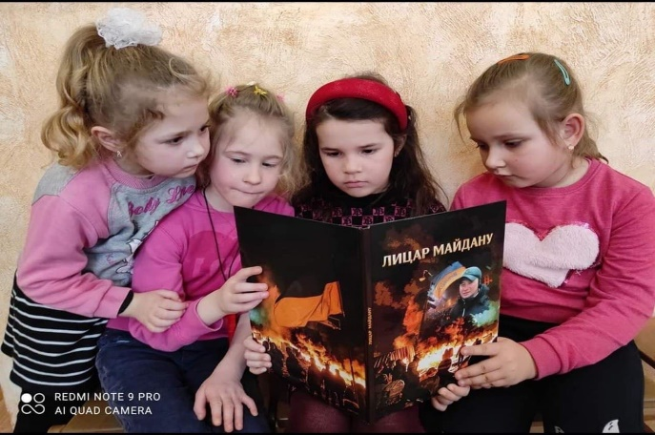
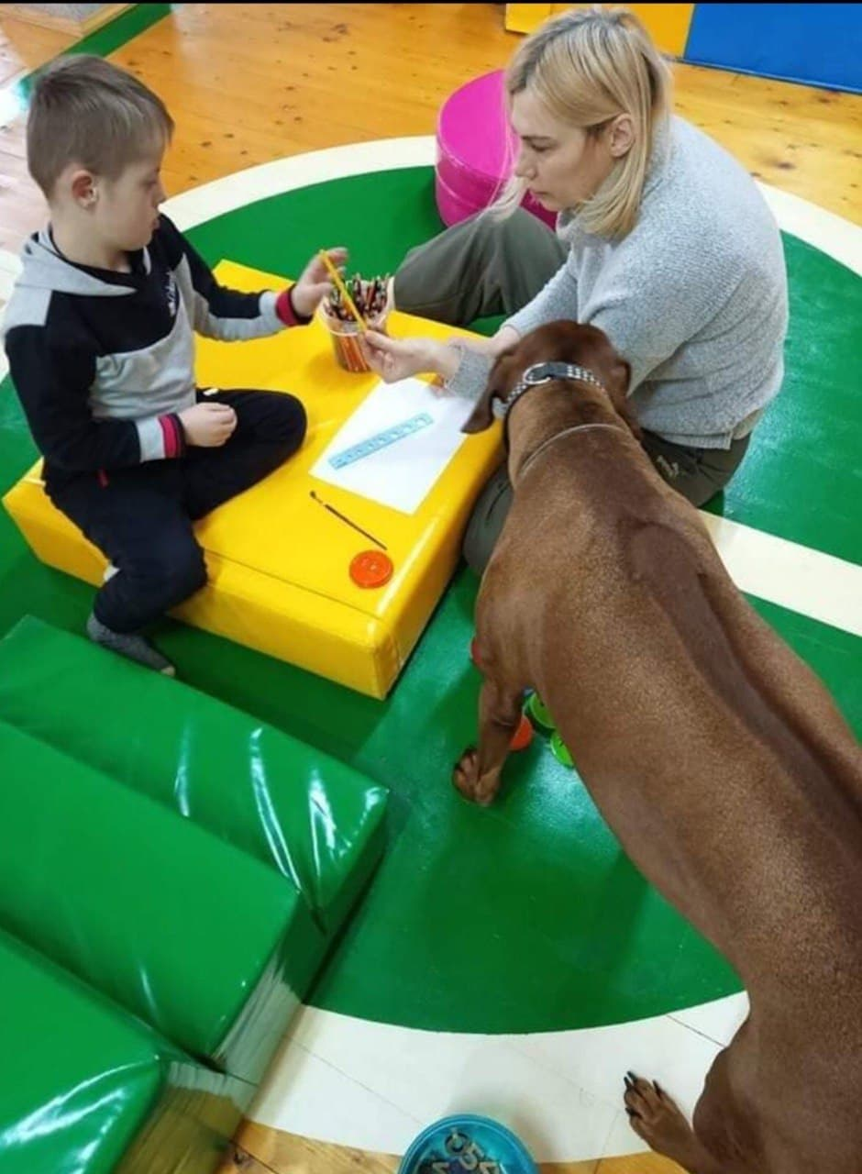
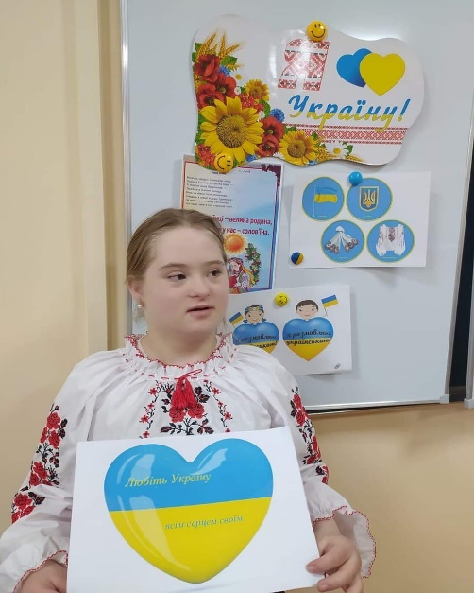
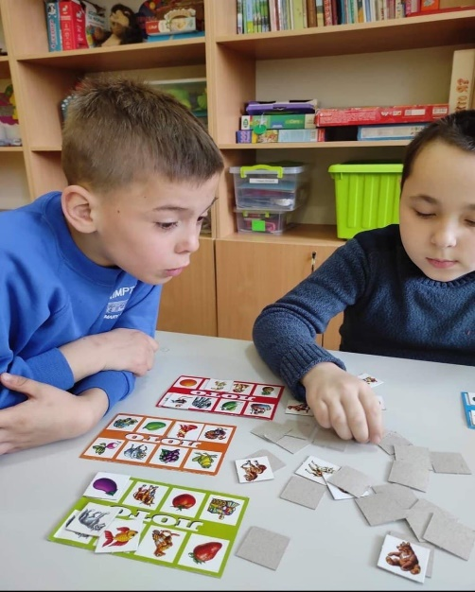
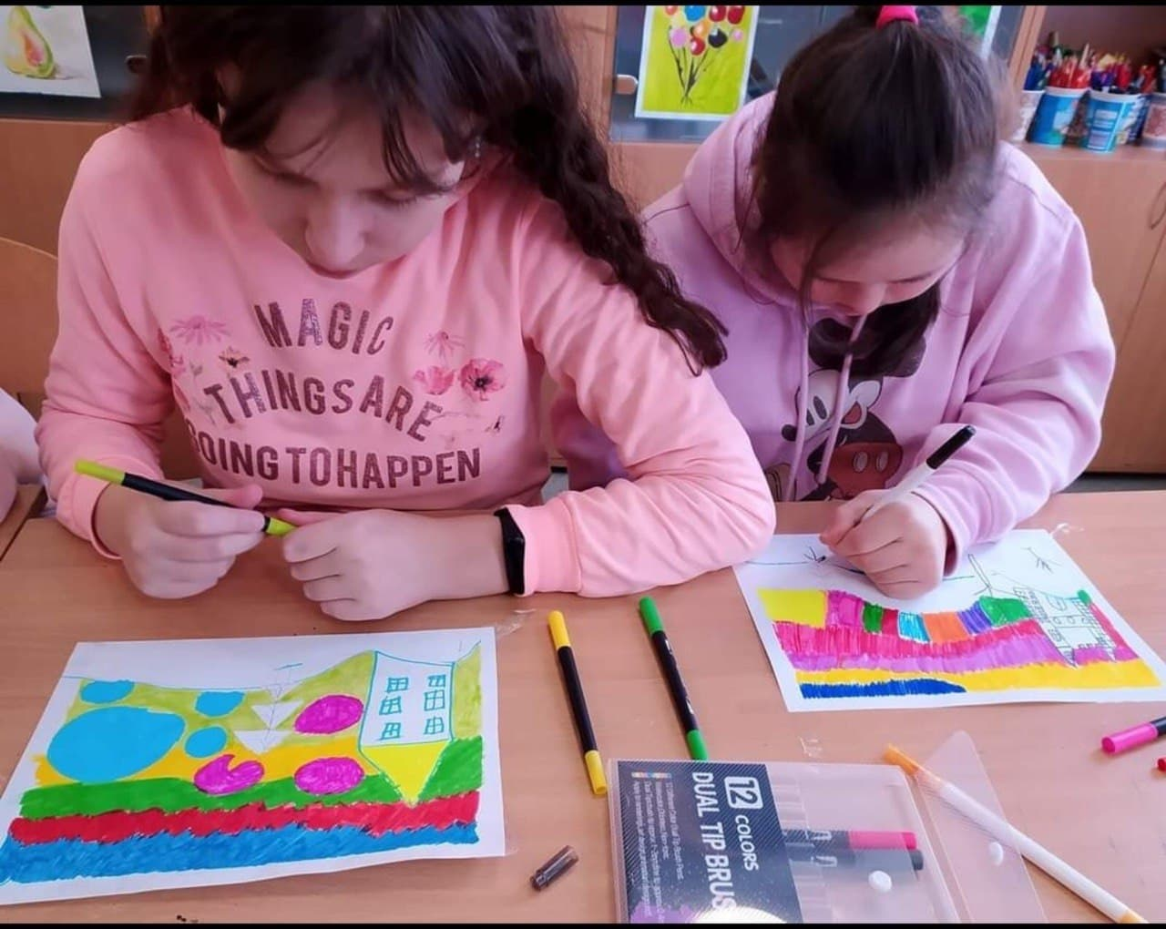
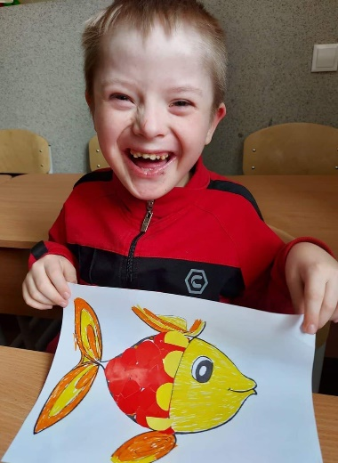
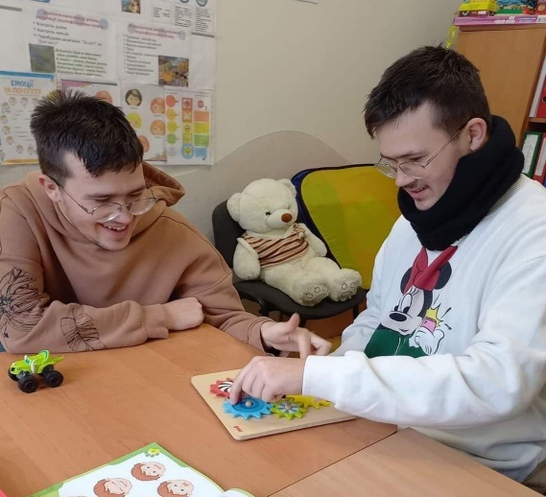
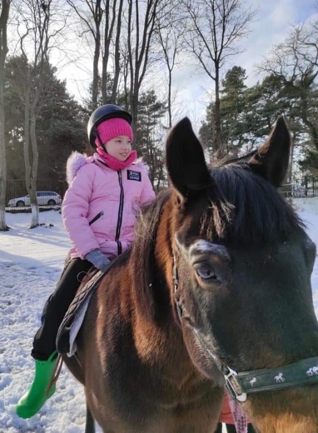
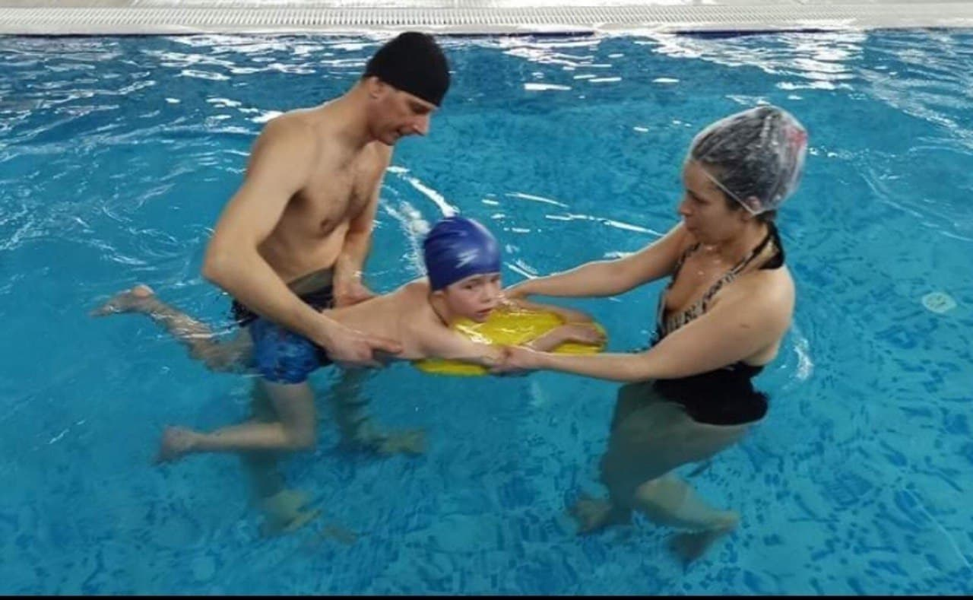
Saint Nicholas School has 210 students

Slide 4
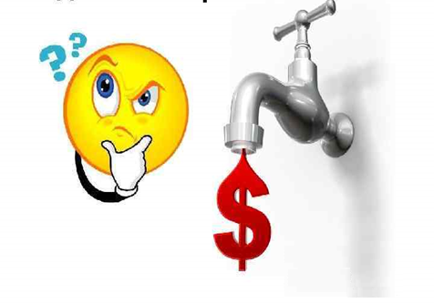
Relevance of the project: How daily habits can help save water
The purpose of the project:
explain the importance of water
demonstrate how you can save water by changing your habits

Slide 5
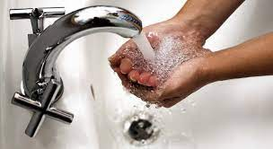
Hypothesis You can save water by:

Slide 6
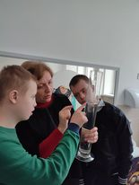
Training experiment of the group “Dental experts”
HOW MUCH WATER DO WE CONSUME WHEN WE BRUSH OUR TEETH?
1. Brushing your teeth without turning off the tap:
Teeth brushing time is
1 minute 30 seconds.
During this time, 7.4 liters of water will flow out of the tap

Slide 7
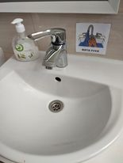
2. Brushing your teeth using a glass:
If you use a glass when brushing your teeth, you only need 200 ml (0.2 liters) of water.

Slide 8
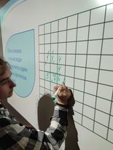
Calculations of the group "Dental Experts"
Calculation of water saving during the school year:
Teeth brush frequency: twice a day
Participants: 15 students
Training weeks: 35
7.2 l × 2 × 4 × 35 × 15 = 30240 l
Conclusion: save 30K liters of water per year

Slide 9
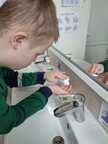
Group "Hygiene experts"
Check how much you can save if you close the tap during:
hand washing
The experiment found:
we save about 1.2 liters of water per one hand wash

Slide 10
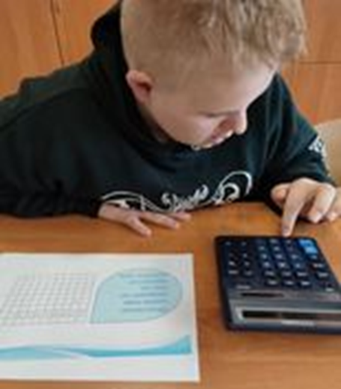
Calculations of the group "Hygiene experts"
Calculation of water saving during the school year:
Hand washing frequency: 8 times per day
Training days:165
Participants: 123 students
1.2×8×165×123= 194832 l
Conclusion: save 200K liters of water per year

Slide 11
Water consumption when brushing teeth
Water consumption when washing hands
Brushing teeth | Liters
Without turning off the tap | 31080
Using a glass | 840
Saving | 30240
Washing hands | Liters
Without turning off the tap | 2435400
Turning off the tap | 2240568
Saving | 194832
The total water saving is about 225072 liters

Slide 12
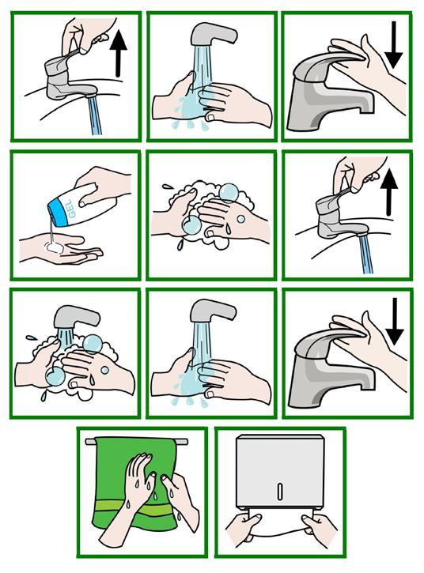
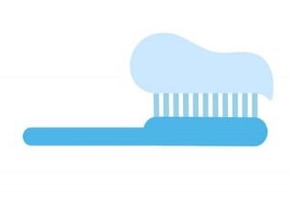
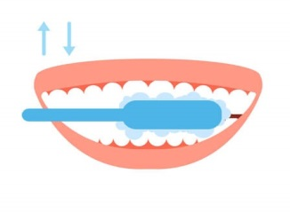
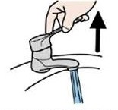
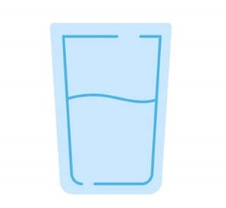
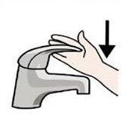
Tips
Brush your teeth and use a glass of water to rinse your mouth
Follow the instruction when washing your hands

Slide 13
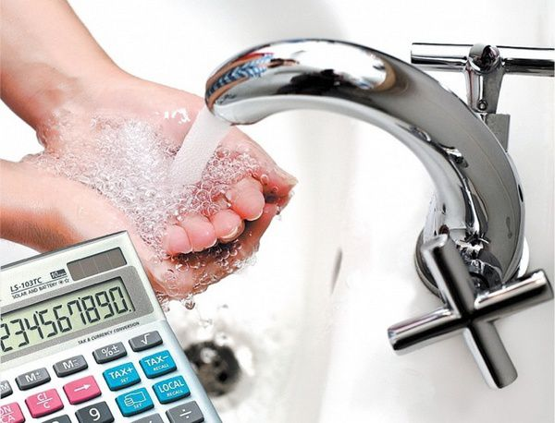
Conclusion
Closing the tap, reducing water flow - save on water, sewage and energy

Slide 14
Thank you for your attention!

