Slide 1
”MIRCEA CEL BĂTRÂN” NATIONAL COLLEGE CONSTANȚA ROMÂNIA

Slide 2
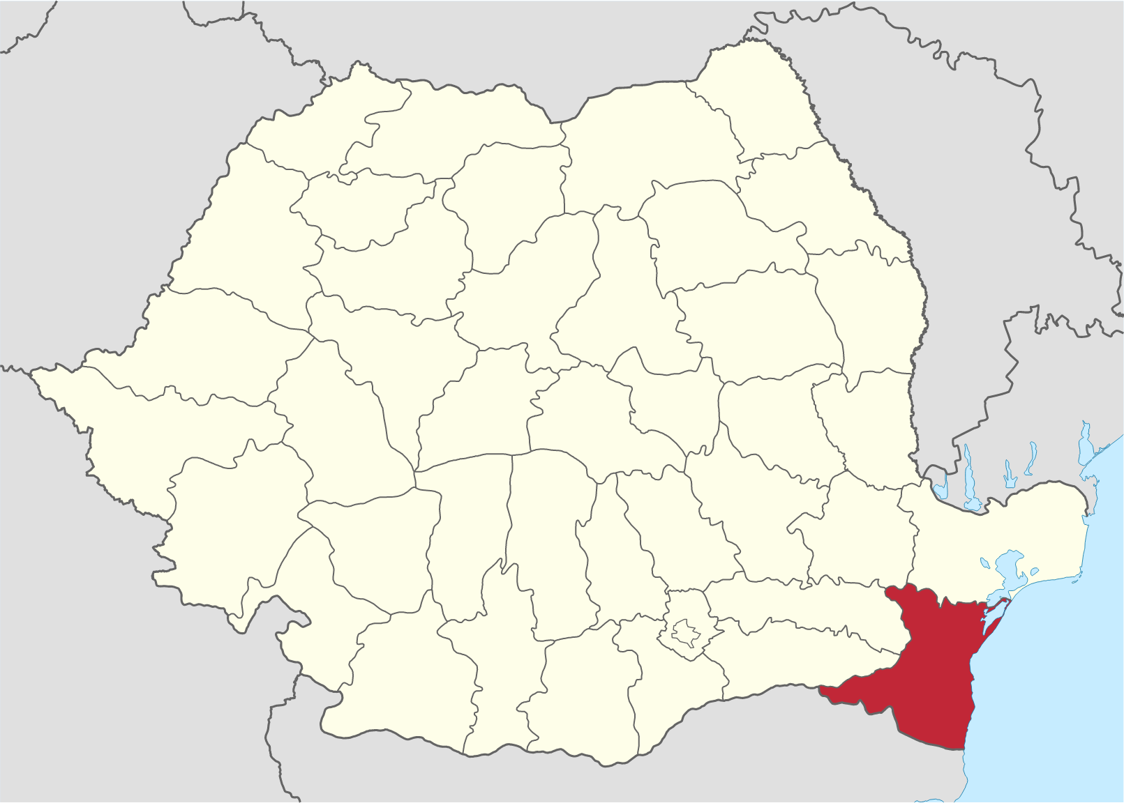
Constanța
The administrative center of the county of Constanța – located in the SW of Romania.
Located on the Black Sea coast, it has largest and most modern resort on the Romanian coast.
Besides the sea, mineral and salty springs in the surrounding area attract many visitors in the summer.

Slide 3
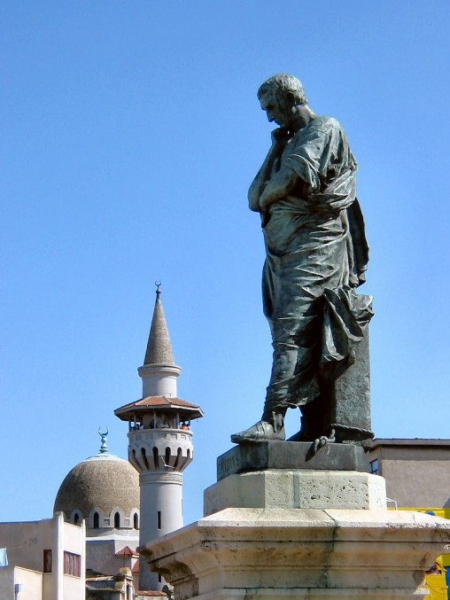
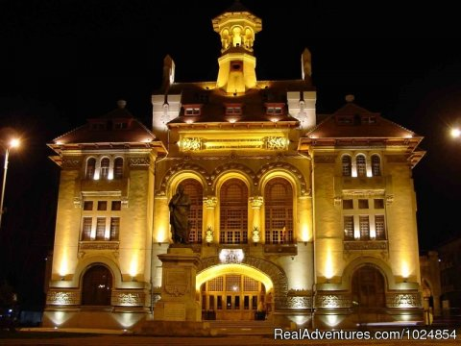
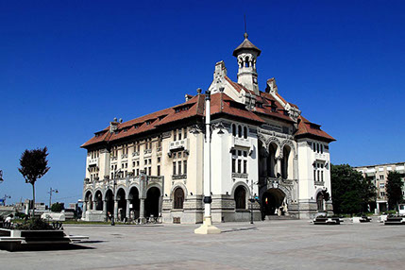
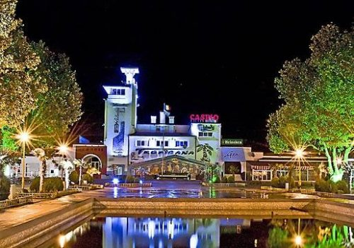
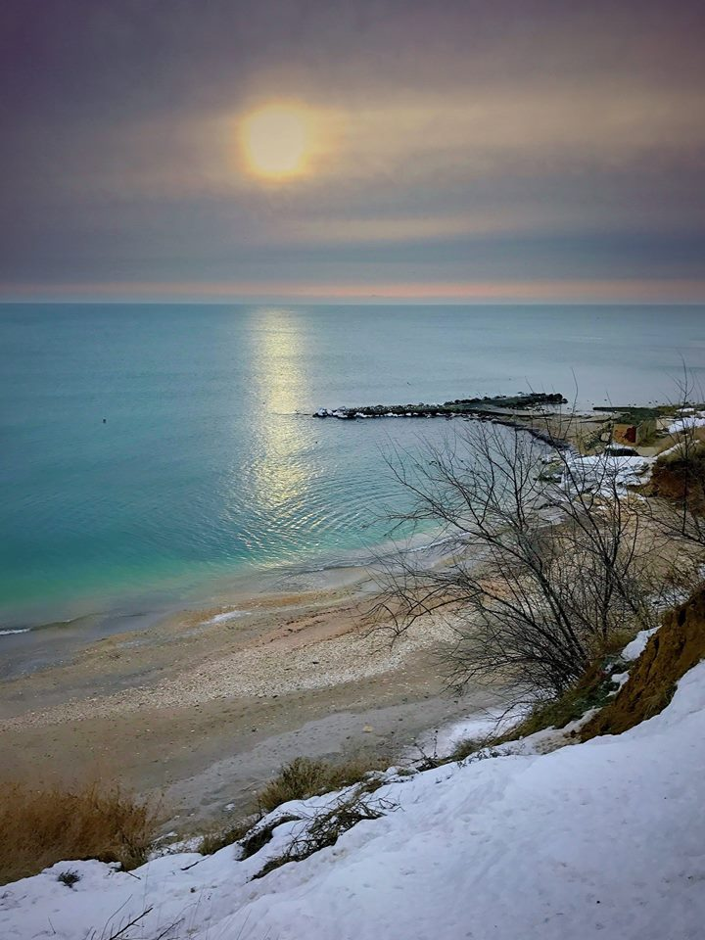
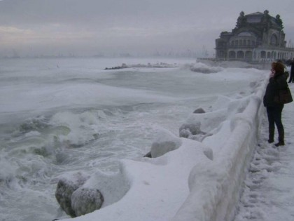
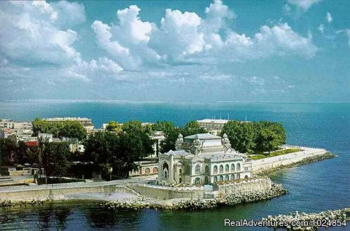

Slide 4
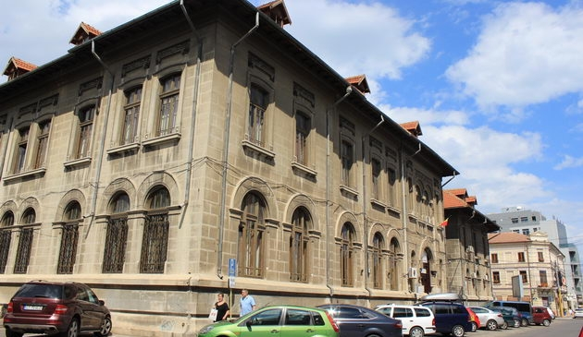
”MIRCEA CEL BĂTRÂN” NATIONAL COLLEGE
Founded in 1896 as a Boys Secondary School
1911 – becomes high school
1928 - Class ”E” (elite) School
1996 - becomes a National College
2006 - granted the title of European School

Slide 5
Special results

Slide 6
Famous Graduates

Slide 7
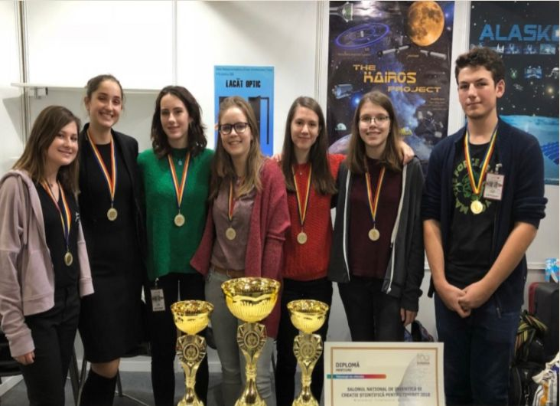
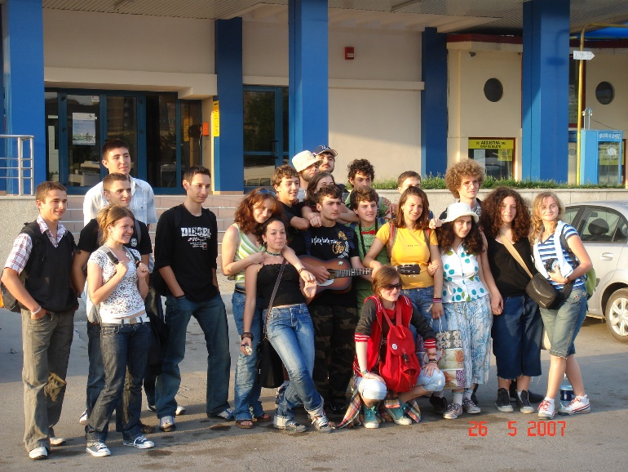
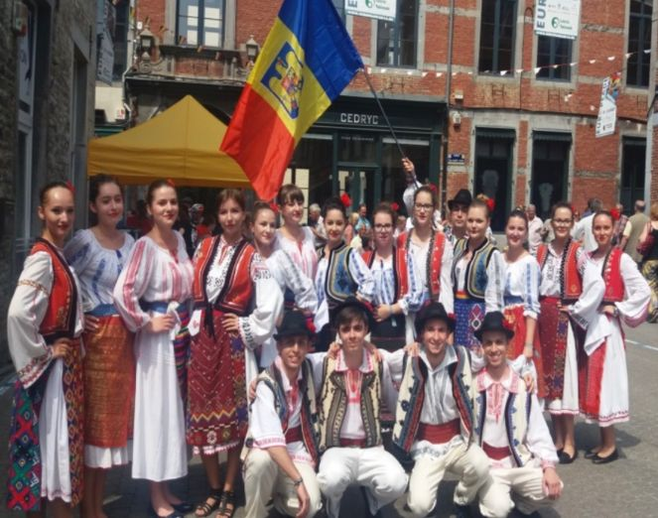
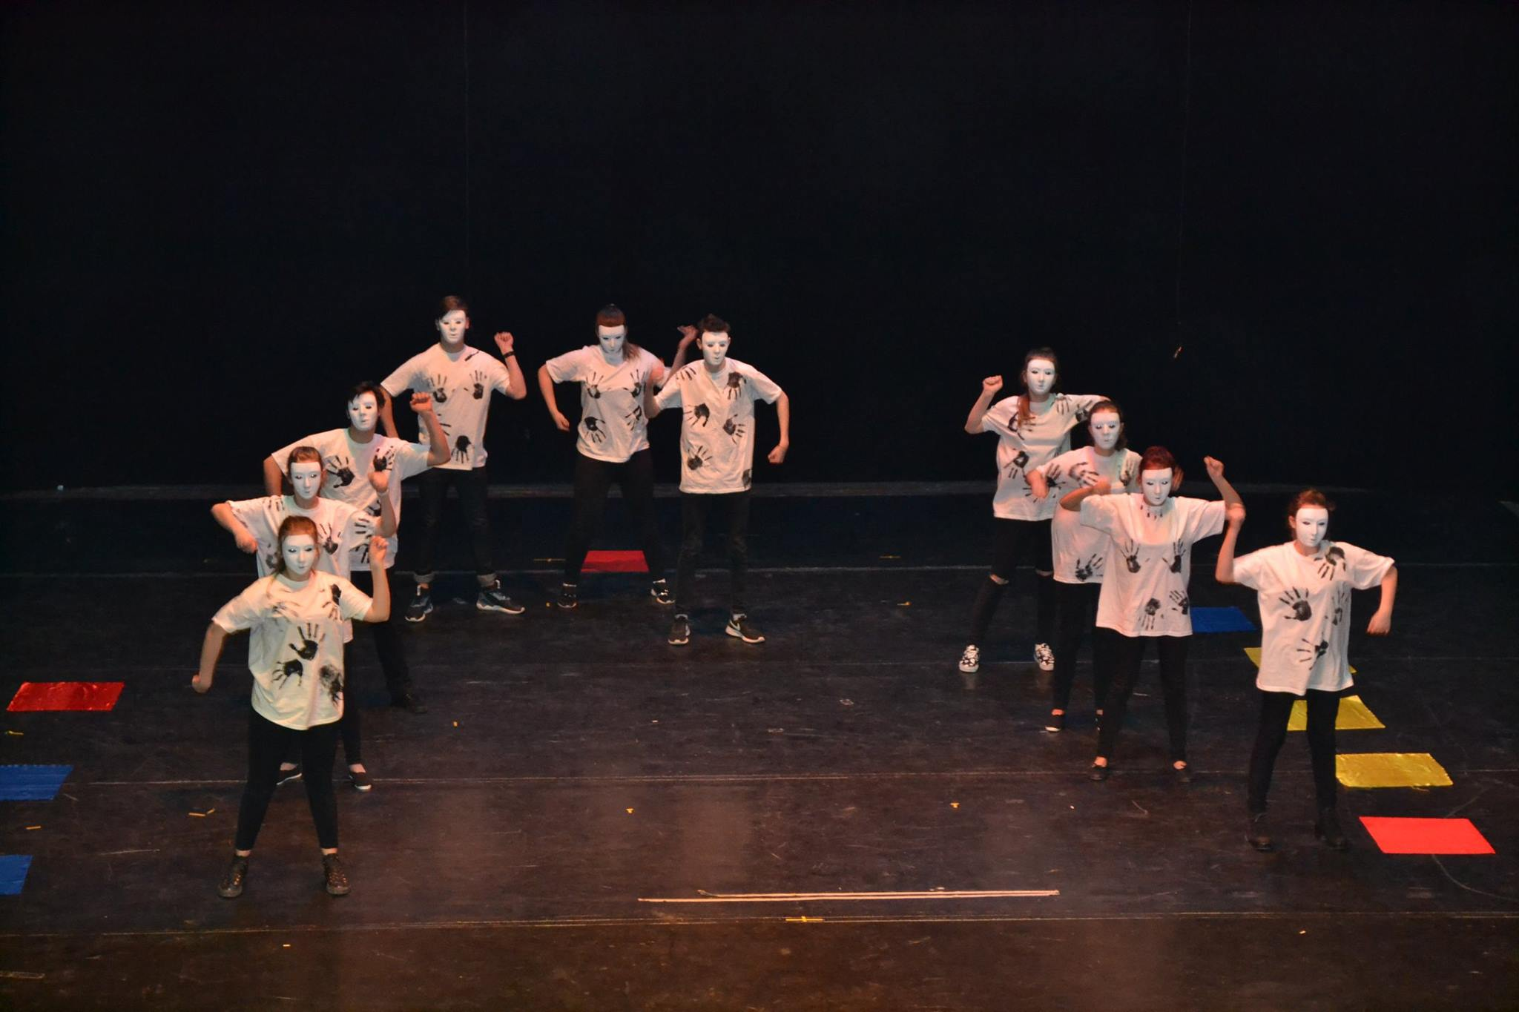
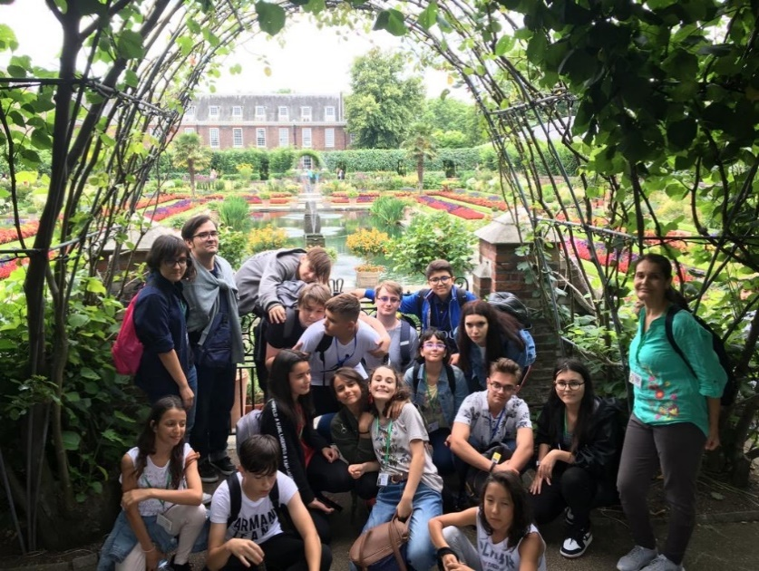
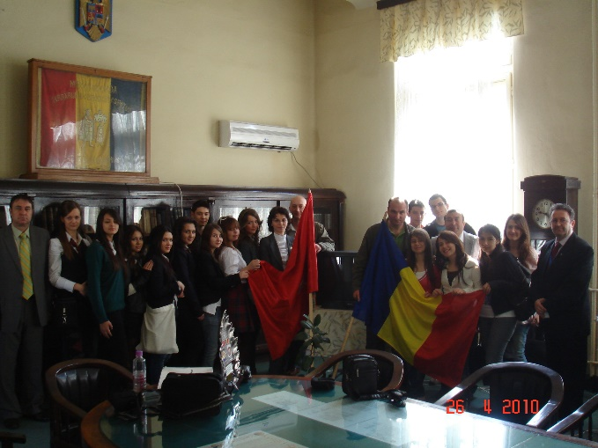
Extracurricular
activities

Slide 8
Vasile Nicoara – PRINCIPAL Bianca Matei – English Teacher Adriana Popescu – Biology Teacher Andaluzia Arif – English Teacher
ROTARY HANDS ACROSS WATER - TEAM
25 students 9th and 10th graders

Slide 9
Thank you!

