Slide 1
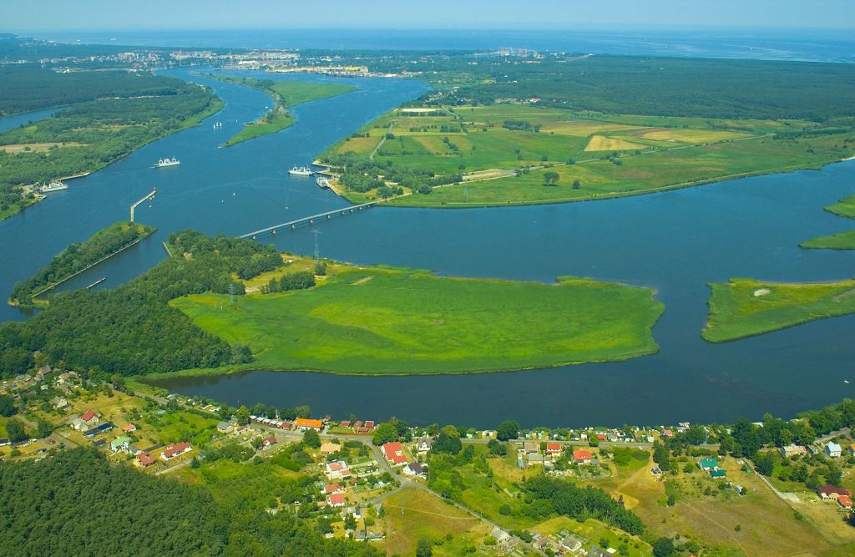
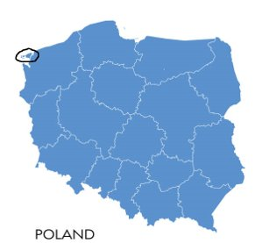
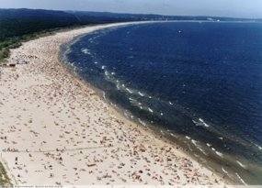
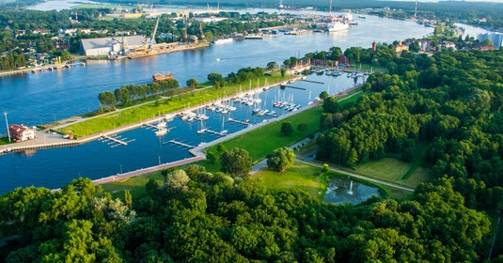
Kliknij, aby dodać tekst
Kliknij, aby dodać test
Świnoujście is called the land of 44 islands.​
It is the only and unique town in Poland
which is situated on archipelago,.
In the north it is surrounded by the Baltic Sea and in the south by Szczecin Lagoon. Świnoujście is famous for a beautiful​ beach. It is also a health resort.​

Slide 2
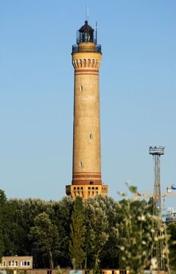
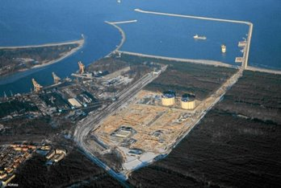
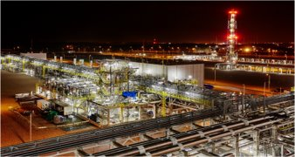
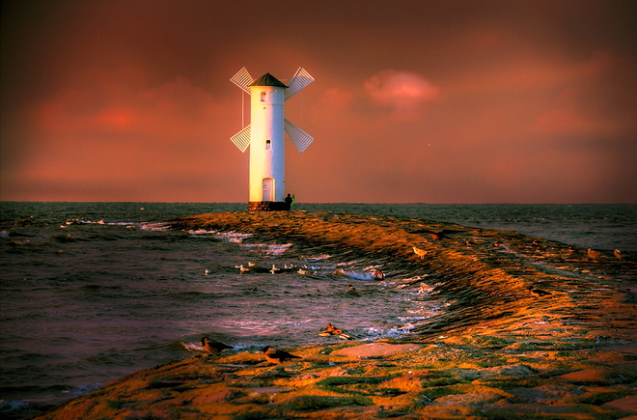
The landmarks in Świnoujście
The Lighthouse
Stawa Młyny The Windmill
Gas terminal

Slide 3
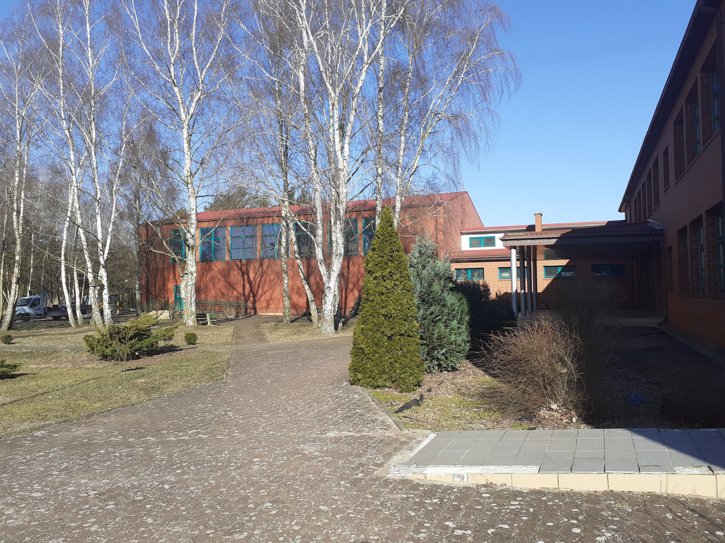
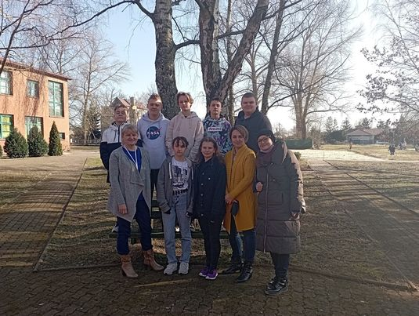
TEAM DREAM OF WATER: THE TEAM OF TEACHERS:
Natalia Łozicka MS. Jowita Chorzępa - English teacher
Karolina Molińska MS. Katarzyna Hamadyk- the headmistress
Wiktor Kłosiński MS. Kamila Zygmunt – biology teacher
Kornel Małolepszy
Kamil Stachewicz
Piotr Szambara
Natan Witasik

Slide 4
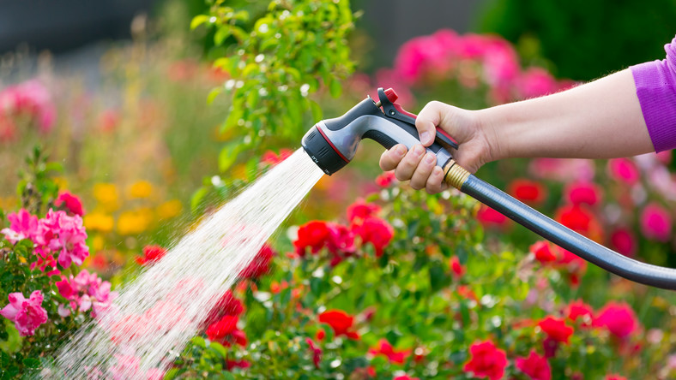
Despite its position, when in the summer a drought lasts for a long time then the groundwater level and the water pressure drops seriously.​
The authorities of our town introduce no
watering of gardens by water from water supply system. ​

Slide 5
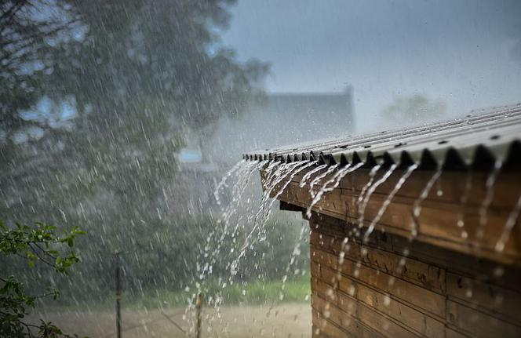
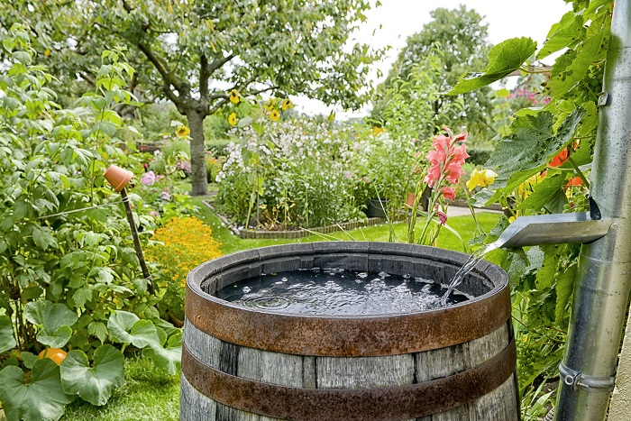
The aim of our project is to find the way how to solve the recurring problem of the lack of water. ​
OUR CONCEPT:​ Using rainwater to water the school garden.​ (RAINWATER ADDS MORE FLORA !)​

Slide 6
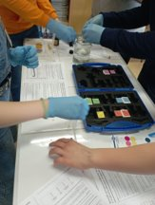
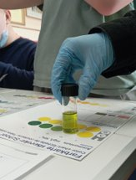
we checked the ph of the rainwater which was high because it remained in the container for two months.

Slide 7
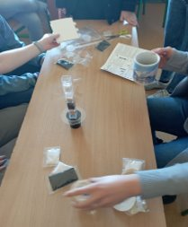
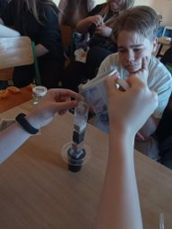
Using column filters we filtered polluted rainwater. This experiment showed us what kind of sediment and how much remained on the sides of the filter.

Slide 8
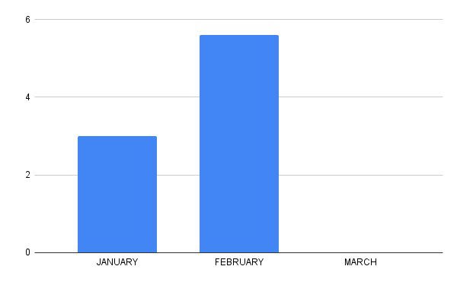
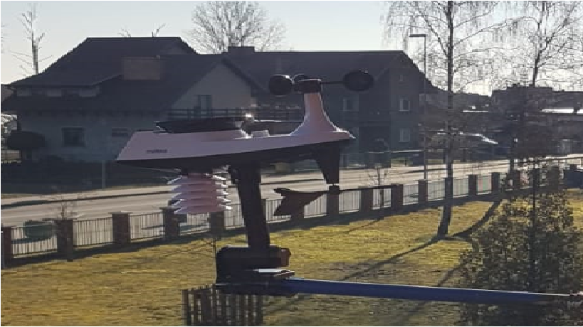
THE SECOND graph shows the number IN MM OF PRECIPITATION IN 2022
THE FIRST GRAPH
SHOWS THE NUMBER
IN MM OF PRECIPITATION IN 2021
WEATHER STATION – We measured the amount of rainwater but it hasn't rained for almost two months.

Slide 9
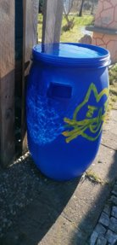
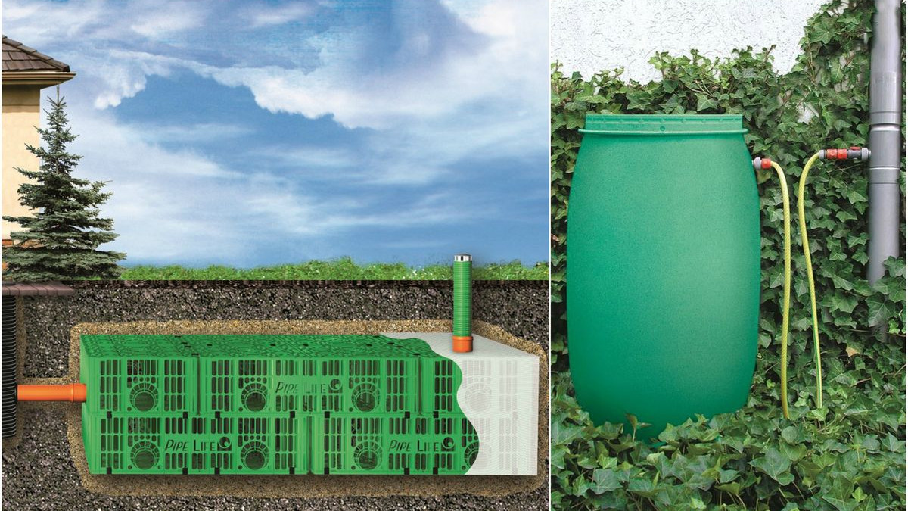
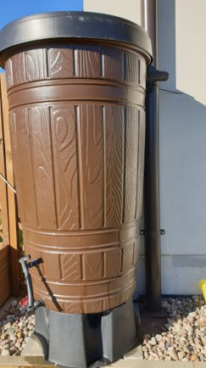
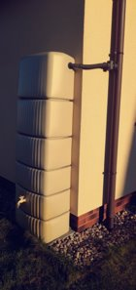
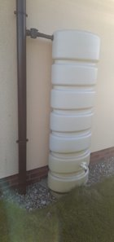
Therefore, during this project we learned :​
about the legal aspects concerning rainwater in Poland​
what we can do without any permissions – we can use plastic containers to water the garde​n -
we can see them in the photos below
what kind of technical solutions are possible to apply ​

Slide 10
Thank you for your attention.

