Slide 1
The effects of different planting and growing strategies on the growth of lettuce plants
The effects of different pumps on the flow speed of water in a hydroponic system

Slide 2
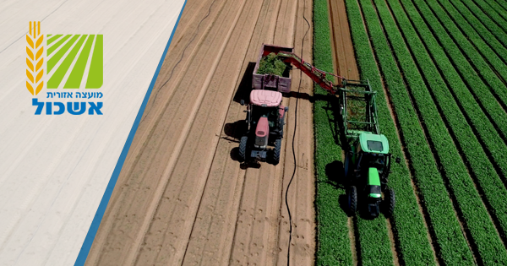
Where are we? Eshkol County
County area: 1,000 square km
Agricultural land: 284 square km

Slide 3
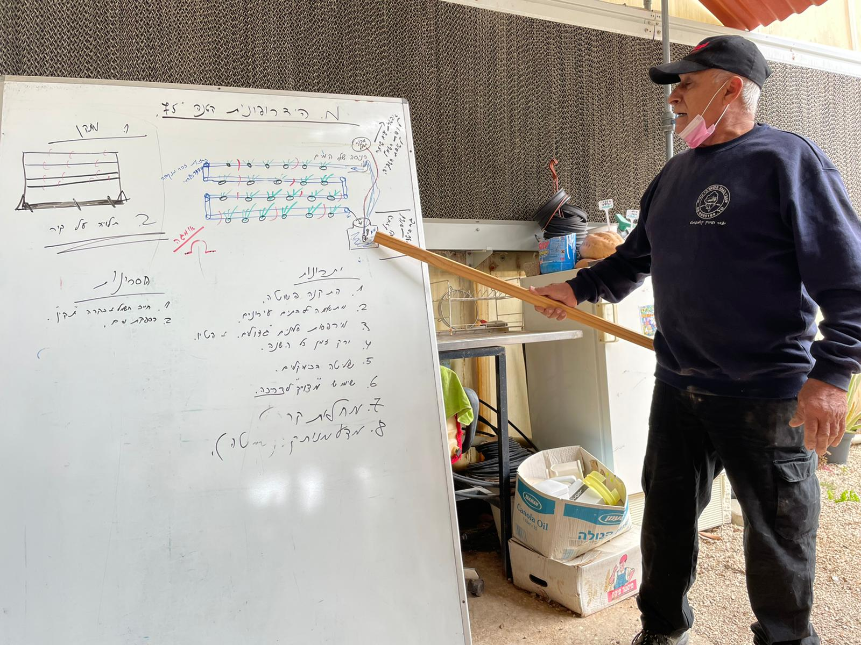
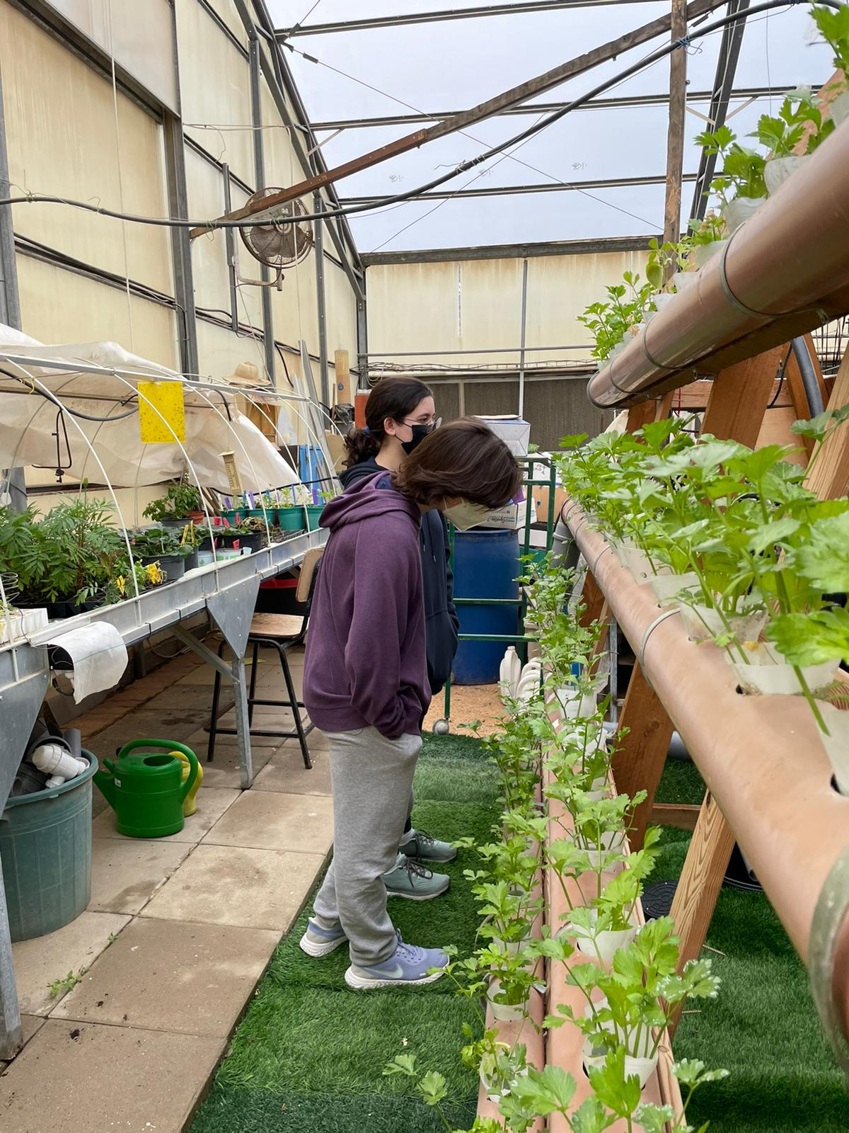
Introduction
A Hydroponic system is a technique available for growing plants.
We are hoping to optimize the system’s efficiency by using different control methods and assessing different variables.
Motty, our greenhouse manager.

Slide 4
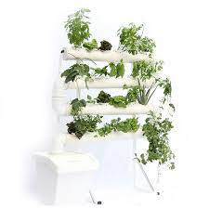
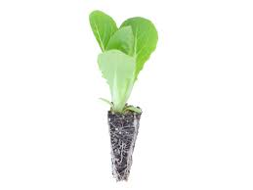
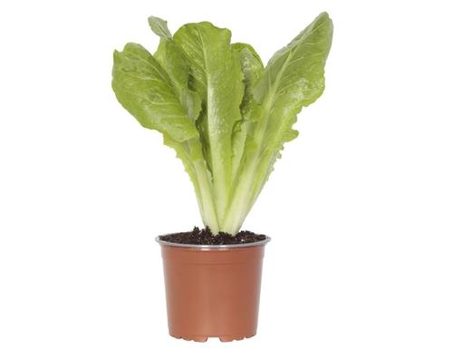
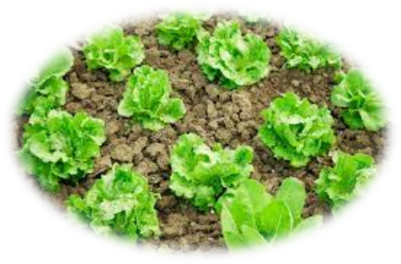
Methods
First Stage:
Analyze the growth of lettuce sprouts, grown in three different methods: in a flowerbed, in planters, and in a hydroponic system.
Second Stage:
Contrasting different water flowing rates in the hydroponic growing system through many different approaches and their effect on the growth
of the lettuce plants.

Slide 5
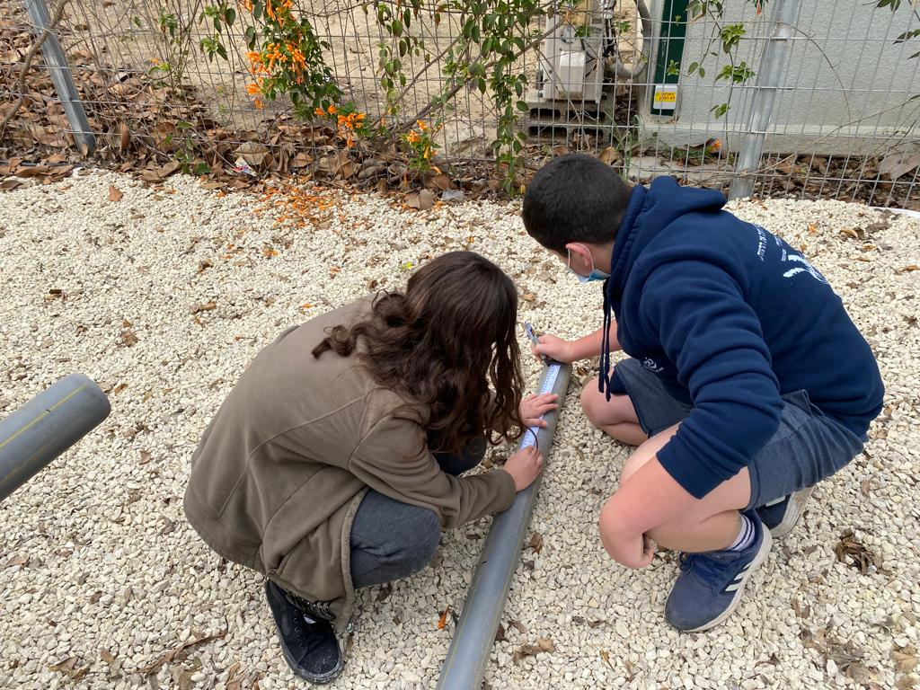
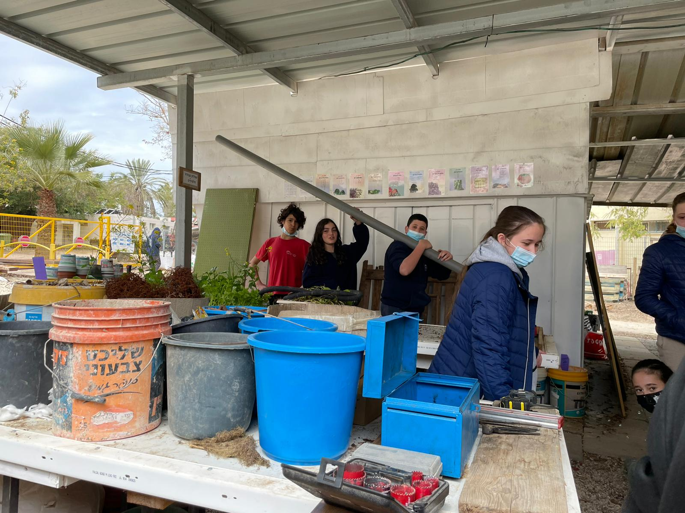
Setting up the experimental system
Hydroponics

Slide 6
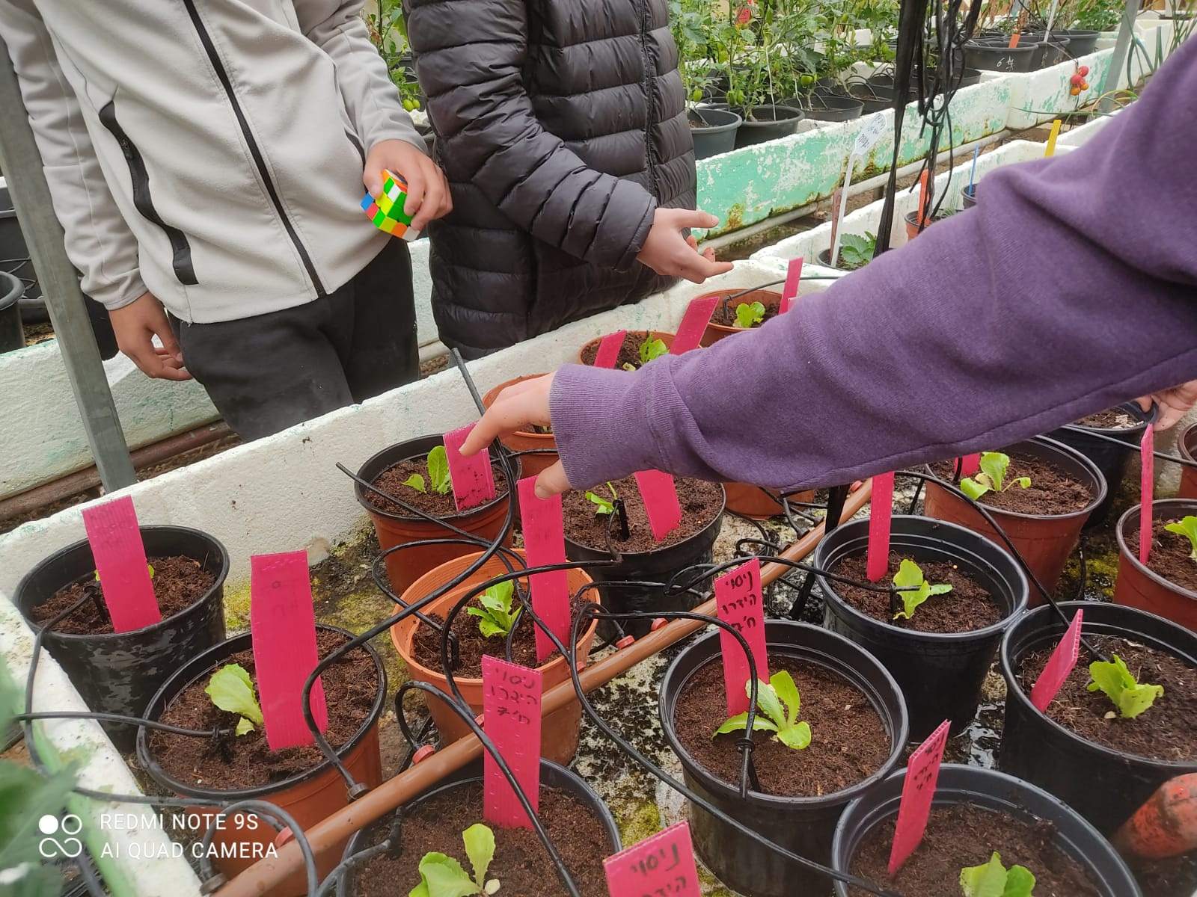
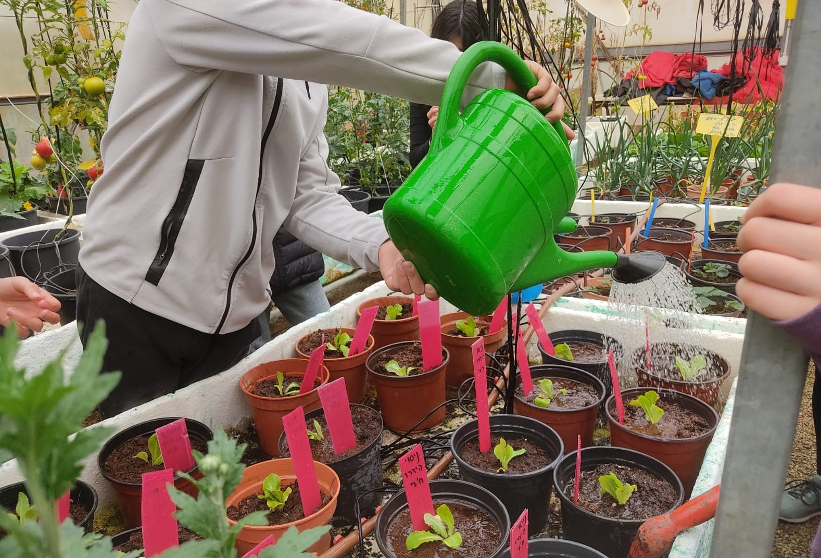
Setting up the experimental system
Planters

Slide 7
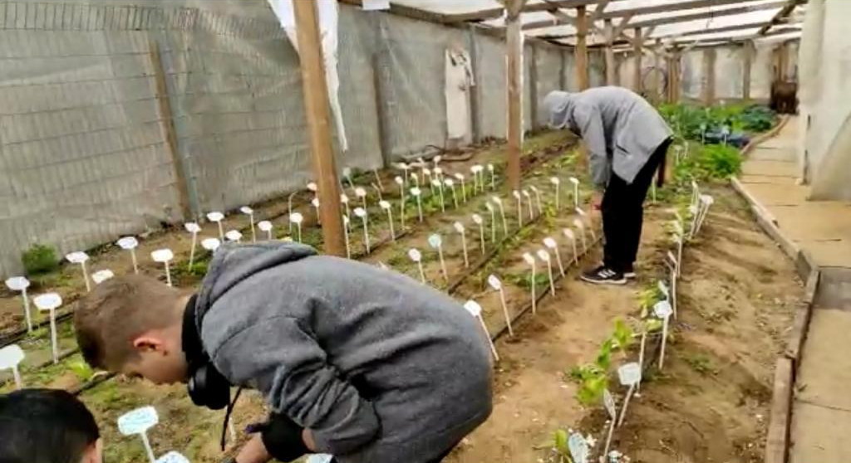
Setting up the experimental system
Flowerbeds

Slide 8
Current Summary
Our project is a complex, longterm one.
We will take it upon ourselves to build and optimize plant growing strategies using hydroponics, so that it will be able to be used by both the average person, companies, and farmers.
In this time of climate change that affects all of us, a hydroponic system allows every person to live in a world where there is symbiosis between plants and ourselves.

