Slide 1



ENERGY
Get energized!!!!
Presented by : Mae Adani, Mika Armbrister

Slide 2
What do we need to know before starting?
Energy is the ability to do work
Energy is required to supply water!
Conservation of energy energy cannot be created or destroyed but can only be converted from one form to another.

Slide 3
Why do we need energy?
Electrical energy:
Homes, schools, factories, businesses
For Light, computers, cell phones, air conditions, machines….
Kinetic energy:
To run
Cars, trains, planes, motorcycle….

Slide 4
Where do we get energy from?
Sources of energy
That are converted to
The energy that we need
Water (hydropower)
Wind
Sun (solar energy)
Natural gas
Coal
Nuclear energy
renewable
Electrical energy
Kinetic energy
nonrenewable

Slide 5
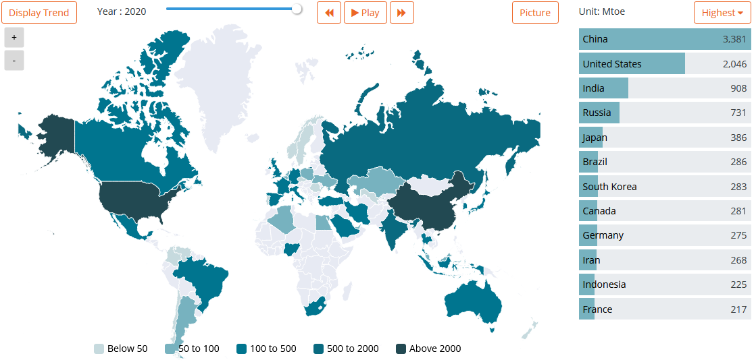
Total energy consumption in 2020
Mtoe, one million toe
1 toe = 11.63 megawatt-hours (MWh)
https://yearbook.enerdata.net/image

Slide 6
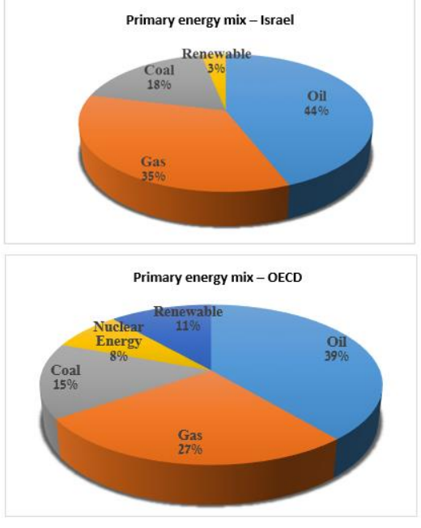
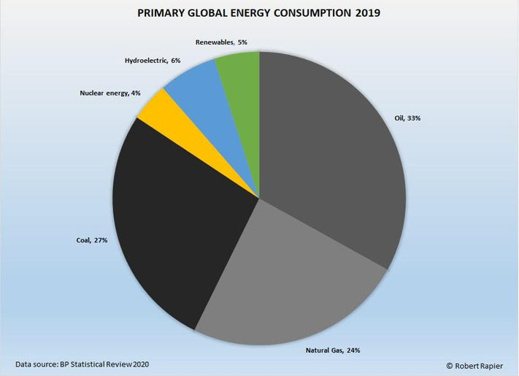
Primary energy consumption mix for 2018

Slide 7
Nonrenewable sources of energy
Source of energy | Pros | Cons | 2018 (Israel) | world
Coal | Relatively abundant and inexpensive | pollution of air, soil, and water bodies emission of CO₂, SO₂, toxic heavy metals, cadmium, arsenic, and mercury | 21% From Columbia, Russia, South Africa to Hadera and Ashkelon | 27%
Gas | Abundant and inexpensive Cleanest of all the fossil fuels (Emits 45% less CO₂ than coal, 30% less CO₂ than oil) | Relatively expensive storage requires long distance pipelines Dangerous contribute to greenhouse gases | 35% Arish-Ashkelon pipeline from Egypt Tamar gas field and Leviathan gas field in Mediterranean Sea | 24%
Nuclear | insignificant carbon emissions More efficient and reliable than fossil fuel Low operating cost | Generates radioactive waste High startup costs Target for terrorist activities Use high amounts of water for production of steam and system cooling | 8-12% Negev Nuclear Research Center near the city of Dimona | 4%
Greenhouse gases result from burning fossil fuel is causing global worming

Slide 8
Renewable sources of energy
Source of energy | Pros | Cons | 2018 (Israel) | world
Water | Does not pollute water or air | May change the temperature and flow of water Disturb river habitats and fish populations Expensive Affected by droughts | - Mediterranean Sea | 17%
Wind | Does not pollute air or water Low operating costs Great potential for powering homes | Intermittent and unpredictable May result in death of bats and birds Noise and visual pollution Biological impacts | 1-6% Genesis wind in Golan | 8.4%
Solar | Abundant, renewable, and sustainable source Does not pollute the air or water Low maintenance | High upfront investment Intermittent Solar panel production emits potent greenhouse gases Requires large space Hard to stoke up solar energy | 1-6% Negev desert region | 4%

Slide 9
Conclusion
We must decrease use of nonrenewable sources
We must increase our renewable energy sources
We think the best renewable energy for Israel is solar source
Solar energy requires large field. Israel has a limited area
We must develop energy capacity of solar panels
And increase energy stockage capacity

Slide 10

Thanks for your attention!!!

