Slide 1
9TH GRADE
Yoana Jabotinski

Slide 2
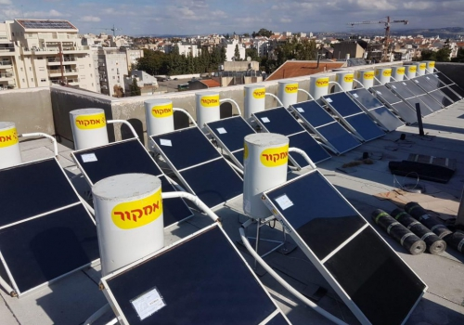
Solar Water Heater
A solar water heater (or “solar boiler”), is the most common installation in the world for solar energy utilization, it is used to heat water by solar radiation. Most of Israel’s roofs are decorated with solar panels using VD radiation

Slide 3
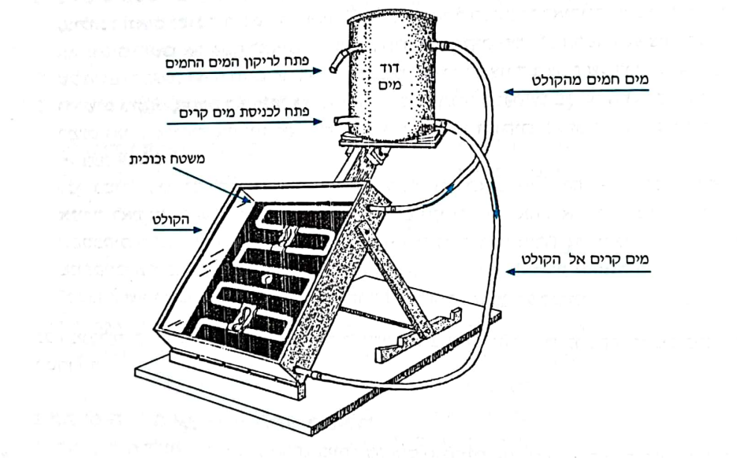
Solar Heater – Structure and Principle of Action.
The boiler structure – The solar boiler consists of 2 parts:
1 water heating device called solar collector.
2. a boiler to collect the hot water.
The collector is composed of a box with a black matte bottom and a transparent top (made of glass or plastic). A water pipe enters the box, coils across the matte flooring and leaves it (see diagram).

Slide 4
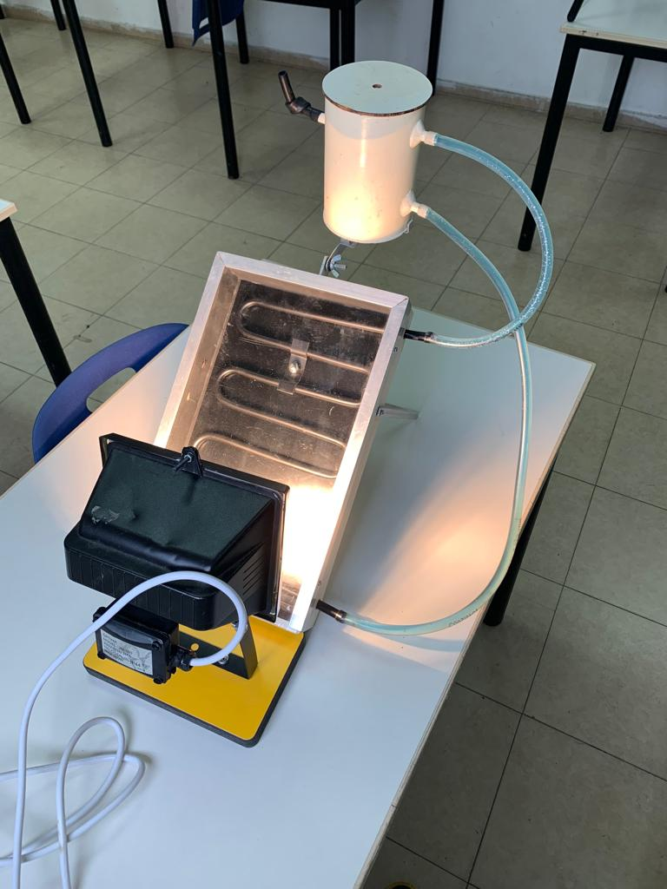
Working principle
As mentioned, a matte surface absorbs almost all the radiation that hits it. Therefore the solar radiation that hits the black matte floor (of the collector) causes it to heat up considerably. The coiled tubing attached to the matte floor is heated by its contact with the floor and the hot air in the collector. Cold water comes from the bottom of the boiler to the coiled pipe, and heat passes from the pipe to the water that reaches it. As a result the water heats up, spreads and rises through the outlet opening to the top of the boiler. This gives way to colder water coming from the boiler to the collector

Slide 5
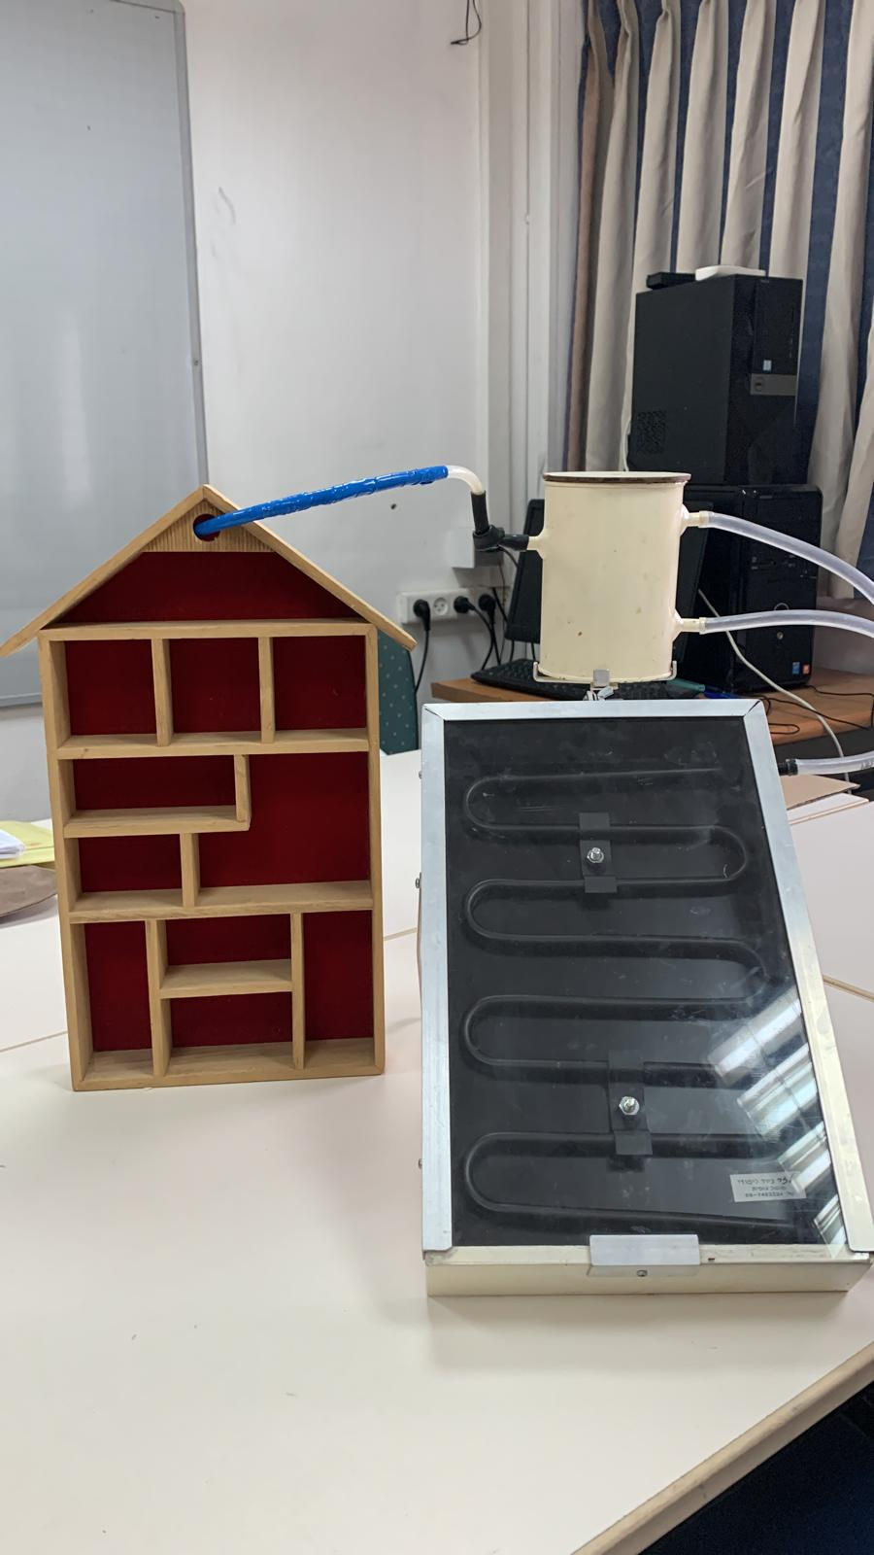
Discussion
The transparent ceiling of the box prevents the evacuation of hot air trapped inside the box. If it were not - gusts of wind would convect the heat from the floor and drive it out of the box. In fact the solar ceiling collector is a small greenhouse

