Slide 1
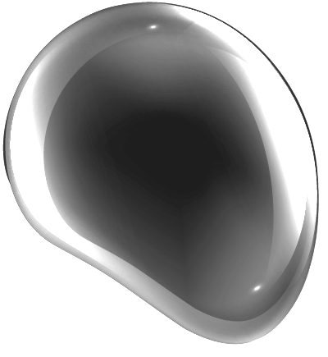
RECYCLING GREYWATER
2022
Saving water
Preserving natural water recourses in our country
Reducing costs related to water
‘QEMAL STAFA’ HIGH SCHOOL
Hands Across Water

Slide 2
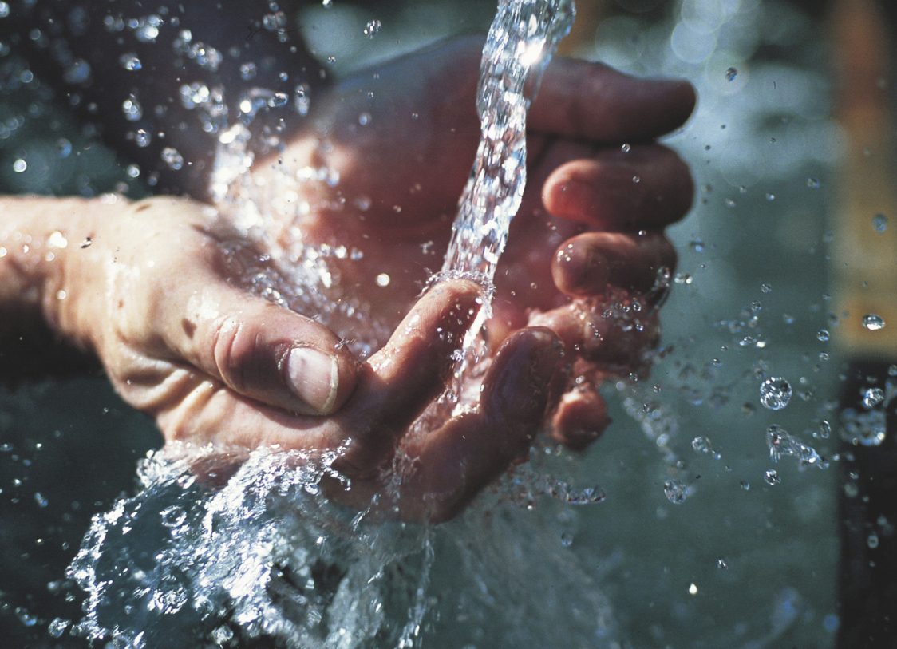
THE ISSUE
HYPOTHESIS
2022
Reusing water discharged from the bathroom sinks and showers of the house to flush our toilets.
Excessive water consumption is major problem in most countries of the world, as well as in Albania.
How can we find an effective way to reduce the amount of running water used in homes and buildings?
SCIENTIFIC QUESTION

Slide 3
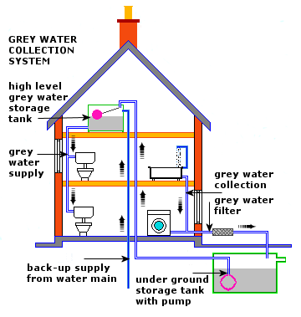
BUT HOW DO WE TREAT GREYWATER?
A household consumes on average 144m³ water per year.
The system is expected to be implemented in 5-storey building with 15 families tested in a period of 5 years.

Slide 4
CALCULATIONS
MATERIALS NEEDED
1m³ of water costs 78L:
78L= 0,64€
842,400L = 7,000€ for 5 years
21% of its daily use is used for toilet flushing
For 15 families this costs 234,000L(2,000€)
We can save about 3 million liters of water in 5 years to pay 608,400L (5,000 €).
 | Costs for plumbing of a building
Pipeline system | 5,000 ALL (40€)
Pumps and tanks | 15,000ALL (120€)
Installation of filters + maintenance (every 5 years) | 80,000 ALL (660€)
Total | 100,000 ALL (820€)

Slide 5
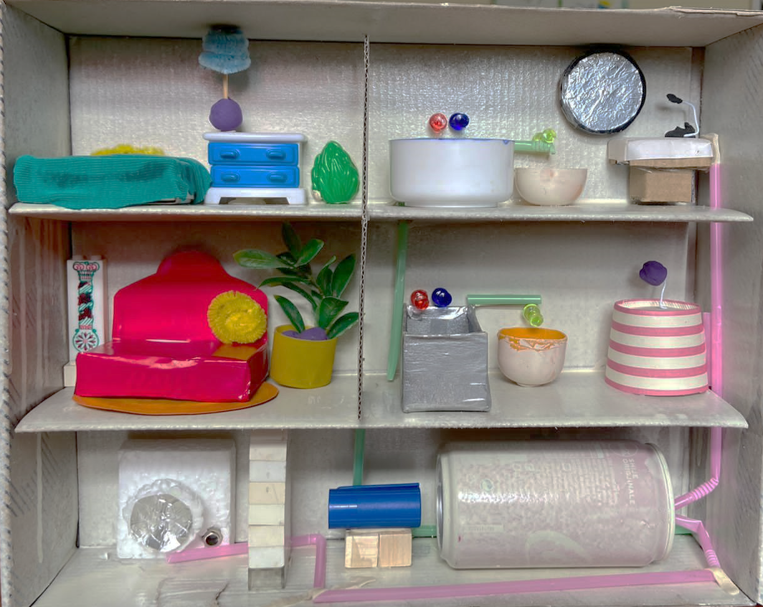
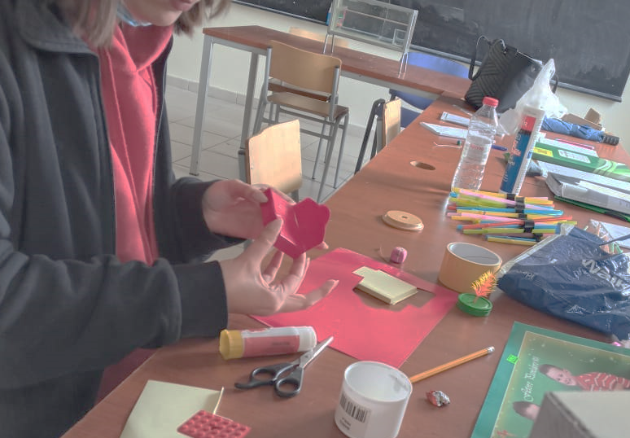
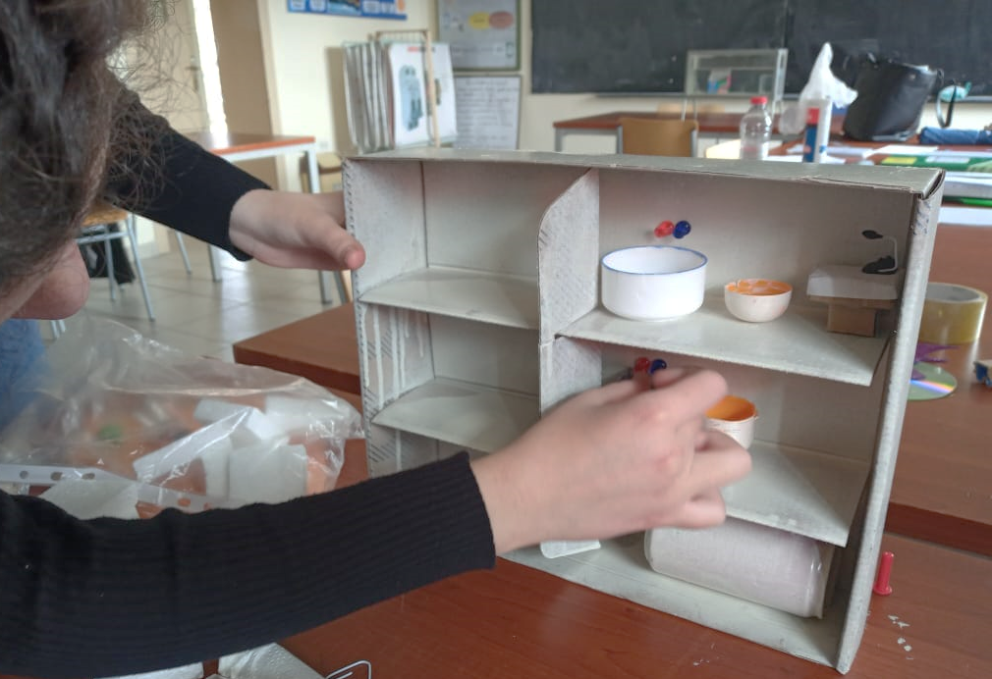
SYSTEM PROTOTYPE OF “WATER RECYCLING HOUSE”
2022
Bathtub
Toilet
Sink
Water tank
Water pump
Drain
Supply

Slide 6
If a building would consume 10 million liters of water in 5 years, it now consumes only 7.7 million.
Costs will be reduced by 20%
This method is beneficial for families that consume a lot of water, large apartments, buildings etc.
2022

Slide 7
THANK YOU!
2022
Do you have any questions?
qemalstafa_tirane@yahoo.com
+355 69 843 6252
gjimnaziqemalstafa.rf.gd
ARTICLES AND REFERENCES:
http://www.shomera.org/initiatives/the-greywater-recycling-initiative/pilot-design/#:~:text=In%202001%2C%20as%20a%20Jerusalem,for%20irrigation%20of%20public%20parks.
http://www.shomera.org/initiatives/the-greywater-recycling-initiative/pilot-design/#:~:text=In%202001%2C%20as%20a%20Jerusalem,for%20irrigation%20of%20public%20parks.
https://bootsiedecent.wordpress.com/2009/06/09/israel-gives-green-light-to-recycling-grey-water/
Worked by: Ana Kellici, Egnald Çela, Alkid Shuli, Perla Koka, Megi Boba, Marsida Xhyra, Luntina Shkreta, Desira Meshaj, Kejda Miftari, Flavina Zefi

