Slide 1
Tap Water Quality in Constanța
vs
Bottled Water
ROTARY HANDS ACROSS WATER
Notes:
Hello everybody! Our names are Delia, Yasmin and Luisa and we represent the group of students from "Mircea cel Batran" National College in Constanta, Romania, who were working on the project we are presenting now.
Our project is called: "Tap Water Quality in Constanța versus Bottled Water" .

Slide 2
Introduction
Over the past few years, bottled water consumption has grown significantly. Many people wonder whether tap water or bottled water is safe?
Research question
Is tap water as good as bottled water?
Hypothesis
Tap water is as safe to drink as bottled water
Methods
1. Quiz
2. Research on the water supply system
3. Observations
4.Experimental research
Notes:
We started our research from the idea that people use too much bottled water when the tap water is plenty.
We wanted to know if they are of equal quality so we wrote a quiz, then did some research in the school laboratories and observations at Water and Sewage Utility Constanța.
In the end we drew some conclusions.

Slide 3
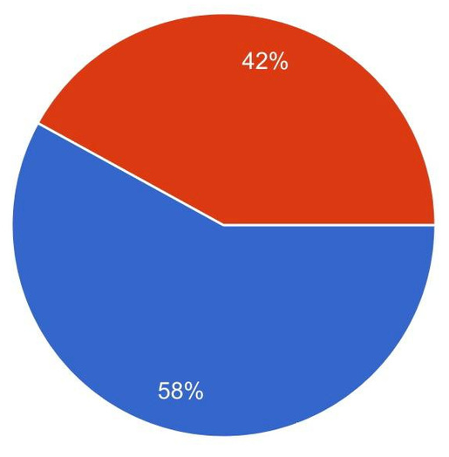
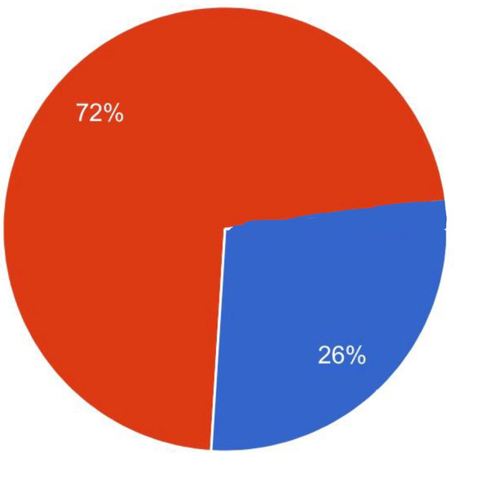
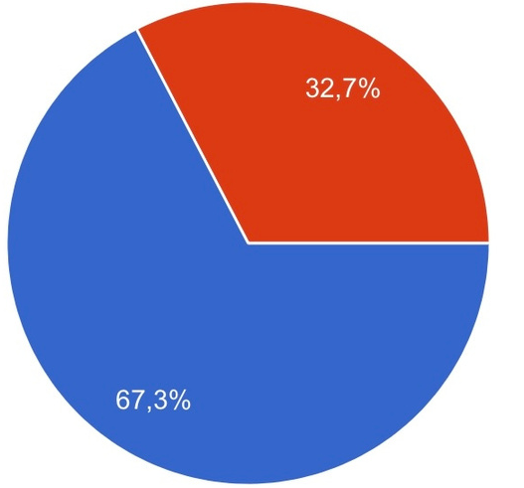
Quiz
Do you drink at least 2L of water daily ?
Do you know that bottled water goes out-of-date?
72% bottled water
26% tap water
42% yes
58% no
32,7% no
67,3% yes
Do you drink tap water or bottled water?
*97 respondents
Notes:
In our questionnaire we asked students about the importance of water in their lives.
The results were almost as expected, but we were surprised about the results regarding tap water and bottled water.
We were curious about the quality of tap water in our houses, so we compared it to the most popular bottled waters in Romania.

Slide 4
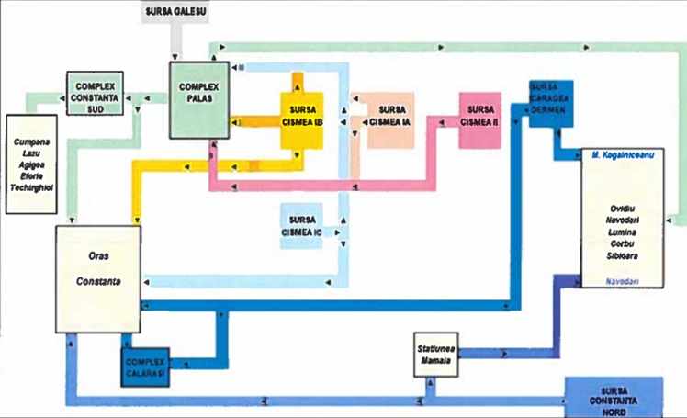
Water and Sewage Utility Constanța
Notes:
The Water and Sewage Utility Constanța has a complex system for storage and pumping.
Water sources in Constanța are both from underground and from the surface.
There are three main facilities for water to be captured, treated and pumped into the city and the water samples we studied were provided from two that are circled in red on the figure.

Slide 5
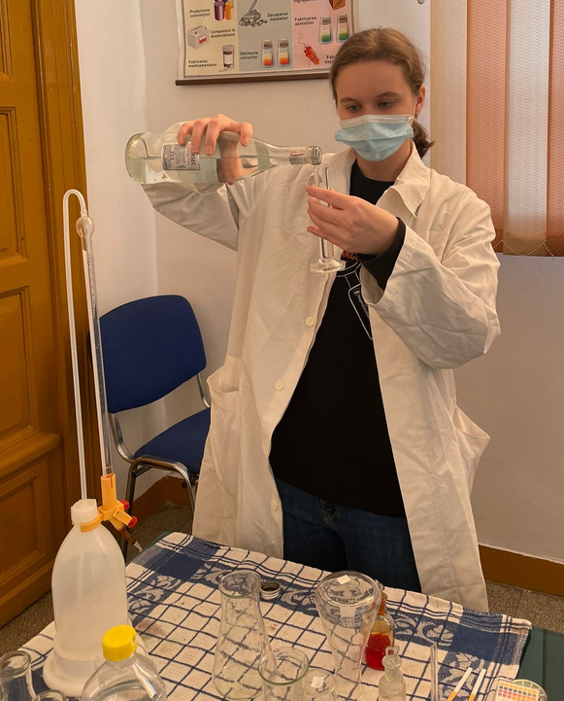
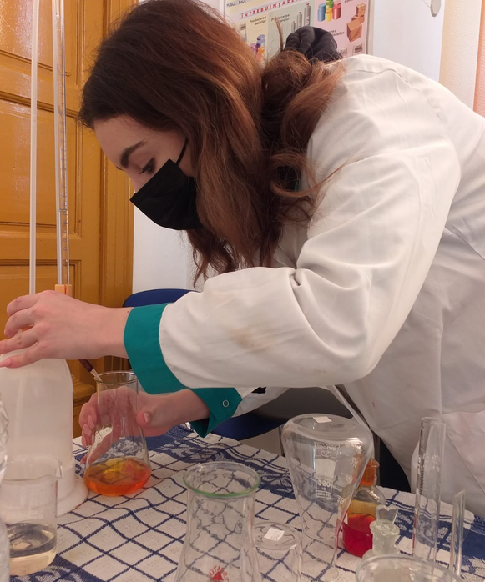
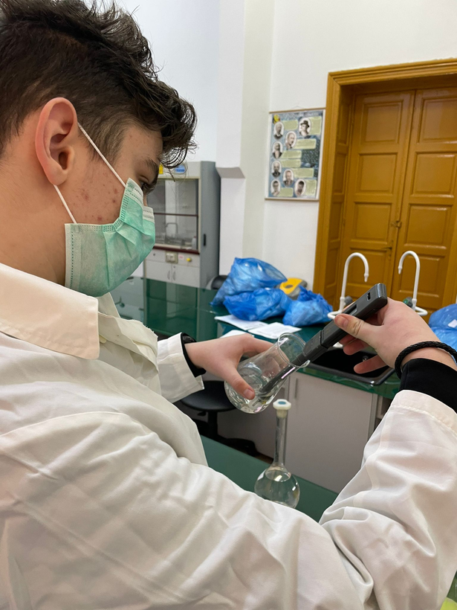
Research in the School’s Biology and Chemistry Laboratories
Notes:
In the school's laboratories, we made microscopic observations and chemical analizes of four samples of tap water from different parts of the city and two samples from bottled water (Dorna and Borsec).
We used microscopic blades in order to detect bacteria (E.coli and enterococus) on our microscopes.
We measured the alkalinity ( partial and total ) and the pH using different methods.
We also made observations on the smell, colour and taste of the samples we had and we concluded they fitted in the national and international standards.

Slide 6
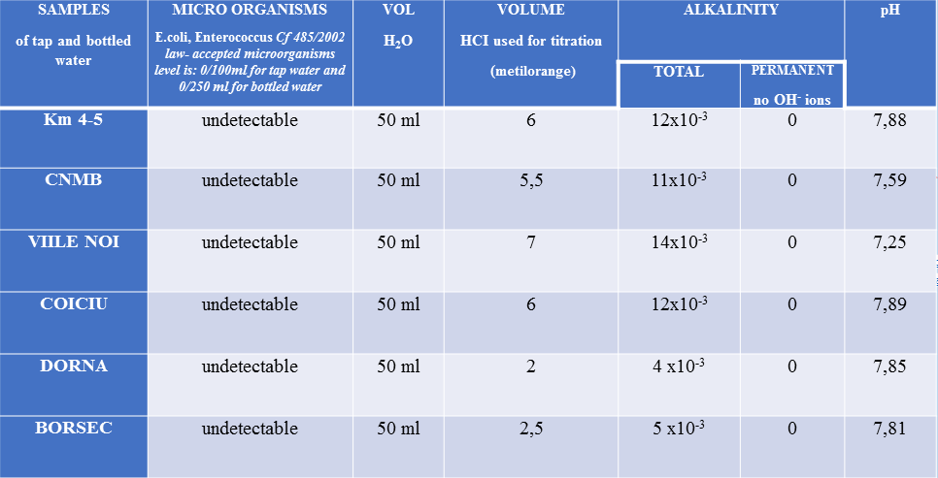
Notes:
Both tap water and bottled water had no bacteria (no Escherichia coli and no Enterococcus) as the 485/2002 law provided.
The total alkalinity is due to the ions carbonate, phosphate, acid carbonate.
The concentration of carbonate and acid carbonate ions in the tap water samples is higher than the concentration of the same ions from the bottled water.
The conclusion is that all the samples contain a certain amount of carbonate, phosphate and acid carbonate ions, but within normal limits.
All the water samples have zero permanent alkalinity, which means that they do not contain hydroxide ions.
The pH of all water samples is between 7 and 8, which conforms with the legal standards (between 6,5 and 9,5).

Slide 7
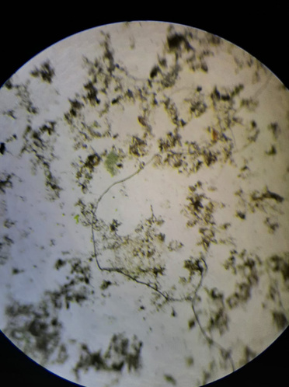
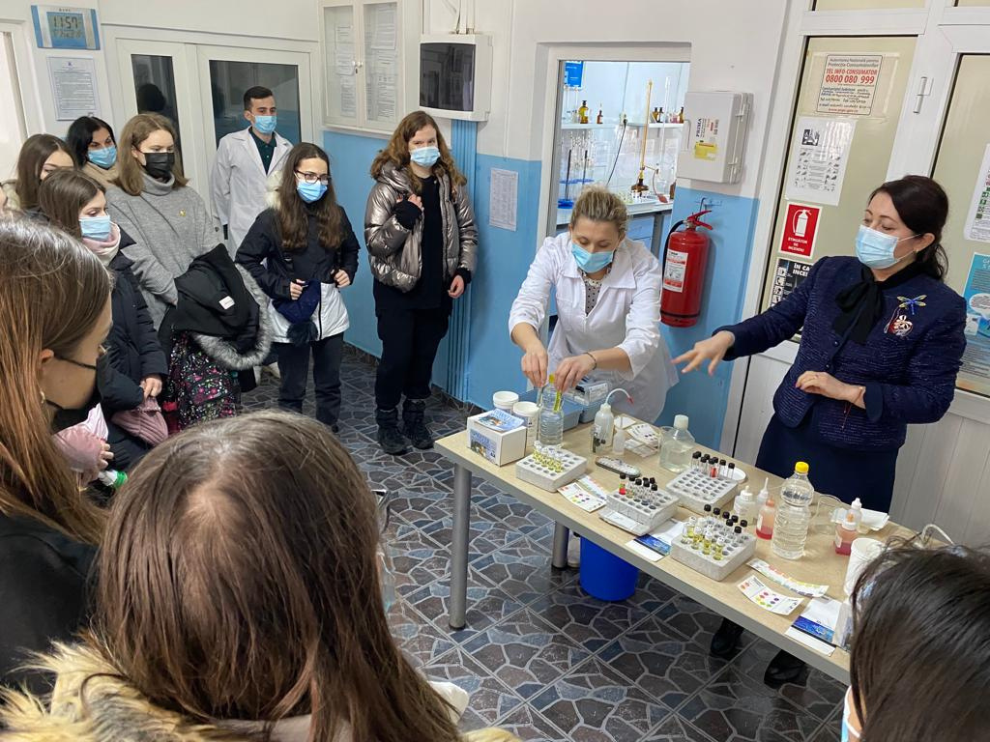
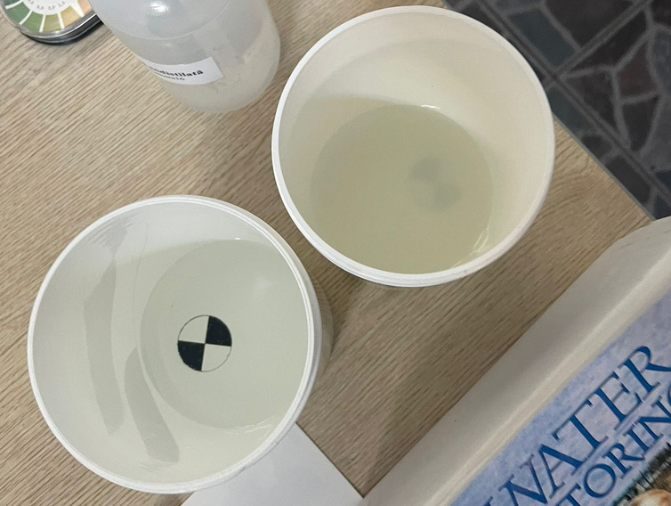
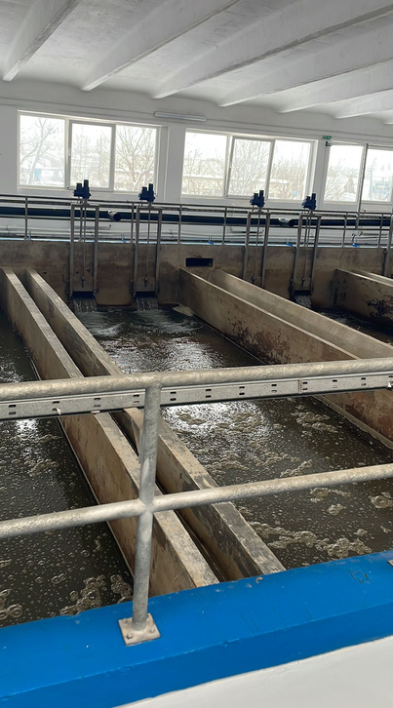
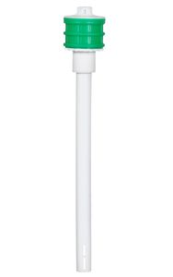
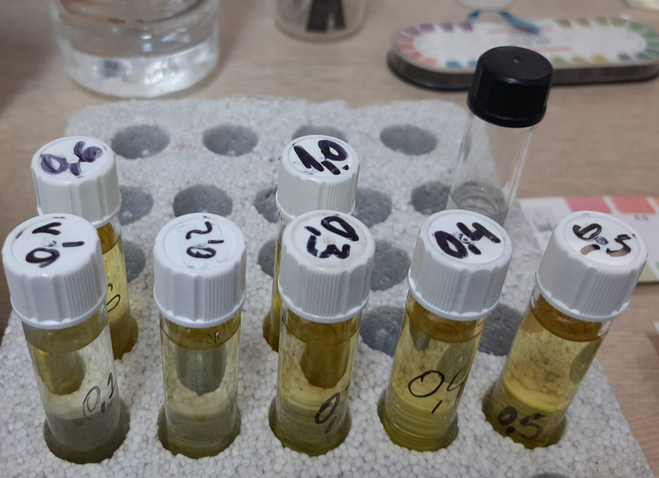
Visit to Water and Sewage Utility Constanța
3
1
2
4
Notes:
We also visited the largest facility of the Water and Sewage Utility Constanța.
During our visit, we saw filtering basins for surface water, we were demonstrated the chlorine concentration, the turbidity of water and also observed residual bacteria from non-treated water.
We learned from specialists that the water in our city is safe for drinking, despite the common opinion (72 percent in our questionnaire ).

Slide 8
AFTER CONCLUSIONS
CONCLUSIONS:
All water samples have:
no smell, no colour and good taste
undetectable microorganisms
zero permanent alkalinity
total alkalinity within normal limits
the pH between 7 and 8.
.
drink
more
tap
water!
Notes:
There are several conclusions:
1.The organoleptic qualities of the water we studied are excellent
2. There are no detectable microorganisms - water is safe
3. Permanent alkalinity is zero
4. The pH is very good to excellent
5. Total alkalinity conforms the standards
Therefore: DRINK MORE TAP WATER!

Slide 9
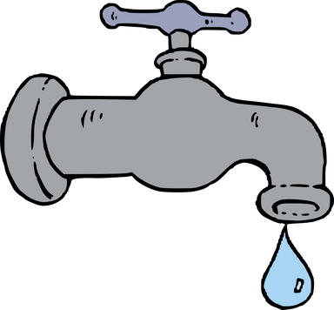
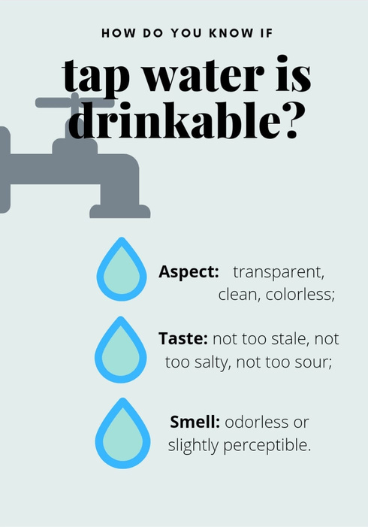
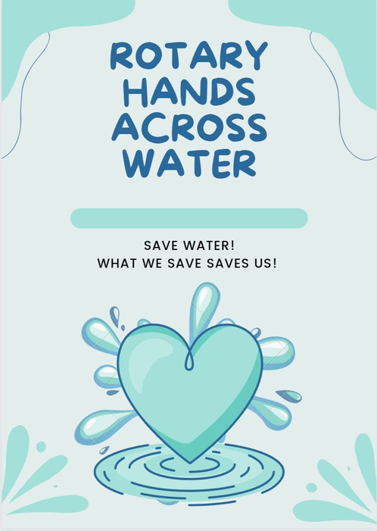
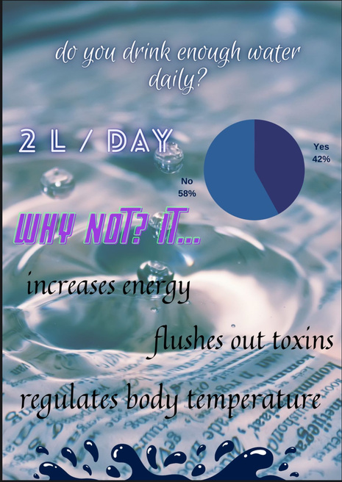
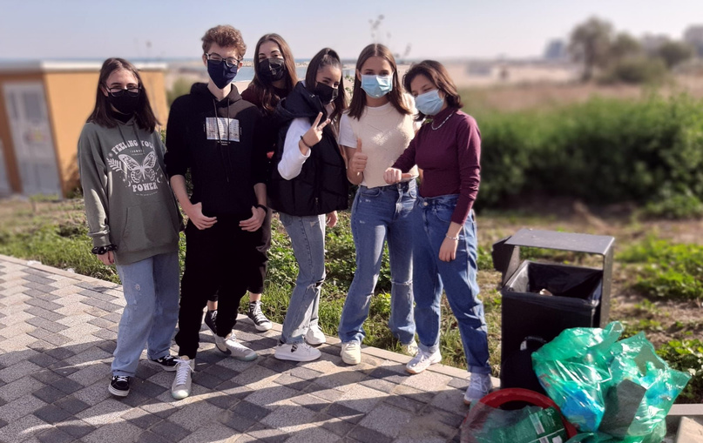
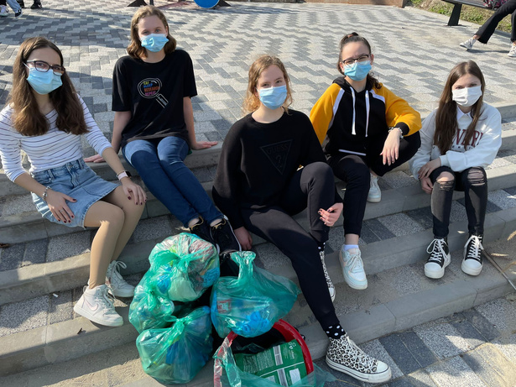
After conclusions
Tap water and bottled water are both safe
Tap water
+ Reduces plastic pollution
+ Does not expire
+ It is cheaper
Bottled water
+ Can be carried
+ Easy to find
+ A wide variety of pHs
Notes:
There are certain positive aspects with regards to both tap and bottled water, but ONE IMPORTANT ASPECT IS THAT BY USING TAP WATER WE REDUCE POLLUTION AS WELL. We campaigned against pollution and we cleaned the Black Sea shore near our college.
We decided to raise awareness about the quality of tap water, equal to bottled water and we made posters, leaflets and flyers.

Slide 10
Special thanks to
Water and Sewage Utility Constanța
Rotary Club “Pontus Euxinus” Constanța
Prof. Gabriela Maeschi – CNMB Constanța
ROTARY HANDS ACROSS WATER
Notes:
THANK YOU FOR YOUR ATTENTION!!

