Slide 1
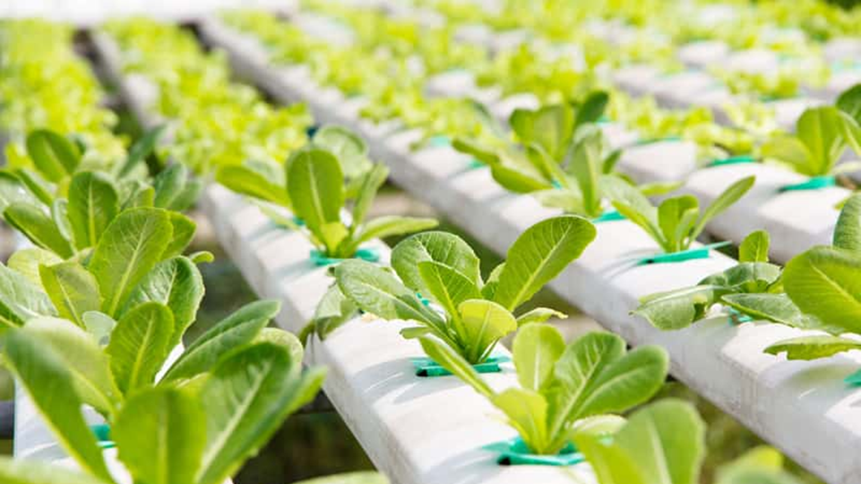
Project – hydroponic cultivation of plants in our school

Slide 2
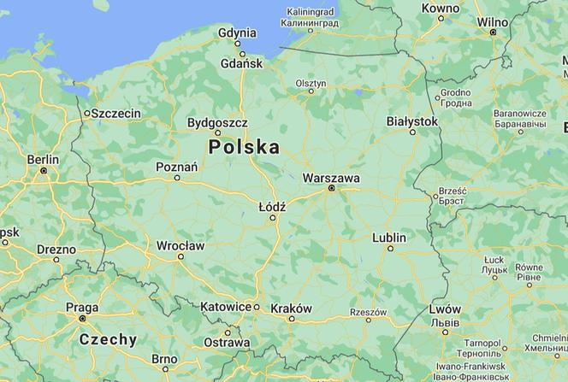
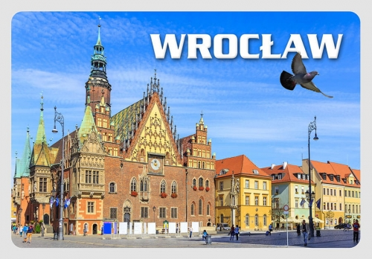
Secondary School nr VII in Wrocław

Slide 3
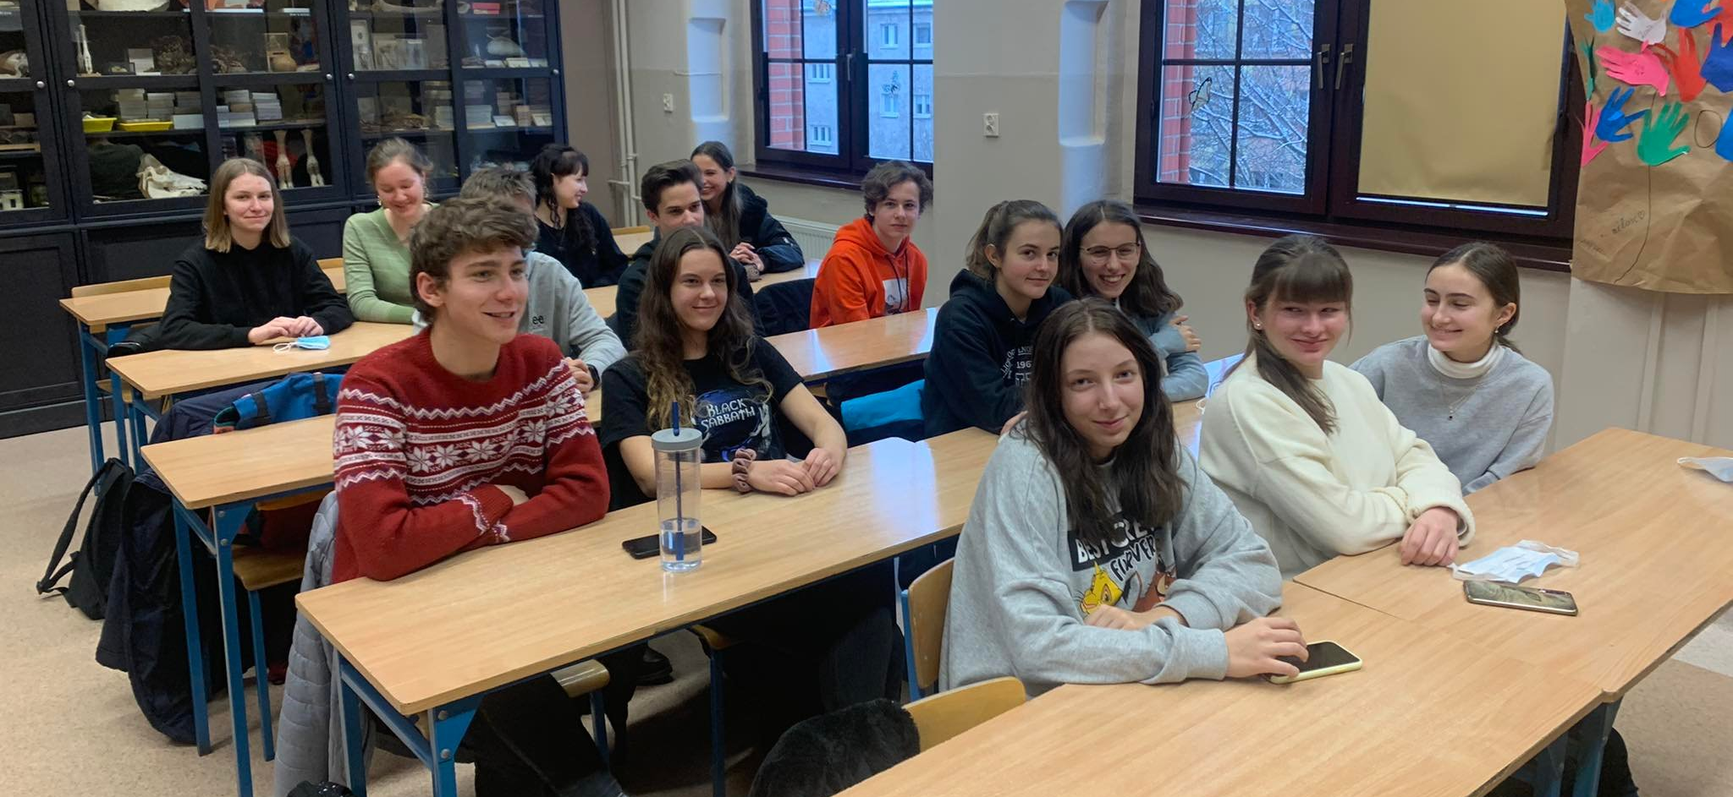
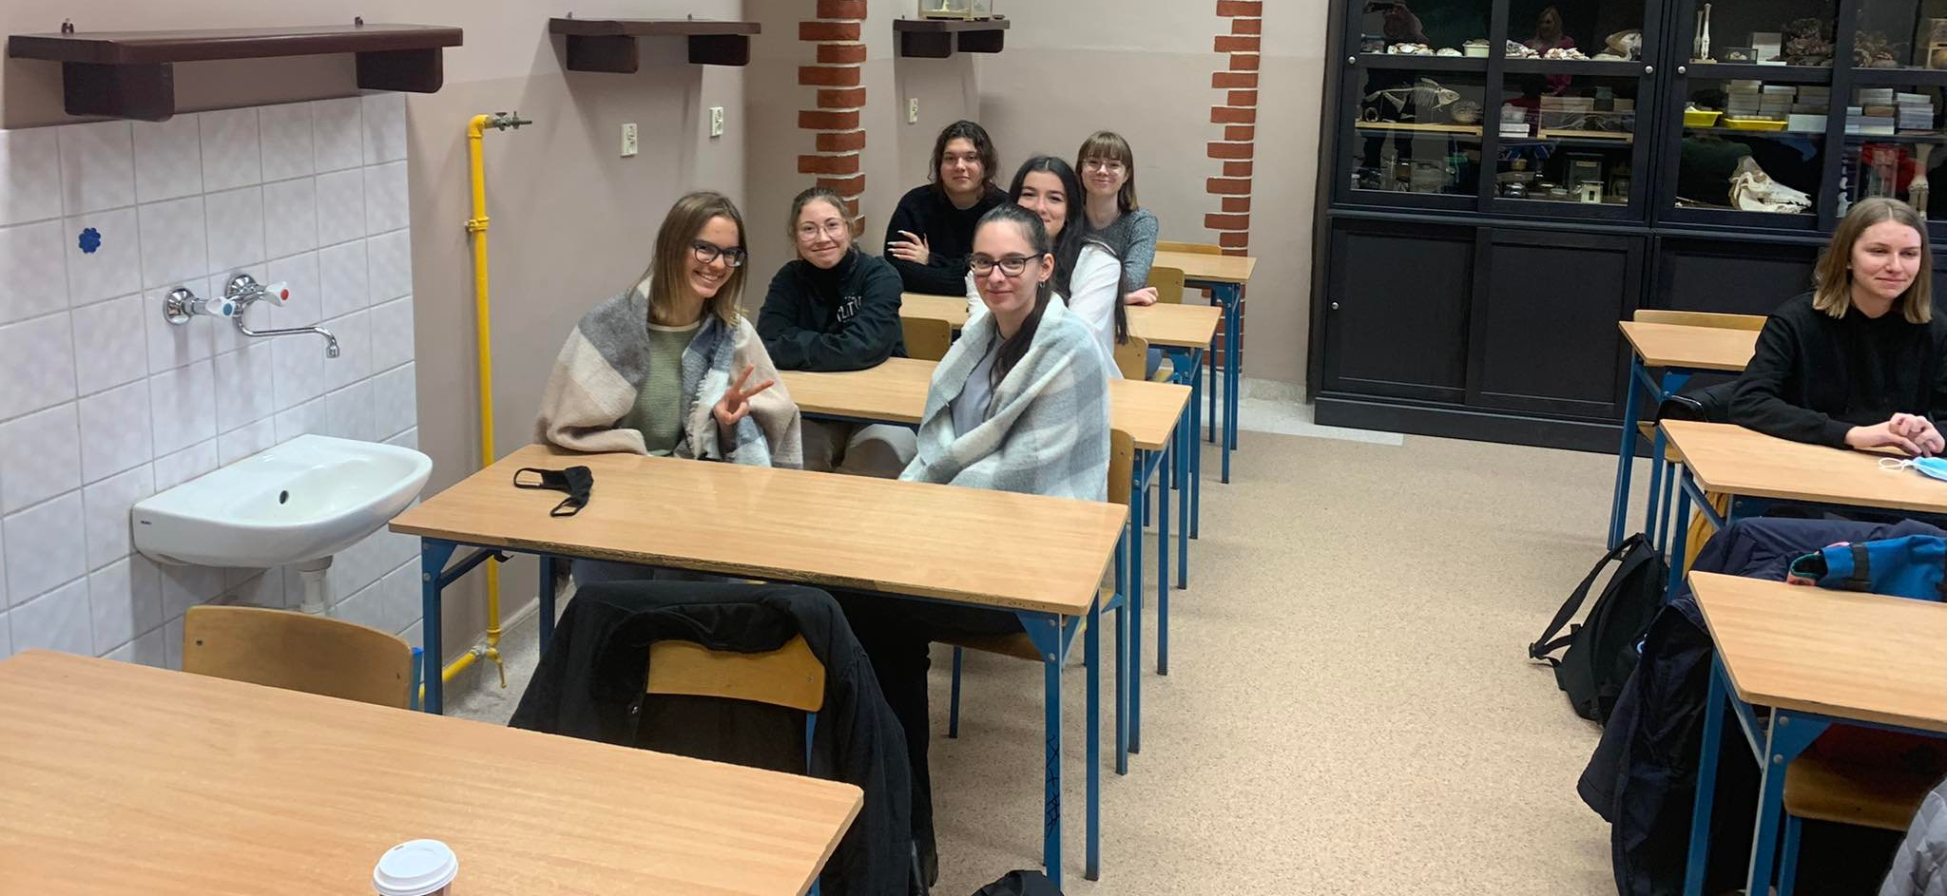
The project involves 21 third-grade students of the secondary school and two biology teachers: Klaudia Karmińska and Tomasz Ostrowski.

Slide 4
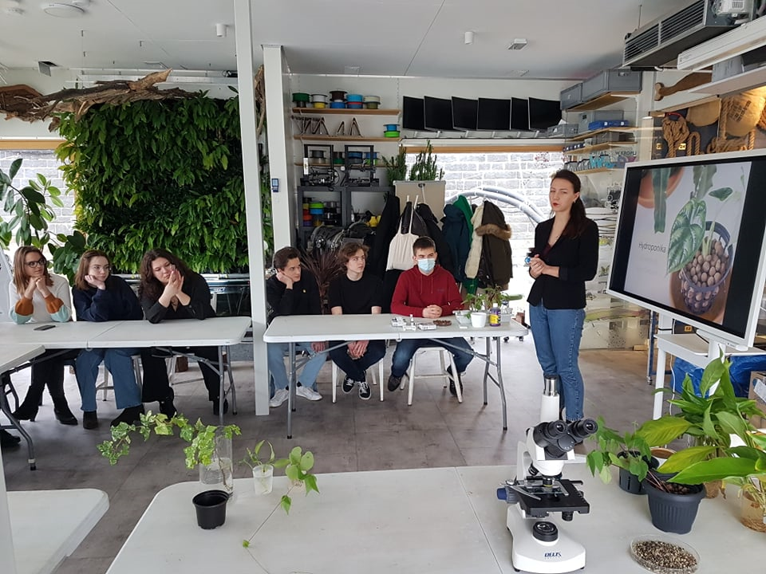
During the lessons of the STEAM group:
We got to know the properties, functions of water, methods of obtaining water, the best conditions for hydroponic breeding;
We took part in a workshop at the Odra Centrum Foundation.

Slide 5
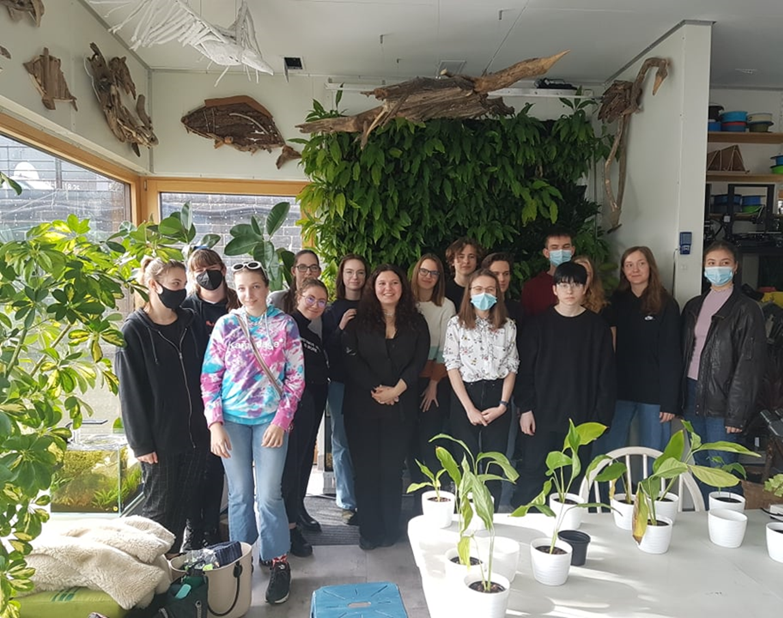
We set up the cultivation of passive hydroponics.

