Slide 1
HYDRO
PURE
HYDROPURE
WORKED ON THIS PROJECT: Alisia Naska, Anja Xifaj, Shendi Çollaku, Uendi Loka, Xhoana Pepa
“Ismail Qemali” high school
Rotary Hands Across Water
Tirana International

Slide 2
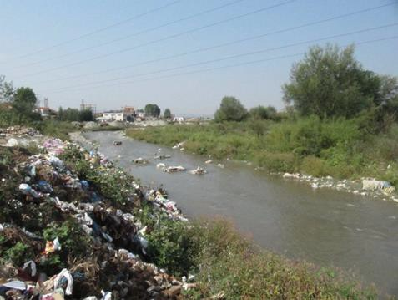
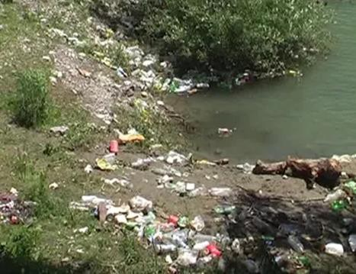
Concrete cases of river pollution in Albania
THE PROBLEMS
THE PROBLEMS With Water Supply IN ALBANIA
Tirana’s river in Dibra
Supplies are often irregular due to power outages, inadequate piping and system failures
The infrastructure that supports the network is old, bad, and in need of much improvement.
A number of rivers in Albania contain pollutants caused by uncontrolled industrial spills that may include oils and phenols, cadmium, zinc and magnesium, making them unfit for consumption if not treated properly.
The losses in the network are large and only 50% of the water reaches the consumers.
Household plumbing systems are also not well maintained as there is no incentive for consumers to save water.
HYDRO
PURE

Slide 3
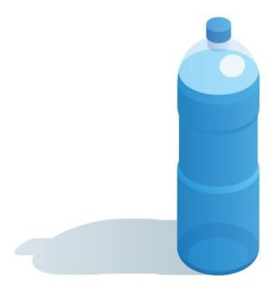
SAMPLE WATER ANALYSIS REPORT
PARAMETER | TAP WATER | DRINKING WATER
Color | 3 Pt/Co | 15 Pt/Co
pH | 6.5 | 6.5-8.5
Taste | normal | tasteless
Chloride | 140.41 mg/l | 250 mg/l
Odor | negative | odorless
Aluminum | below 0.20 mg/l | 0.2 mg/l
Nitrate | below 0.11 mg/l | 10 mg/l
Total Bacteria | 6.9 x 102 per ml | 1.0 x 102 per ml
WAYS OF SUPPLY WATER IN TIRANA
bottled water- 40% underground wells water- 13% tap water- 47%
HYDRO
PURE

Slide 4
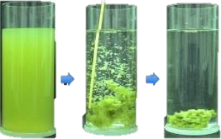
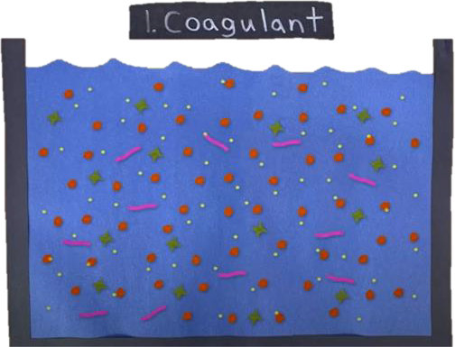
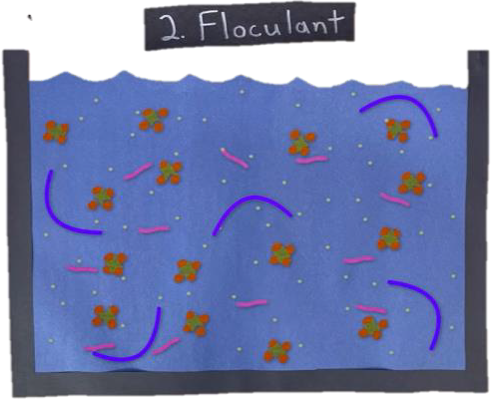
THE SOLUTION
HYDRO
PURE
POLYGLU
H y d r o P u r e
The key ingredient of the powder is a polymer of the amino acid glutamic acid, a coagulant made
from fermented soybeans, which helps quicken the coagulation of impurities in water.
How does it work?
One gram of the PolyGlu powder is capable of treating up to five liters of polluted water, which makes this powder very effective.
1.
2.
3.
The water is filled with lots of dirt particles, parasites and bacteria. It’s
basically seed crystals that are positively charged.
The dirt in the water is negatively charged, these seed crystals act like dirt magnets.
The flocculant is a polymer, which you can think about as having long arms that wrap up all the little dirt magnet clumps.
PolyGlu sticks to dirt in water and makes it sink to the bottom.

Slide 5
^{P}T^{L}H^{AN}E^{N}H^{ING}YDROPURE IDEA
The Hydropure Idea – as we like to call it – is our water purifying idea, which consists in the innovative combination of the use of polyglu and filtration in a scale of three water tanks.
As mentioned before, we will be using rainwater, as our water source. The main aim of our project is to turn the rainwater, into drinking water.
Without further ado, let’s get started!
HYDRO
PURE

Slide 6
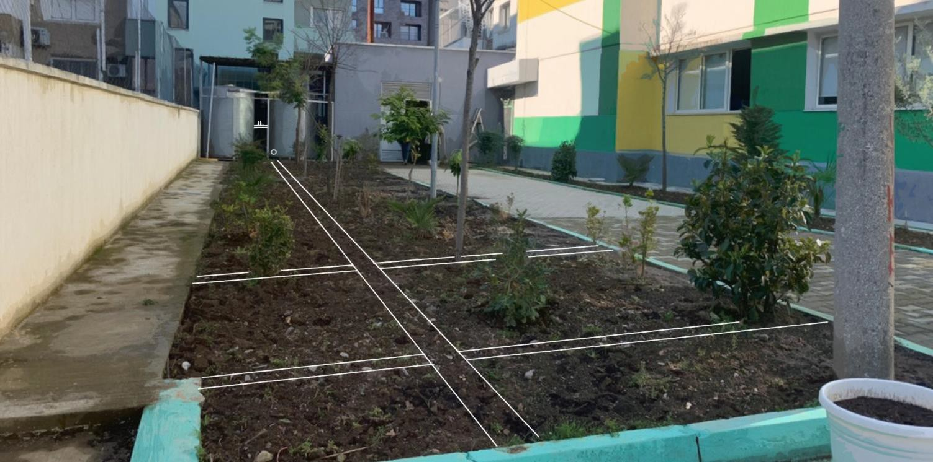
AN IMAGE OF THE IDEA
In this image we have taken a picture of our high school and we made a sketch on top of it, describing in a visual way how the pipes are going to go across the small garden, in order to water the soybean plants.
HYDRO
PURE

Slide 7
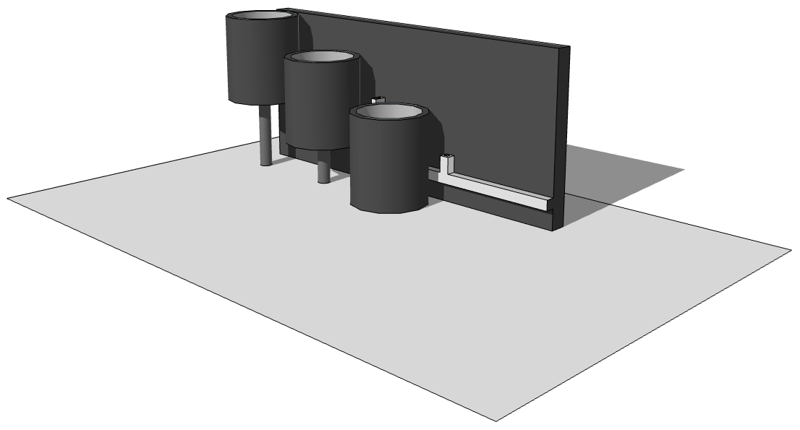
THE HYDROPURE IDEA
FIRST TANK: In the first tank, we will pour our substance: polyglu. This will be the first step in water filtration due to the coagulation of impurities by polyglu.
SECOND TANK: In the second tank, we will have placed sand and carbon. Sand and carbon filtration are typically used for achieving removals of suspended solids and pathogens not destroyed by the first process.
THIRD TANK: This is the last step. According to expectations, in the 3rd tank we will have eliminated impurities and pathogens and we will have obtained clean water.
HYDRO
PURE

Slide 8
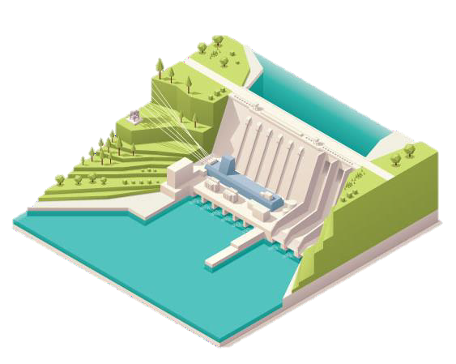
THE ADVANTAGES AND DISADVANTAGES
OF USING POLYGLU AS A METHOD OF WATER FILTERING
HYDRO
PURE
ADVANTAGES
It is an inexpensive method of water filtering.
It is made out of an organic product such as soybean. The process can happen under minutes.
DISADVANTAGES
Soybeans grow only during warm seasons. It still needs upgrades as an idea.
COST PER UNIT OF THE PRODUCTS
1 water deposit 500 liters- 9900 lekë/ 118.82 euro
1 kg soybeans- 357.36 lekë/ 2.94 euro
1 bag of charcoal (3kg) - 490 lekë/ 4.05 euro

Slide 9
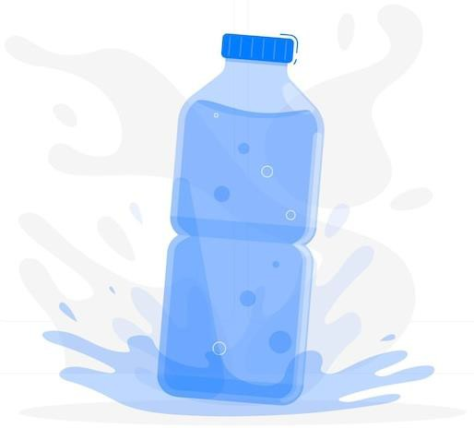
CONCLUSIONS AND ANALYSIS
We see as an effective solution:
1.
The use of polyglu, as a powerful cleaning and filtration coagulant, which we will ferment by ourselves, a process for which
will be needful soybeans, the cost of which
goes 357.36 lekë or 2.94 euro per kilogram.
Cost reduction for each student about their individual purchase of water ( which
also will bring the reduce of using plastic).
Construction of the system consisting of 3 tanks, which will contain 500 liters each and will go to a cost of 9900 lekë or 118.82 euro each.
Cleaning and maintenance of deposits is taken as an individual responsibility by our school.
HYDRO
PURE

Slide 10
HYDRO PURE
THANK YOU!
“Ismail Qemali” high school
this project was made possible by the work of the students of “Ismail Qemali” gymnasium
WORKED ON THIS PROJECT: Alisia Naska, Anja Xifaj, Shendi Çollaku, Uendi Loka, Xhoana Pepa
Rotary Hands Across Water
Tirana International

