Slide 1
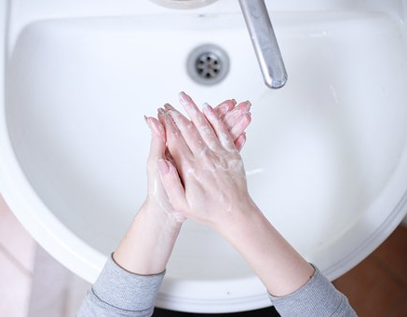
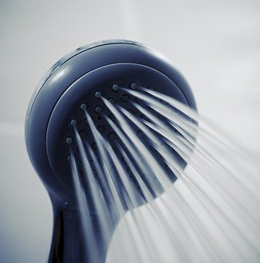
Gray water - bathroom water recovery system project

Slide 2
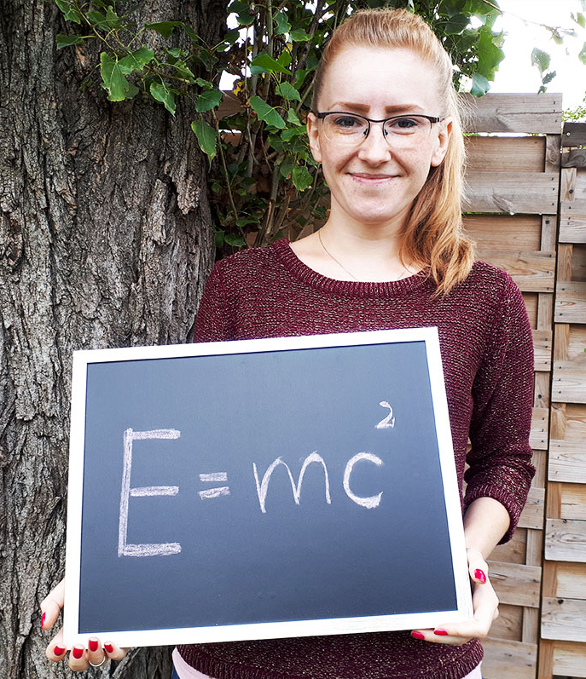
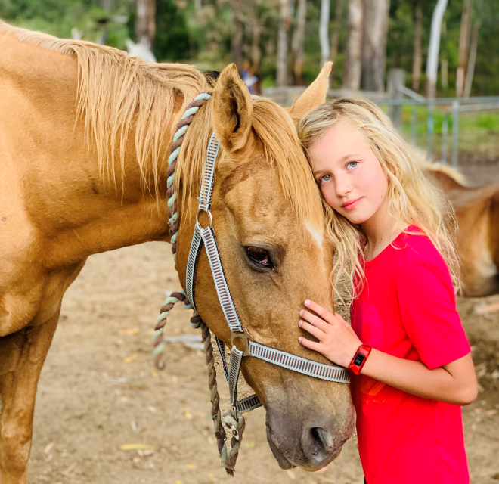
Leading teacher – physics​
Weronika Andrzejewska​

Slide 3
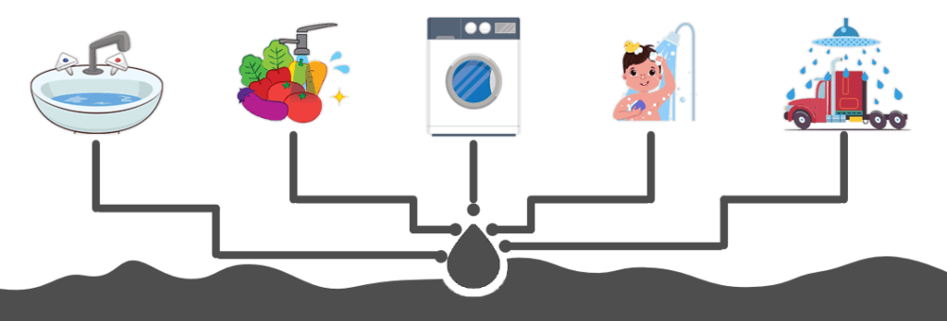
What is greywater?

Slide 4
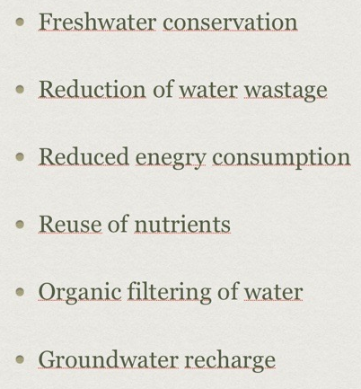
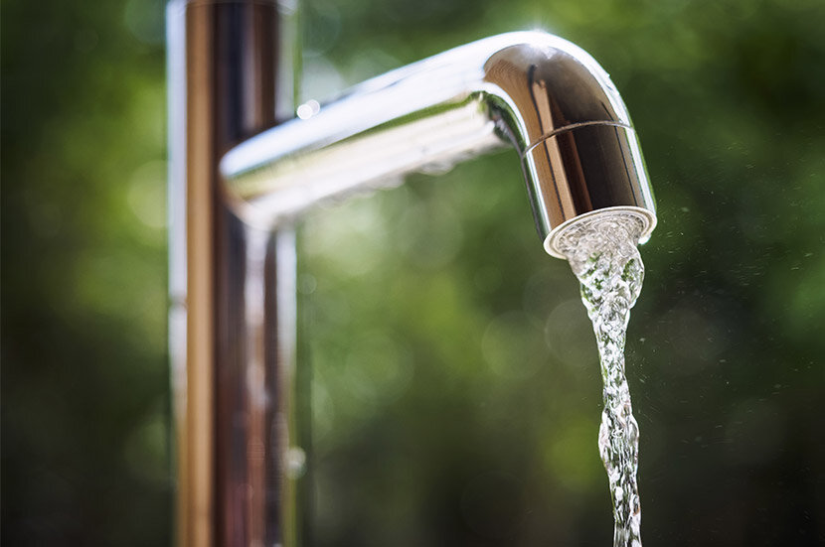
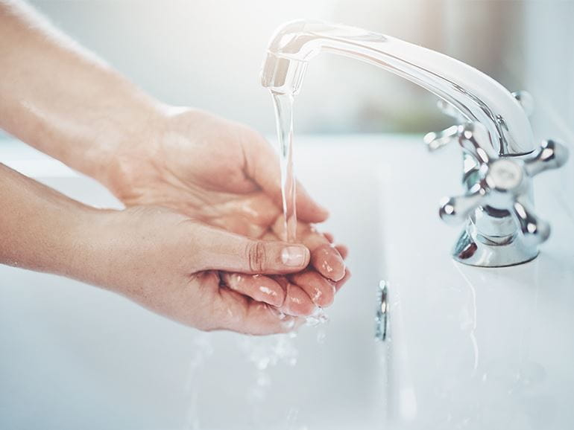

Slide 5
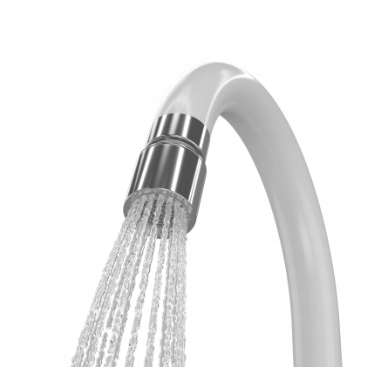
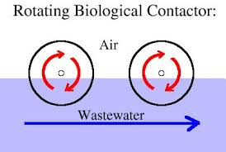
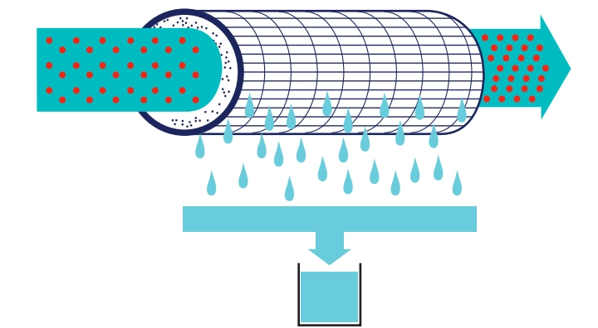
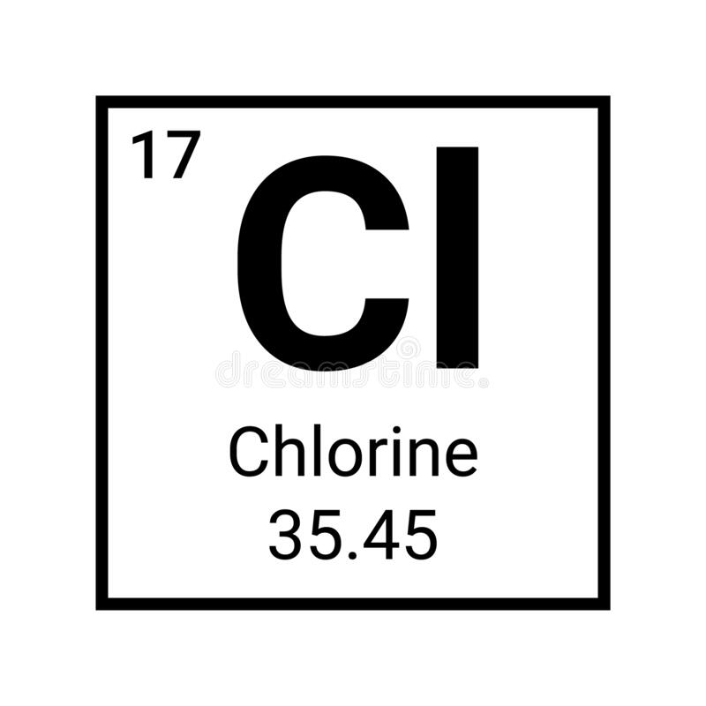
What type of filtration should we use to recycle greywater?
1. Pre-treatment
2. Biological
treatment
3. Filtration
4. Disinfection
Kliknij, aby dodać tekst

Slide 7
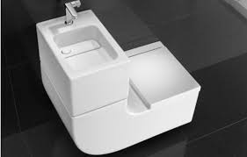
Performance
7.5l/min *2 per day * 100 students = 1500 l for washing hands (ONE DAY)
7l/min *2 per day * 100 students = 1400 l for flushing the toilet (ONE DAY)

Slide 8
Acknowledgements
Anna Stawikowska,
Rotary Toruń
Bartosz Szablewski
Rotary Poznań
szkola@omegaszkola.edu.pl

