Slide 1
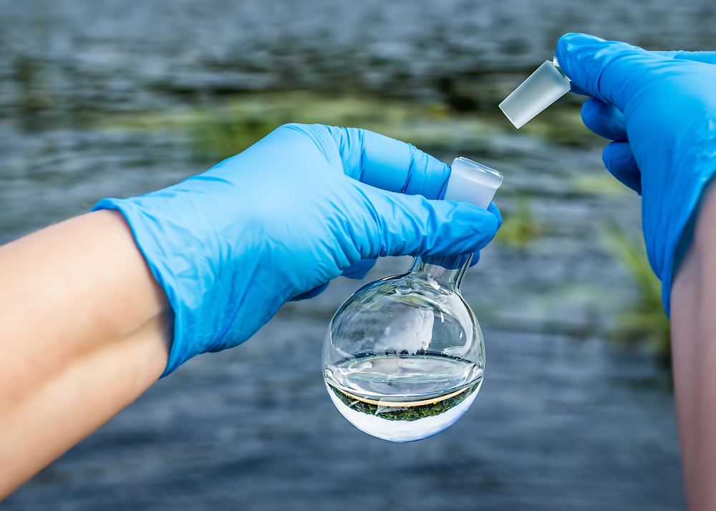
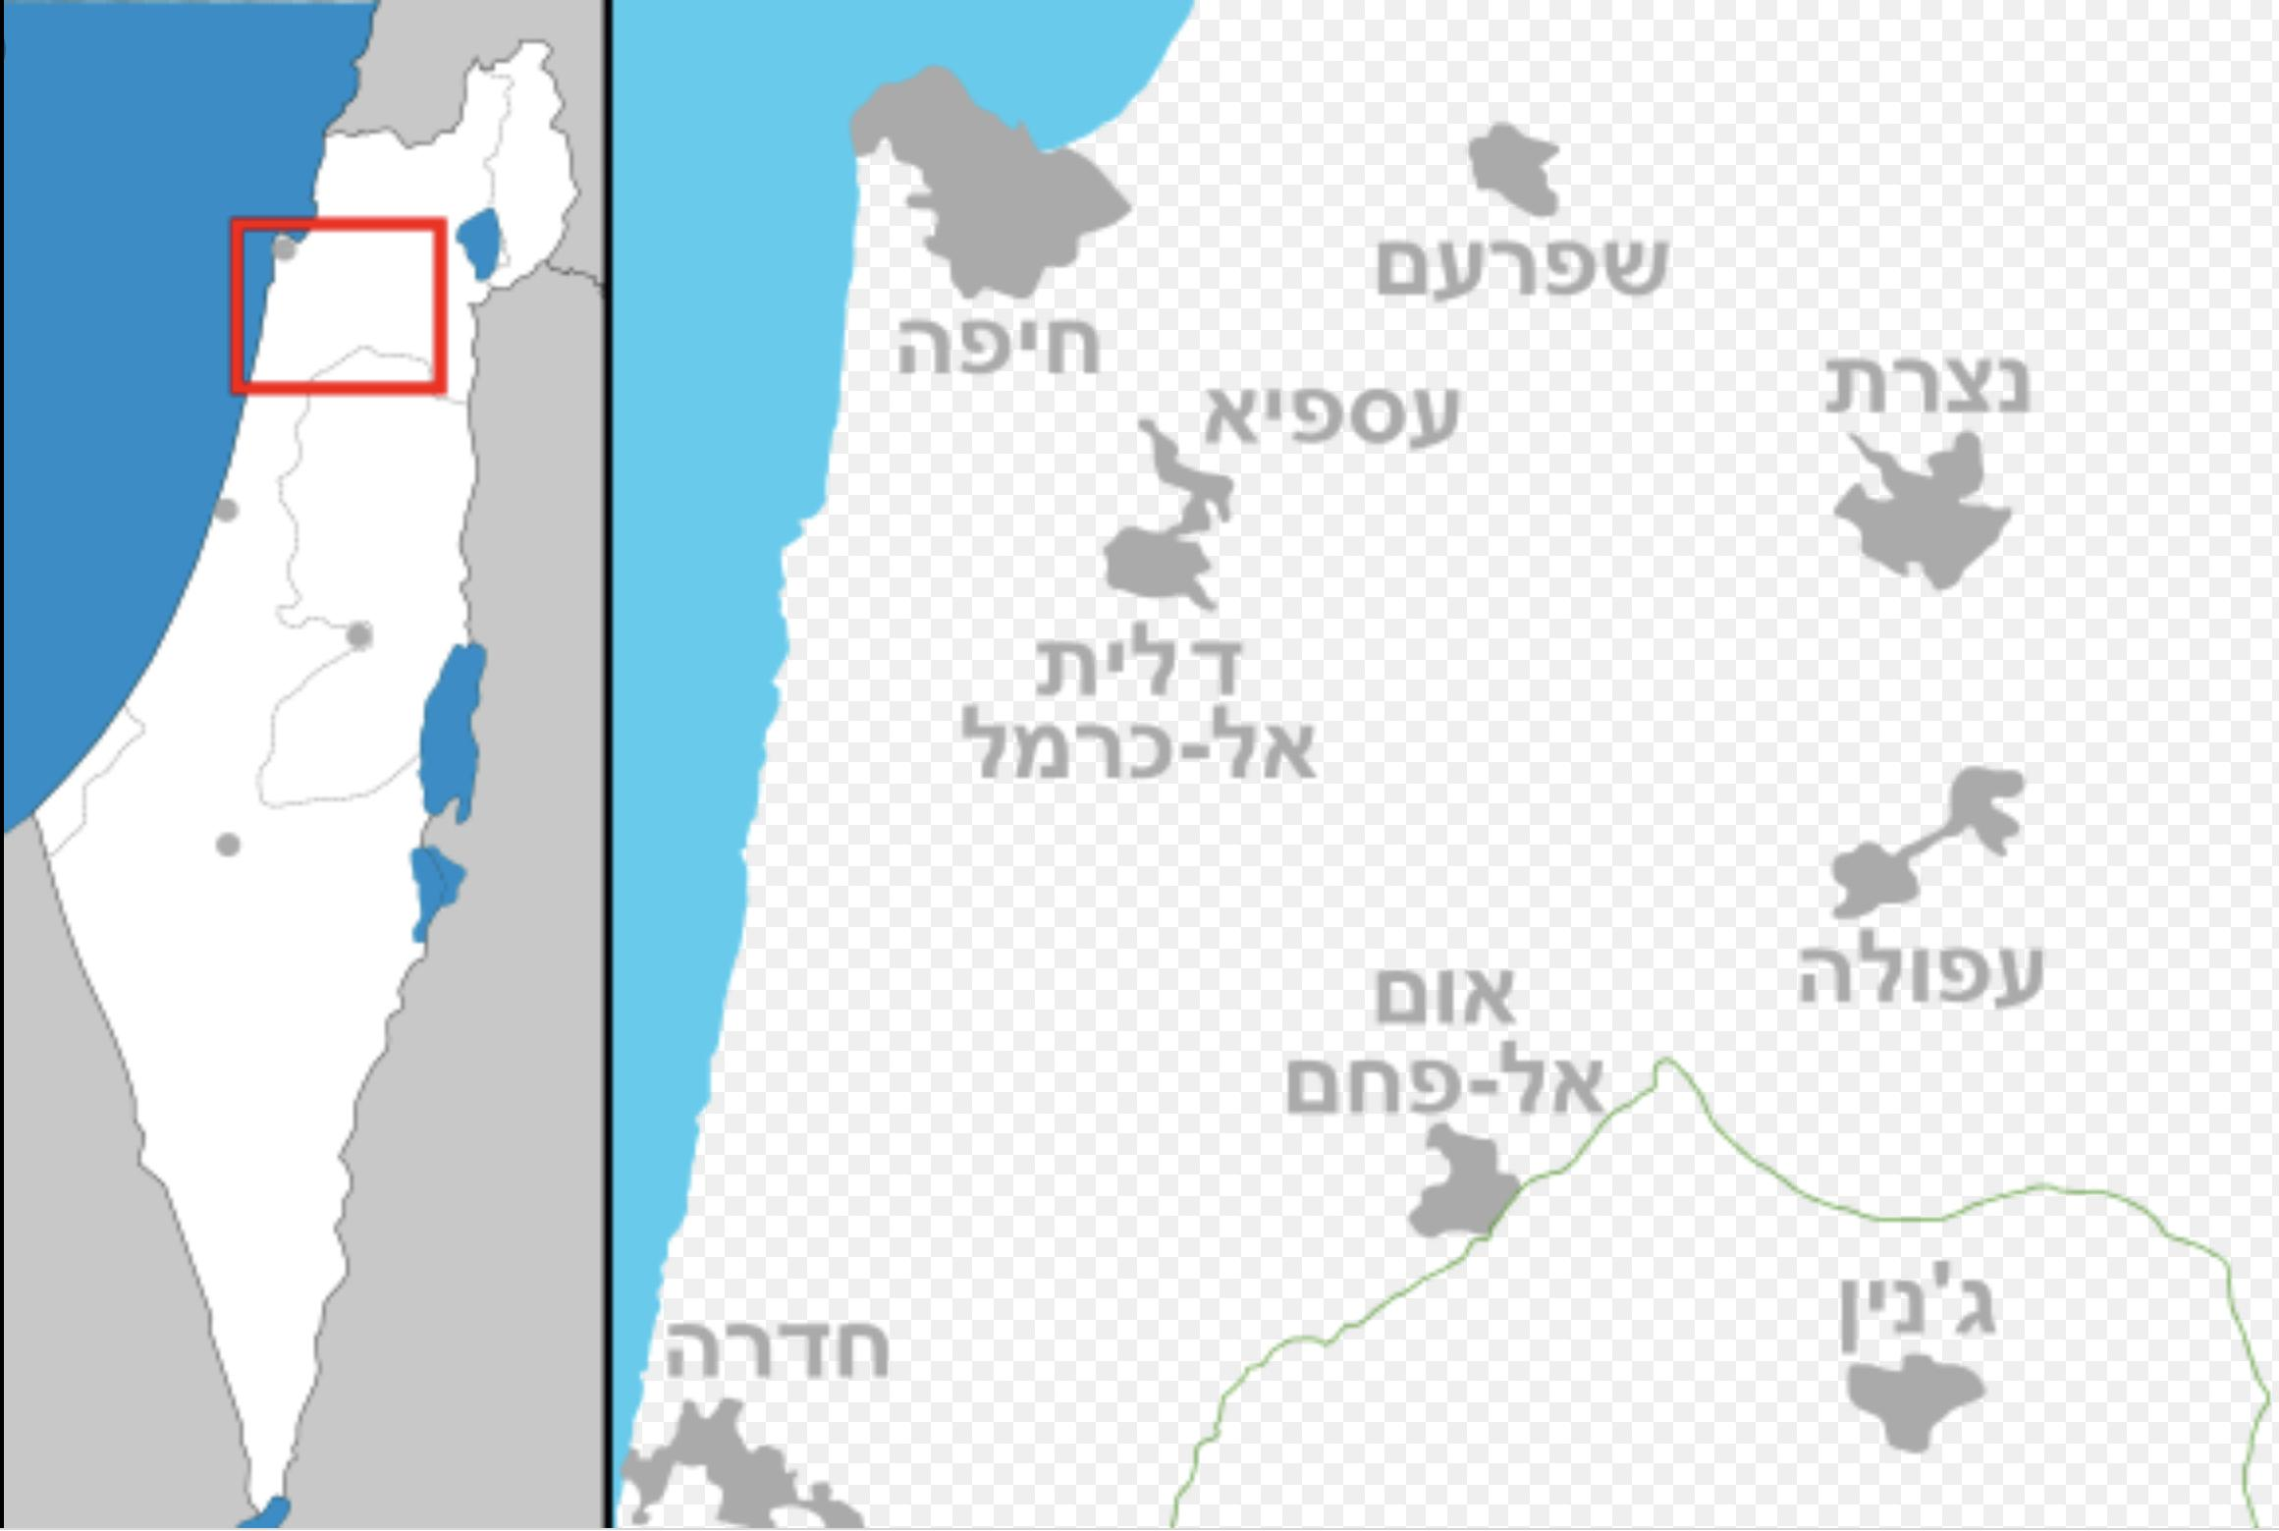
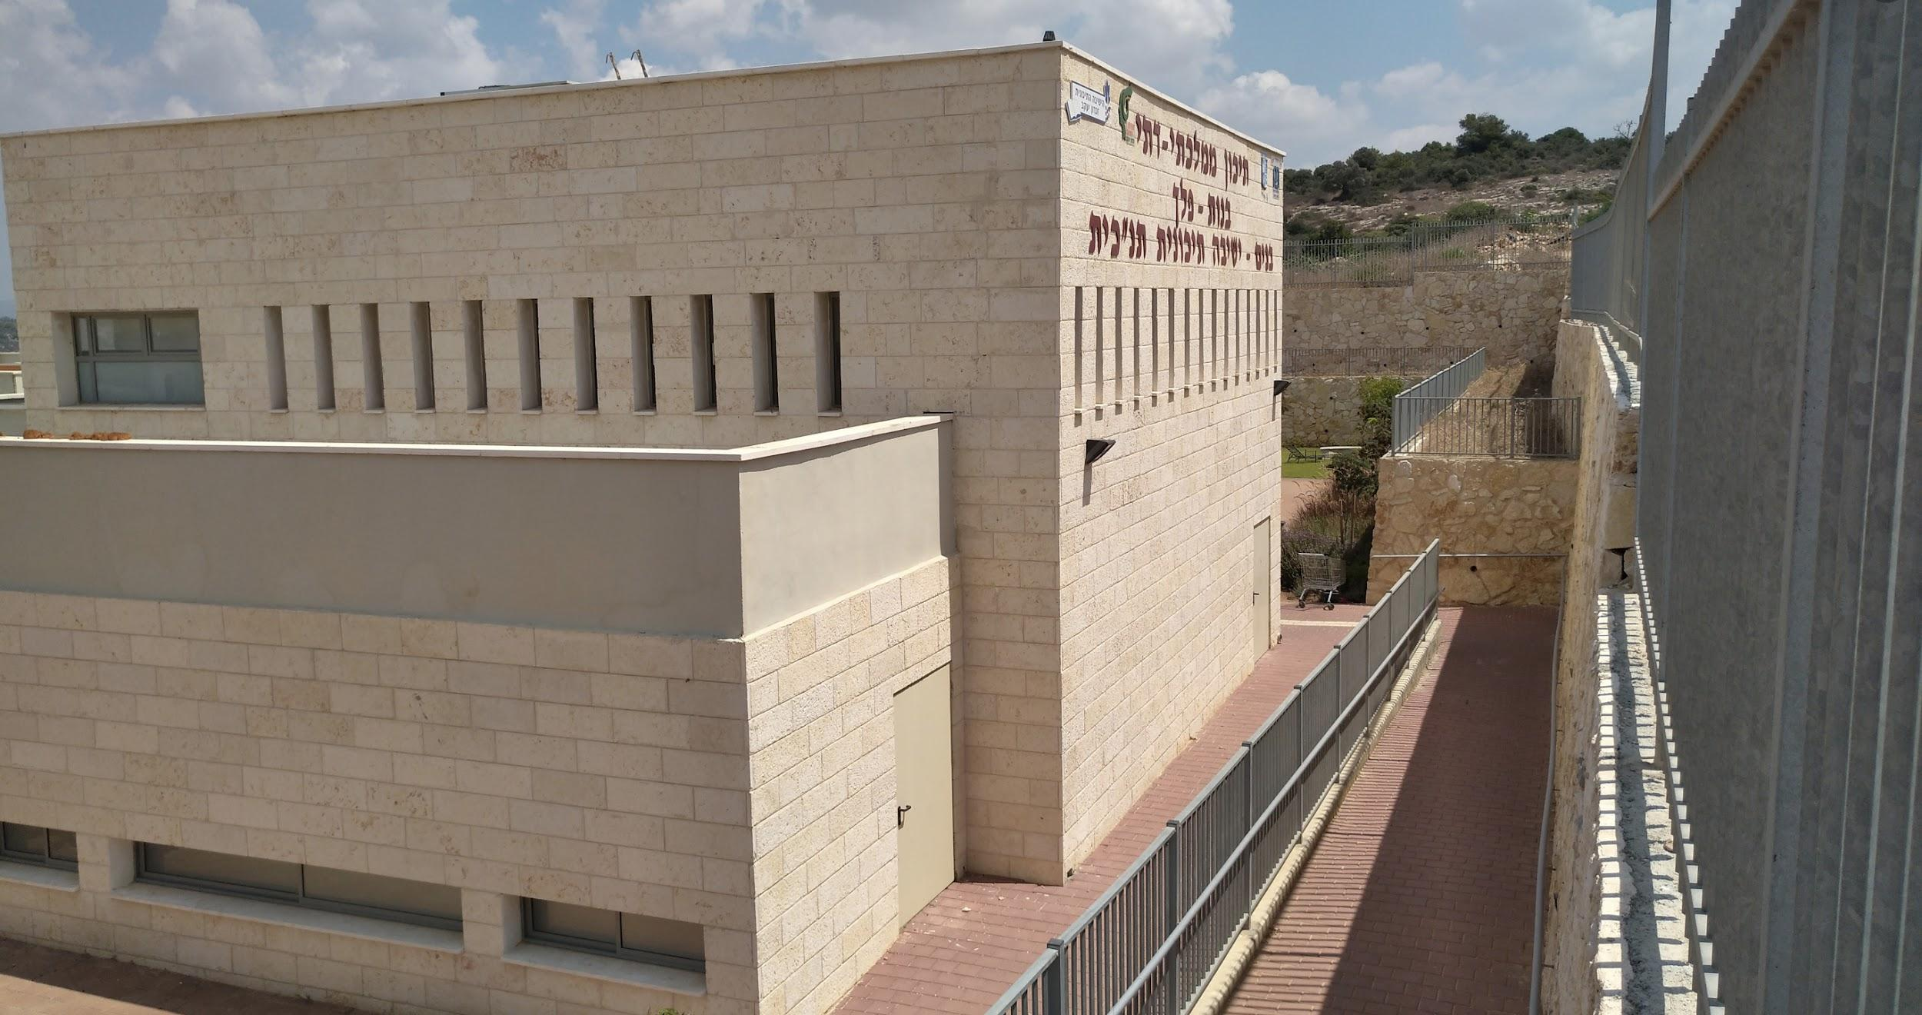
Water quality
Peleh, Zichron Yaakov, Israel

Slide 2
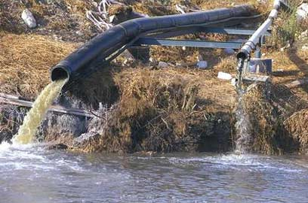
Water quality and pollution
Water pollution is a condition in which substances are present in water in abnormal concentrations.
Natural sources of water pollution: Alluvial accumulation, Animal feces, Dust, Sand and Soot.
Pollutant human actions: Sewage, Domestic or Industrial, Groundwater over-pumping, Penetration of pollutants from liquids originating from waste and fertilizer into groundwater.
Water pollution impairs the quality of life in the natural water environment and prevents human use of water.
Bacteria growth, viruses, heavy metals and chemicals in the water damaged underground water sources.

Slide 3
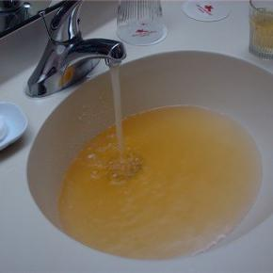
Iron in water
Iron - a metallic element, the most common on earth.
Measure iron in water - using measuring sticks.
The normal range of iron in water - max. concentration 1 mg per liter.
Iron causes a bitter taste in the drinking water and a murky color.
Drinking water with high concentration of Iron will make you feel tired, weak, dizzy, and this may impair pancreatic and liver function.
Iron can contaminate drinking water as a result of the dissolution of pipe fittings made of iron or iron alloy.

Slide 4
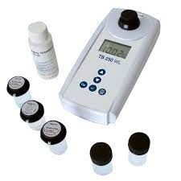
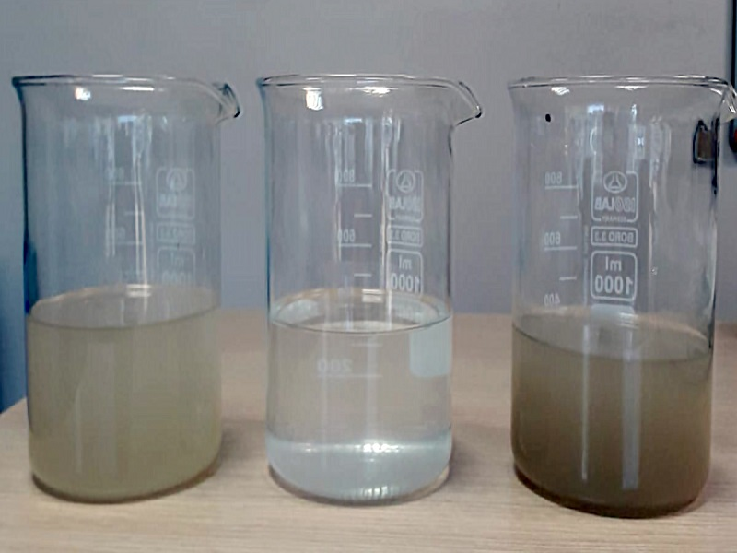
Turbidity
Turbidity is a measure in chemistry that expresses the density of particles in solution. The turbidity increases as the particle density increases.
Turbidity is a significant parameter that has become an integral part of water analysis, quality assurance and process control.

Slide 5
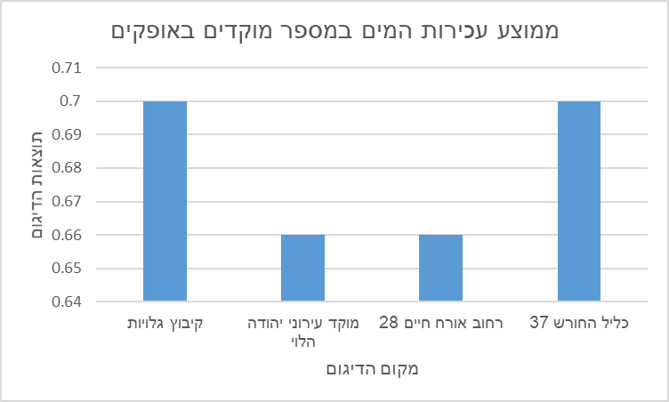
Water turbidity
According to the graph there are two stations where the level of turbidity is high
Those areas are closer to malls and large factories.
Average water turbidity in several foci in Ofakim
Sampling results
Kibbutz galuyot
Yehuda halevi
Orach chaim
Klil hahoresh

Slide 6
In conclusion
The water quality at the sampling points we presented meet the standard, with no special deviations.
Yet, recently ,water turbidity has risen in all sampling sites presented.
In places where the turbidity is high there are industrial areas, shopping centers, etc.

Slide 7
-The end-
-Thank you for listening-

