Slide 1

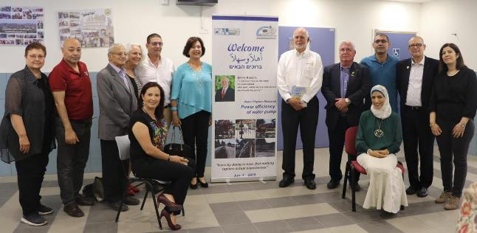
Rotary Hands Across Water
Twinning Side by Side
Develop awareness of Water and Sanitation
Challenges and solutions, with joint STEAM education
Visiting PRI Rassin “Take it to the world”
Dr. Amnon Shefi
Feb 2021
Hi-Teach

Slide 2


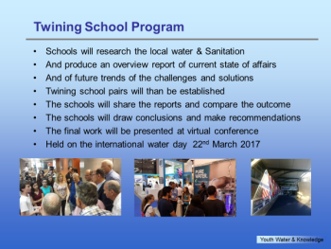
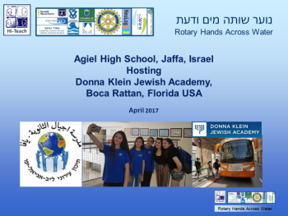
Twinning Side by Side
Lunching
The Rotary Hands Across Water
School twinning Program.
A collaboration of schools around the world
To promote awareness
Of Water & Sanitation
challenge and the available solutions

Slide 3
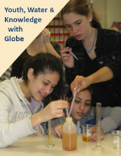
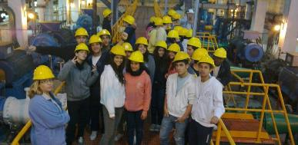
Rotary Hands Across Water (RHAW)
STEAM education: Science*, Technology, Engineering, Art, Math
Based on water and sanitation
Relevant to the curricula
Research, PBL and reverse engineering
Futuristic and engaging
Cross cultural collaboration
* Sciences: Physics, Chemistry, Biology, Geography, environment

Slide 4
RHAW – numbers and achievements
Collaboration with Industry, Academia, The Rotary, water authority
Government (Education, Economy, Environment Energy& water.
Since 2006, over 100 schools, 15,000 students, hundreds of teachers
Providing Content, Teacher Training, in class and remote support, connection with industry, STEAM ideas.
Recognized as a TRF Noteworthy program
Developed to address the knowledge growth era

Slide 5
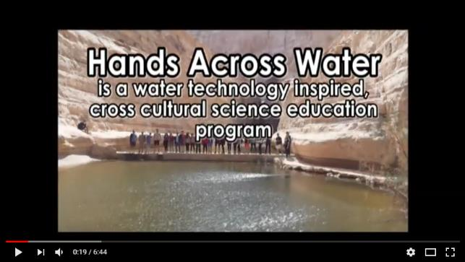
The Hands Across Water Program
The Israeli Way: Water Education
A waterline Podcast

Slide 6

Hi-Teach Guidance & Support
Teacher training and guidance
STEAM project ideas
E Leaning and remote support (zoom)
School visits, Class talk (including virtual visits with zoom)
Outdoor research visits
School twinning program & coordination
Connection with local industry, water utilitiess
Hi-Teach

Slide 7

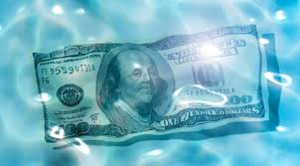
The challenge: Water Awareness Shortage
Lack of awareness holds back
Needed long-term infrastructure investment
Promoting awareness of the young generation around the world
is the solution
Required global Investment
$40 Trillion

Slide 8
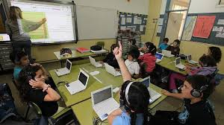
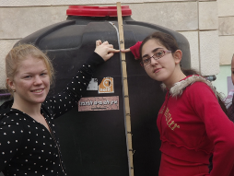
Twinning Program Goals
Provide current water-based science education.
Promote awareness of the water challenge .
Present possible solutions, (Israel as an example)
Collaborate globally.

Slide 9
Twinning Process
Hi-Teach
Train teachers, provide content, coordinate twinning
Identify focus area with local curricular value
Study science background, water challenges & solution
Develop STEAM project
Connect with twinning class
Share and discuss products and reports
Spread the word

Slide 10
Typical Curricular Relevance examples
Curricular relevance is defined by local school faculty.
Hi-Teach provides guidance.
Bridging between local industry, utilities, academia and schools
<< Table: Example STEAM relevance identified in Israel.

Slide 11
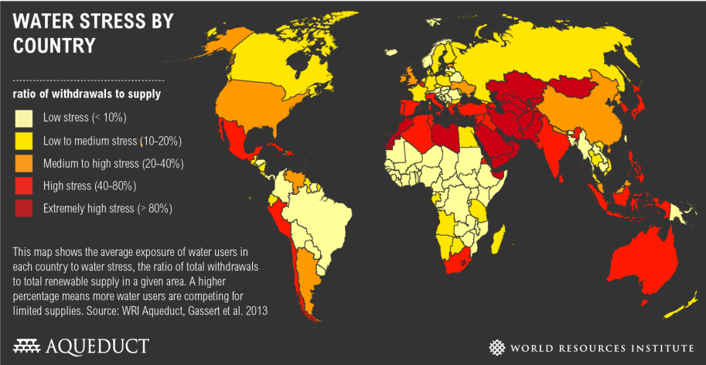
Global water crisis

Slide 12

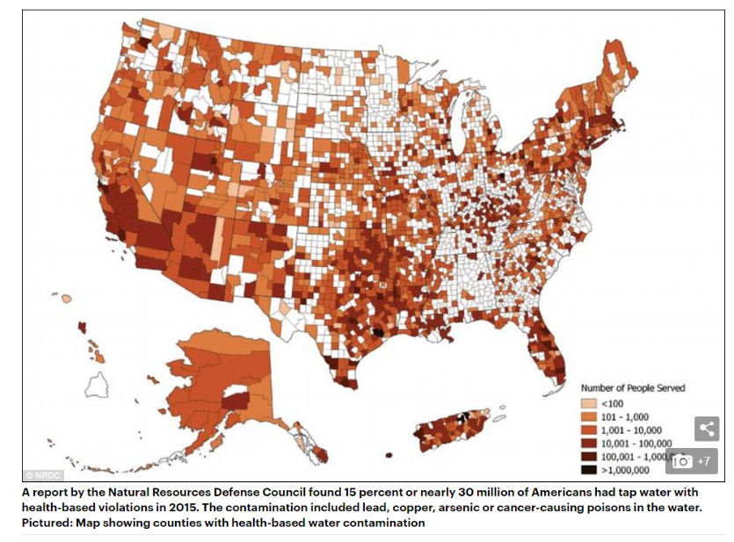
Dry global facts
85% People in dry areas.
783 million without clean, safe water.
2.5 billion without proper sanitation.
More people have cellphones than toilets.
6-8 million lost annually to lack of clean water.
15% of tap water in America with health violations

Slide 13
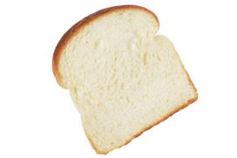
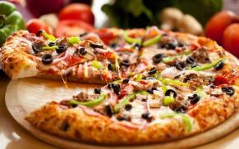
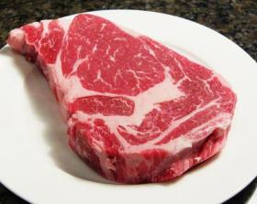

Water footprints examples
50 Litres
1260 Litres
17,200 Litres!!
15,000 Litres

Slide 14
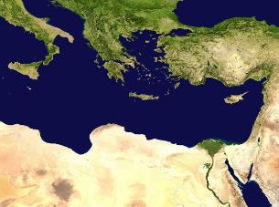
Water Shortage Culture
Israel borders on the desert, water shortage drives innovation
Hands Across Water is an education Innovation

Slide 15
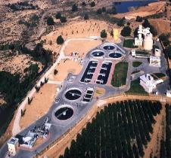
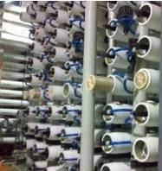




Israeli Water Innovation
Reclamation
Desalination
Effective irrigation
Leak prevention
Broad applications Proper management
Education
A dialog with the future

Slide 16

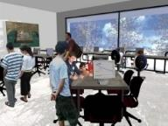
Water Innovation STEAM
Multidisciplinary education combining
Science, Technology, Engineering, Art, Math
Based on water innovation
The book “Let there be water” serves as a textbook

Slide 17
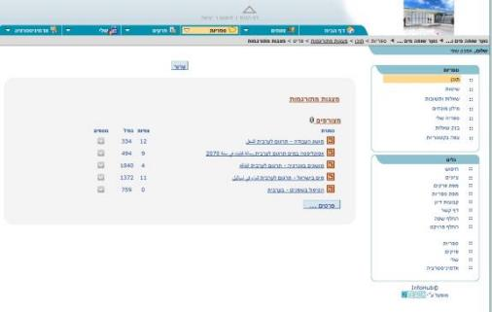
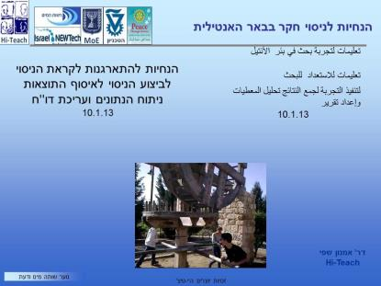
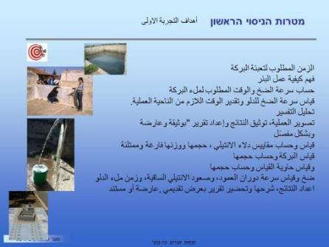
Cross Cultural Education

Slide 18

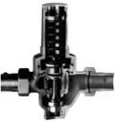


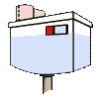

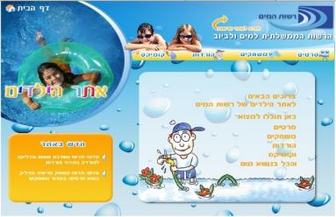
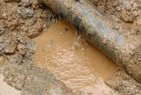
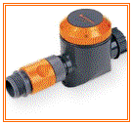
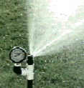


Project Based Learning: Research home use and savings
Shut tight
Save on toilet water flush
Reduce pressure
Water conservers
Take care during a car wash
Stop Leaks
Water the garden wisely
Educate and Create awareness

Slide 19





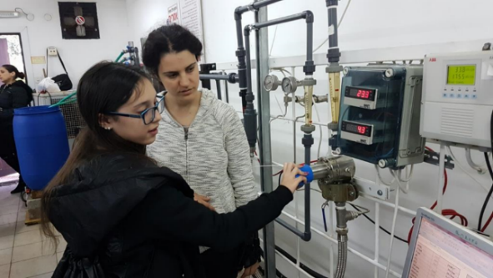
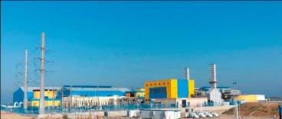

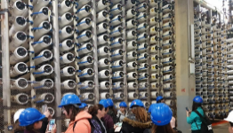
Sea water desalination
From membrane to lessons
From the Technion labs to broad implementation

Slide 20
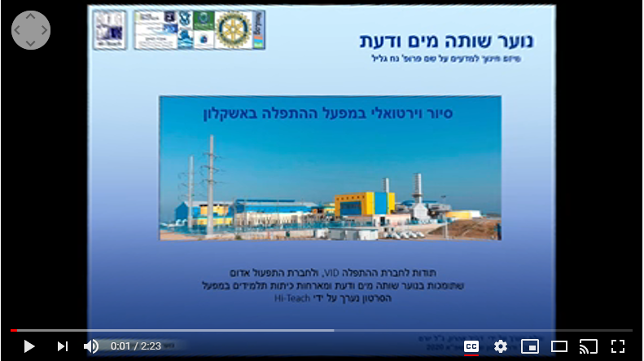
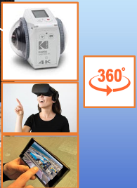
Virtual 360 visits to water facilities
This is a VR 360 video, look around
1. Introduction
2. Virtual Tour
3. Embedded Task Room
Click the links

Slide 21
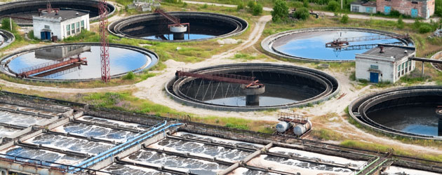
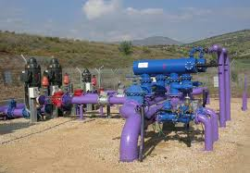
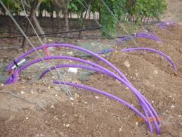
Wastewater reclamation
Jerusalem wastewater treatment plant
Reclaimed water reservoir and supply system
Clouse to 90% of wastewater in Israel is reclaimed,
stored in reservoir during winter for summer irrigation
via a dedicated purple supply system

Slide 22
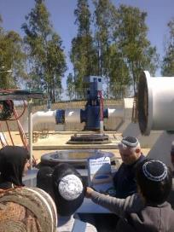
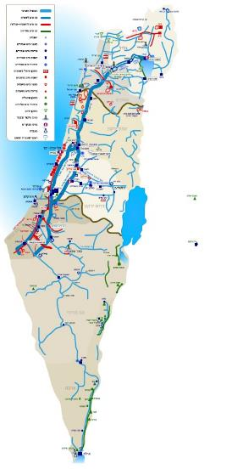
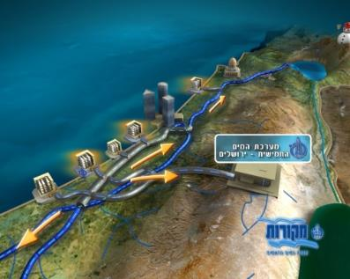

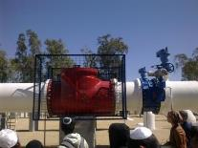
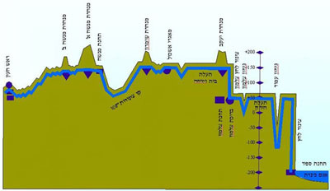
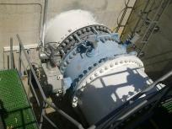
Water Supply Systems
Visit the new 82” water pipe to Jerusalem and the surrounding Jewish and Arab towns
דיזל חולדה ההיסטורי
Elevation cross section of Water Line from the sea of Galilee to the Negev

Slide 23
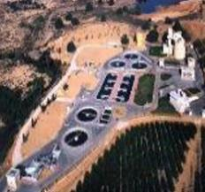
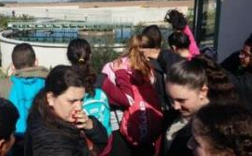
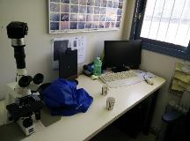





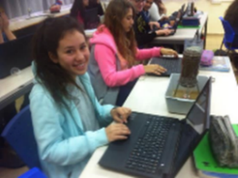
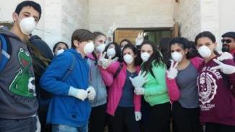
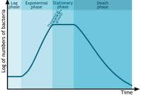
STEAM based on wastewater reclamation
Sludge growth curve
Long term soil impact
Plant visit
Microorganisms lab
Projects in Biology, Chemistry, Ecology, Physics

Slide 24
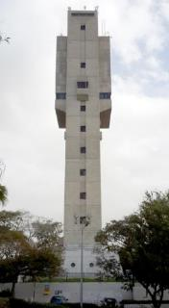
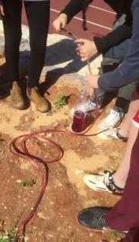
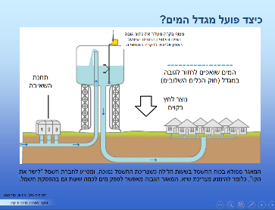

STEAM based on laws of physics in water pumping
Water tower and pressure
field experiments at school

Slide 25




Advanced STEAM with simple tools
Lego Mindstorms, Renewable Energy, Pneumatic

Slide 26







Hydraulic Valves – STEAM to teach physics
Newton in the hydraulic valve

Slide 27




The physics of ancient wells

Slide 28




Digital Educational Test Gear Neulog
Affordable, Simple, Friendly

Slide 29



High Level Academic Support
The Technion Grand Water Research Institute
support the research
and hosts the graduation event

Slide 30





STEAM projects

Slide 31









Share project and research reports

Slide 32



Twinning Comparison Israel - Florida, USA
Israel
Water tariff used for to conserve and improve infrastructure.
Advanced technology:
Reclamation, Desalination,
Leak prevention, Smart irrigation Effective national management
Miami
An inclining water rate structure
Laws limiting excessive water use
Rebates for conservation technology
Education programs
Development of conservation technology.
Water tariff history

Slide 33







Twinning comparison: Leak Prevention
Israel
Water leakage in Israel below 6% using a variety of methods:
Hydraulic water valves lower pressure at night
Big data analytics detect leaks
Advanced wireless water meters
Miami
Miami-Dade applןed Gattermann leakage detection system, leakage < 10%
(Using sensors installed along the pipe-line, which record and transmit data to an automatic analysis system.)

Slide 34




Twinning Schools Cross Visits
Agiel High School, Jaffa, Israel
Hosting
Donna Klein Jewish Academy,
Boca Raton, Florida USA
April 2017

Slide 35




The WATEC exhibition challenge
Students apply technologies exhibited in WATEC to address water challenges
Challenge Presented
Visit
Exhibition
Brainstorm
Solve the challenge
Present
Solutions

Slide 36


Wining school teams at Watec 2017
נוער שותה מים ודעת
Rotary Hands Across Water
Watec 2017

Slide 37

Rotary Hands Across Water in WATEC 2019

Slide 38





support
District 2490, WASH committee, Haifa host club, 20 local Rotary clubs
Coral Springs/Parkland lead Int’l committee of 15 RC, 3 US and Canada Districts
Two major TRF Global Grants close to $500,000 since 2009
3rd grand application underway
Centennial Noteworthy Program Recognition

Slide 39





Rotarians involved around the world

Slide 40

PRI Barry Rassin Address
Peacebuilding, Water & Sanitation,
Research, Education and entrepreneurial innovation
is changing the world for the better
Pure and simple: This is Rotary
We must examine how to
take the wonderful things you do here
to the world…

Slide 41




VP RI Babalola visit Begin school in Gedera
Student impression:
“We learned we can understand things…”

Slide 42

Program Launched during 2020-21
Romania RC were first to start led by
Dr. Florin Iliescu and PDG Aver Fuchs
of the Bistrita and Gedera RC

Slide 43

Program expanding
Rotary Club activity increased and next were RC from Poland
led by PDG Prof. Marian Jerzy Korczynski and PP Shlomo Bronher
of the Lodz and Ramle RC

Slide 44
Program expanding further
Activity continue to grow in Albania, Kosovo,
USA, and later in India
with interest raised in
Lithuania, Greece Spain Hungry and
And this is just the pilot…

Slide 45

















Many Partners
Science Museums
History Museums
Visitor Centers
Archeologists
Desalination Eng.
VID
Tahal
Mekorot
Karaso
Amiad
Barmad
Ein Netafim
Mei Raanana
Mei Carmel
Palgi Maim
ARI, NUF
ROTARY
Min of Economy
Min of Education
Water Authority
National Part Authority
Antiquities Authority
Municipalities
Technion GWRI
Hebrew university
The Globe program,

Slide 46

Program Outline
Approve Grant, Funding
Provide Twinning content
Start training and guidance,
Find school, Explain the program
Find partners Utility, Gov. Academia
Identify topic, curricula, STEAM
Start STEAM
Start Twinning process
Exchange STEAM products (English)
Cross review and feedback dialog
Prepare for year end graduation
Analysis and final report
Israel, Poland, Romania, India, USA, Albania

Slide 47
40 Contributing and participating
Rotary Clubs & Districts
20 RC in Israel district 2490
Host: Haifa RC
Int’l partner CS/PL RC
Int’l RC in eight (8) counties
USA
Canada
Romania
Poland
India
Albania
Kosovo
Greece
Districts
2490
6990
7070
3141 3142 2231 2241

Slide 48
Contact
Dr. Amnon Shefi Hi-Teach CEO, RHAW founder & Mgr.
+972 (54) 4929093 amnons@hi-teach.com
Malkiel Saraby Twinning Program Coordinator
+972 54 7675237 malkielsaraby@gmail.com
PDG Avner Fuchs WASH committee chair, WASRAG Ambassador
+972 (50) 5275593 avifuchs@netvision.net.il
Rtn Natan Feldman Haifa (program host club) contact,
+972 54 5616263 natan.feldman@haifa-group.com

